Slide 1

History of SPECOM
Geza Nemeth, SPECOM-2016, Budapest, Hungary
Nikos Fakotakis, SPECOM-2015, Athens, Greece
Vlado Delic, SPECOM-2014, Novi Sad, Serbia
Milos Zelezny, SPECOM-2013, Pilsen, Czech Republic
Potapova Rodmonga, SPECOM-2011, Kazan
Andrey Ronzhin, SPECOM-2009, St. Petersburg
Potapova Rodmonga, SPECOM-2007, Moscow
Andrey Ronzhin, SPECOM-2006, St. Petersburg
George Kokkinakis, SPECOM-2005, Patras, Greece
Andrey Ronzhin, SPECOM-2004, St. Petersburg
Potapova Rodmonga, SPECOM-2003, Moscow
Yury Kosarev, SPECOM-2002, St. Petersburg
Irina Khaleeva, SPECOM-2001, Moscow
Rajmund Piotrowski, SPECOM-2000, St. Petersburg
Irina Khaleeva, SPECOM-1999, Moscow
Yury Kosarev, SPECOM-1998, St. Petersburg
Mircea Pusca, SPECOM-1997, Romania
Rafael Yusupov, SPECOM-1996, St. Petersburg

Slide 2
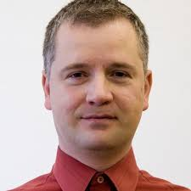
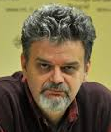
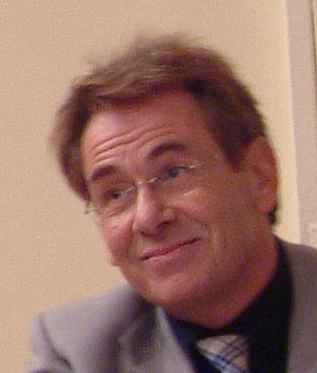
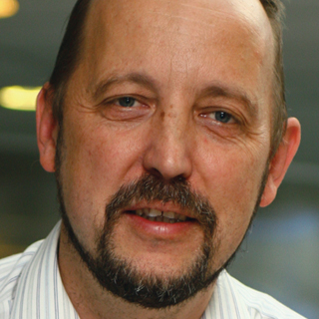
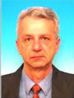
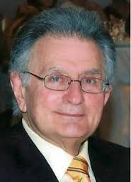
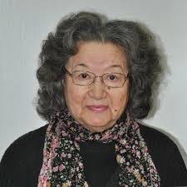
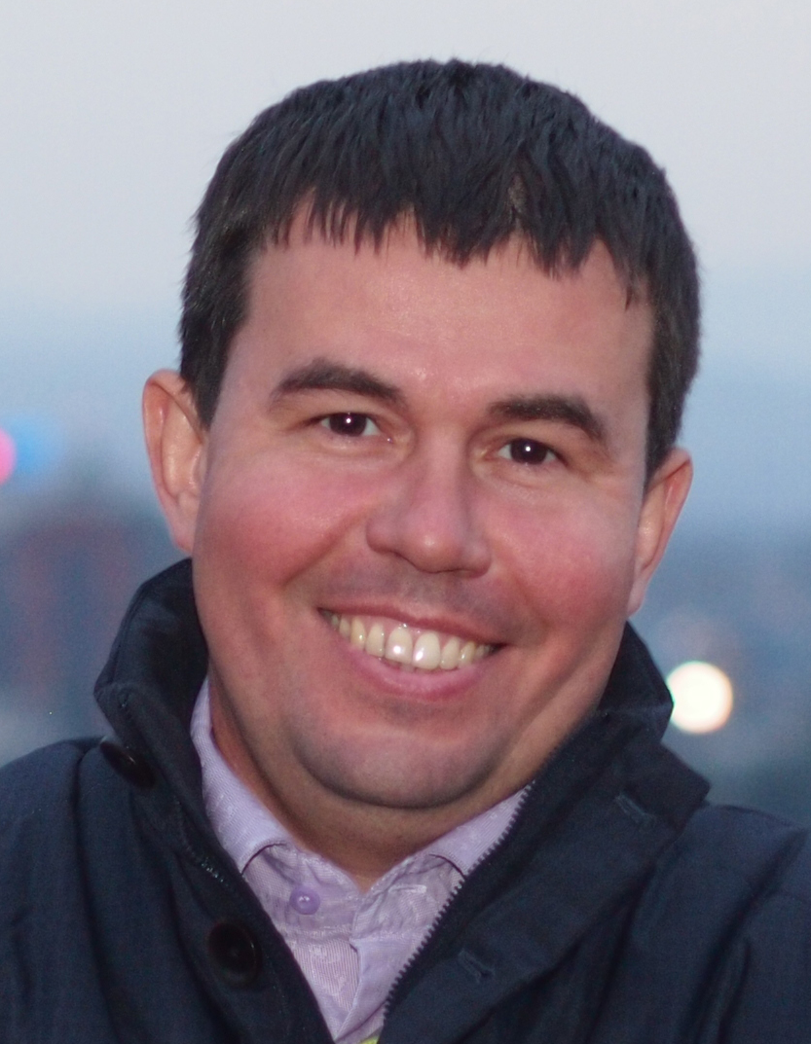
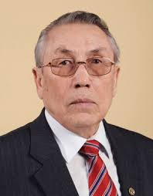
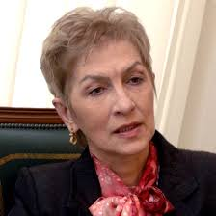
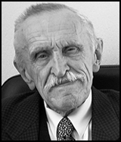
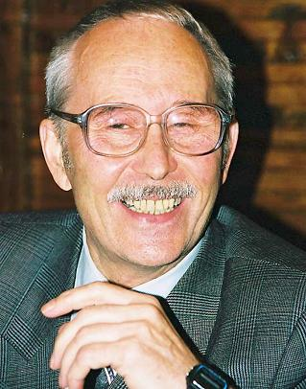
Сhairs of SPECOM 1996-2016

Slide 3
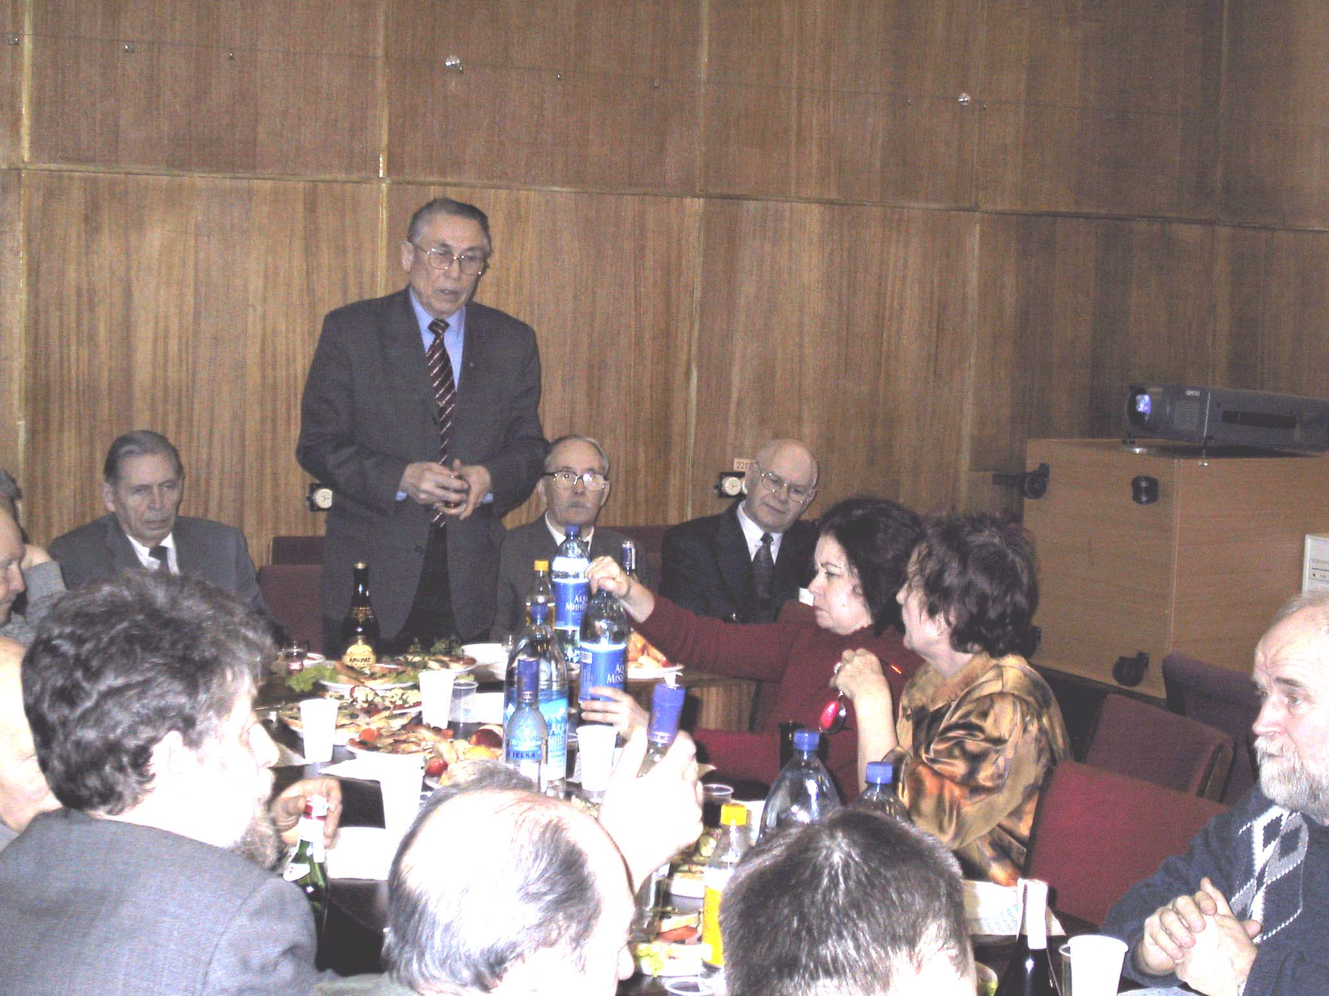

Slide 4
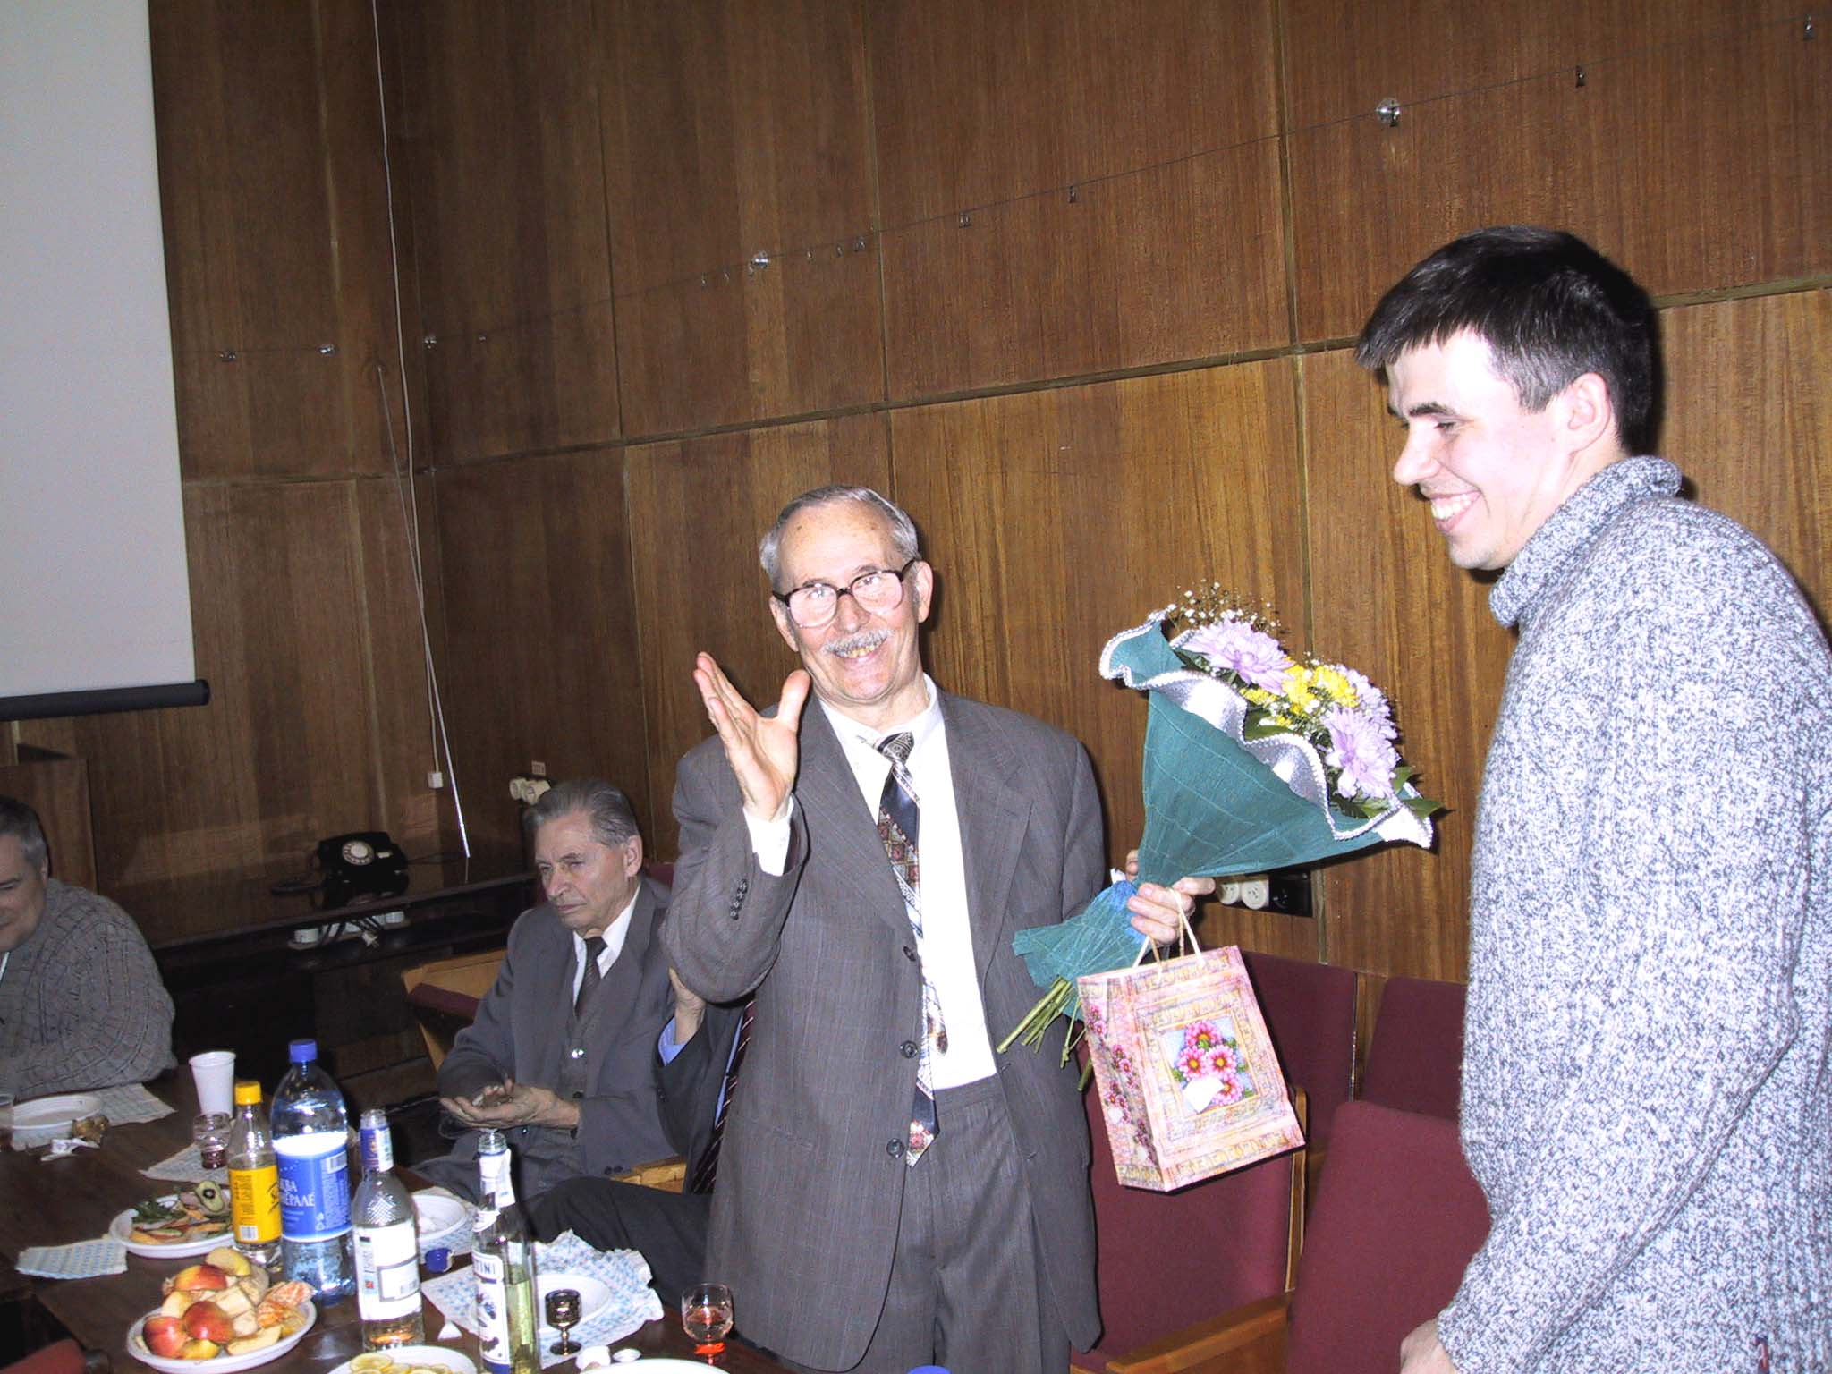

Slide 5
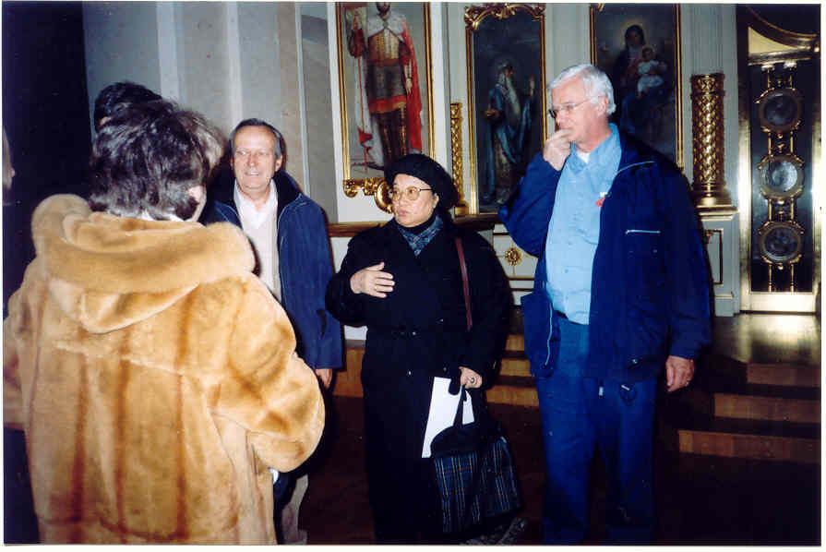

Slide 6
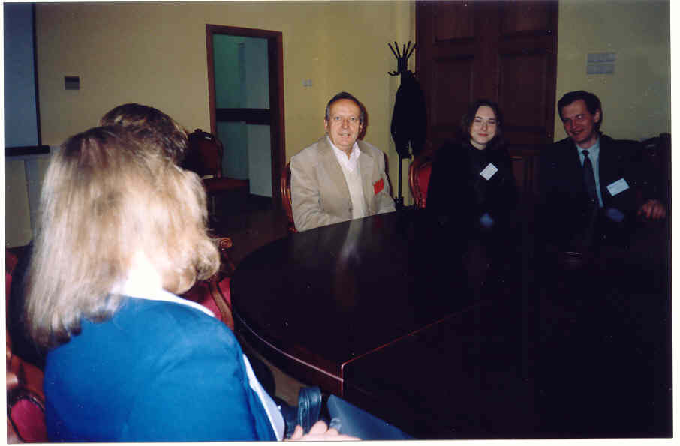

Slide 7
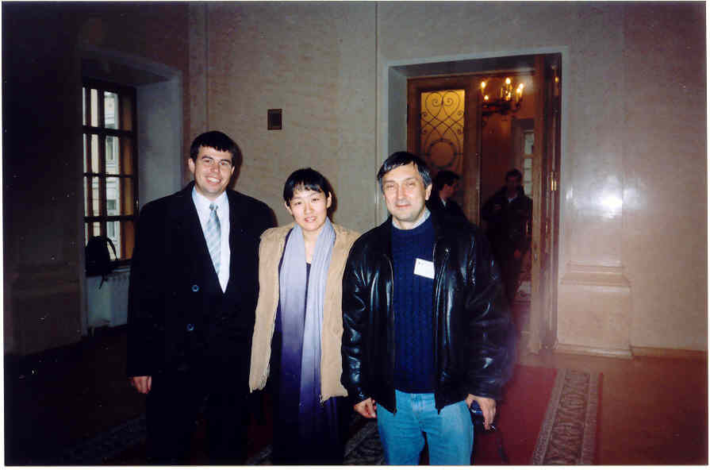

Slide 8
History of SPECOM
Geza Nemeth, SPECOM-2016, Budapest, Hungary
Nikos Fakotakis, SPECOM-2015, Athens, Greece
Vlado Delic, SPECOM-2014, Novi Sad, Serbia
Milos Zelezny, SPECOM-2013, Pilsen, Czech Republic
Potapova Rodmonga, SPECOM-2011, Kazan
Andrey Ronzhin, SPECOM-2009, St. Petersburg
Potapova Rodmonga, SPECOM-2007, Moscow
Andrey Ronzhin, SPECOM-2006, St. Petersburg
George Kokkinakis, SPECOM-2005, Patras, Greece
Andrey Ronzhin, SPECOM-2004, St. Petersburg
Potapova Rodmonga, SPECOM-2003, Moscow
Yury Kosarev, SPECOM-2002, St. Petersburg
Irina Khaleeva, SPECOM-2001, Moscow
Rajmund Piotrowski, SPECOM-2000, St. Petersburg
Irina Khaleeva, SPECOM-1999, Moscow
Yury Kosarev, SPECOM-1998, St. Petersburg
Mircea Pusca, SPECOM-1997, Romania
Rafael Yusupov, SPECOM-1996, St. Petersburg

Slide 9
Сhairs of SPECOM 1996-2016

Slide 10
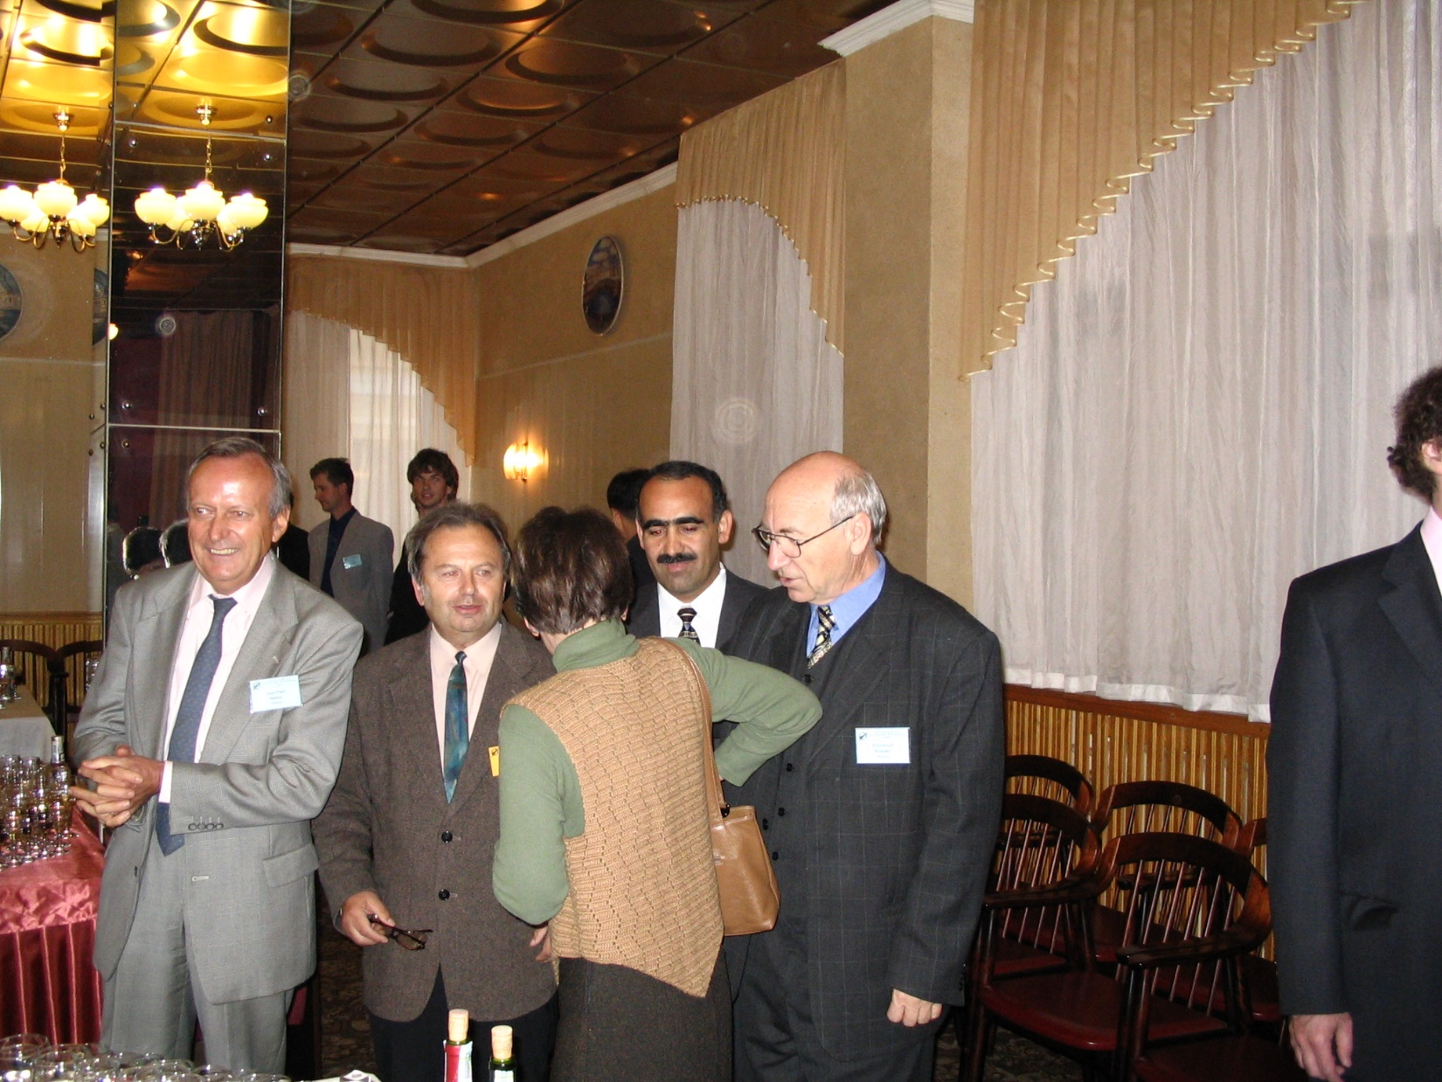

Slide 11
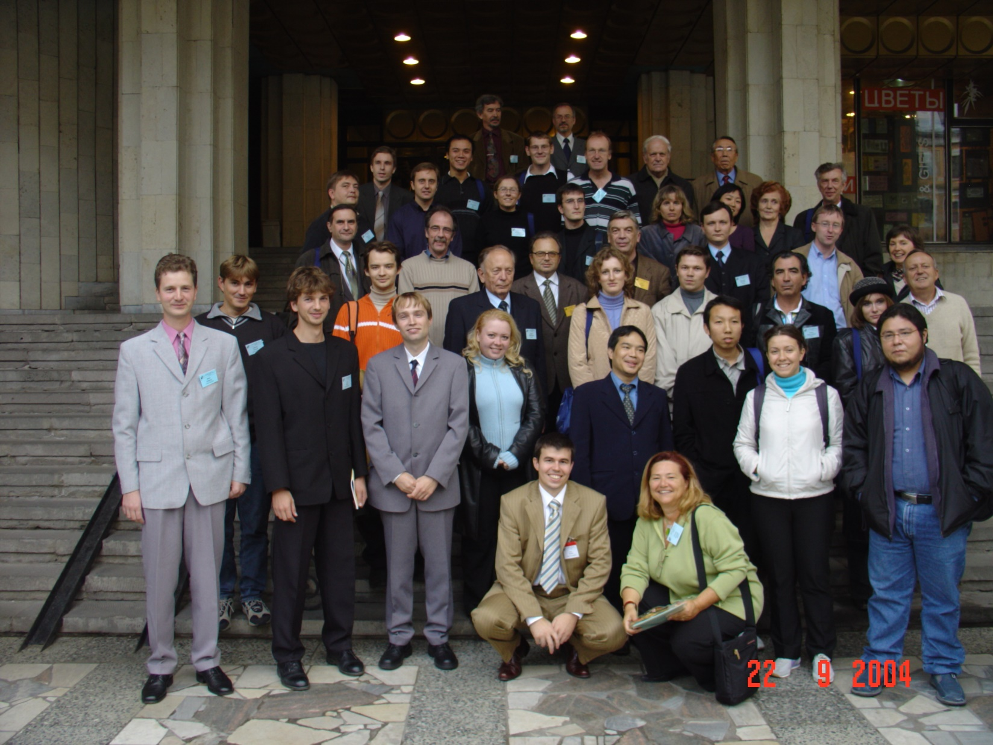

Slide 12
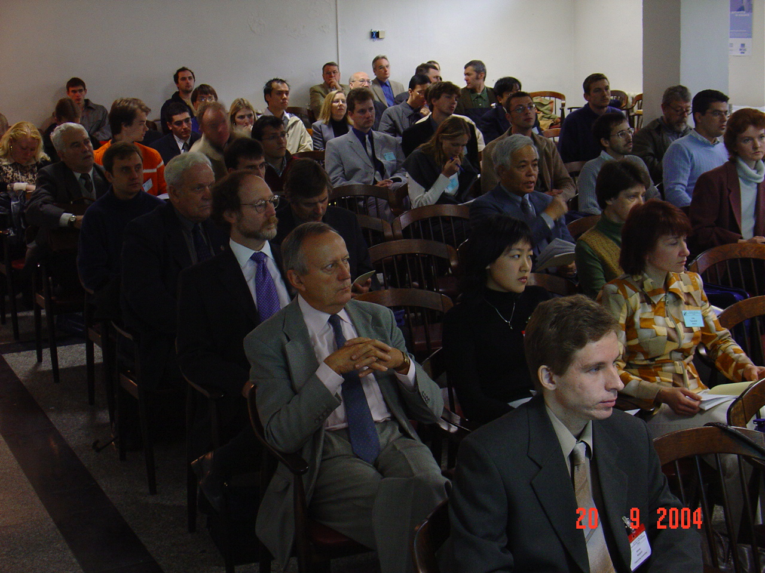

Slide 13
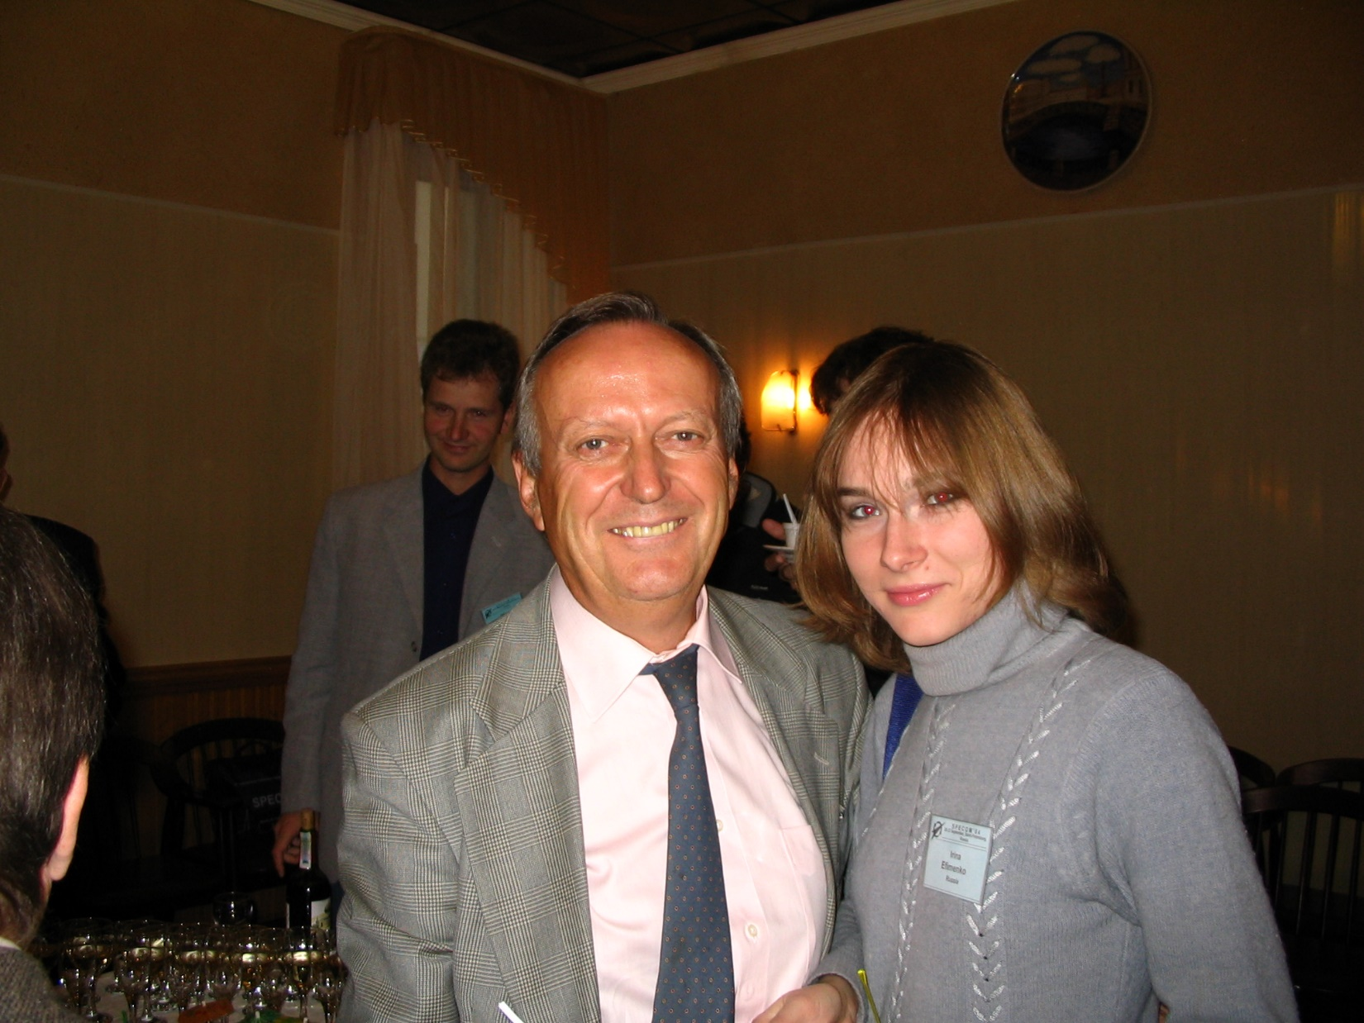

Slide 14
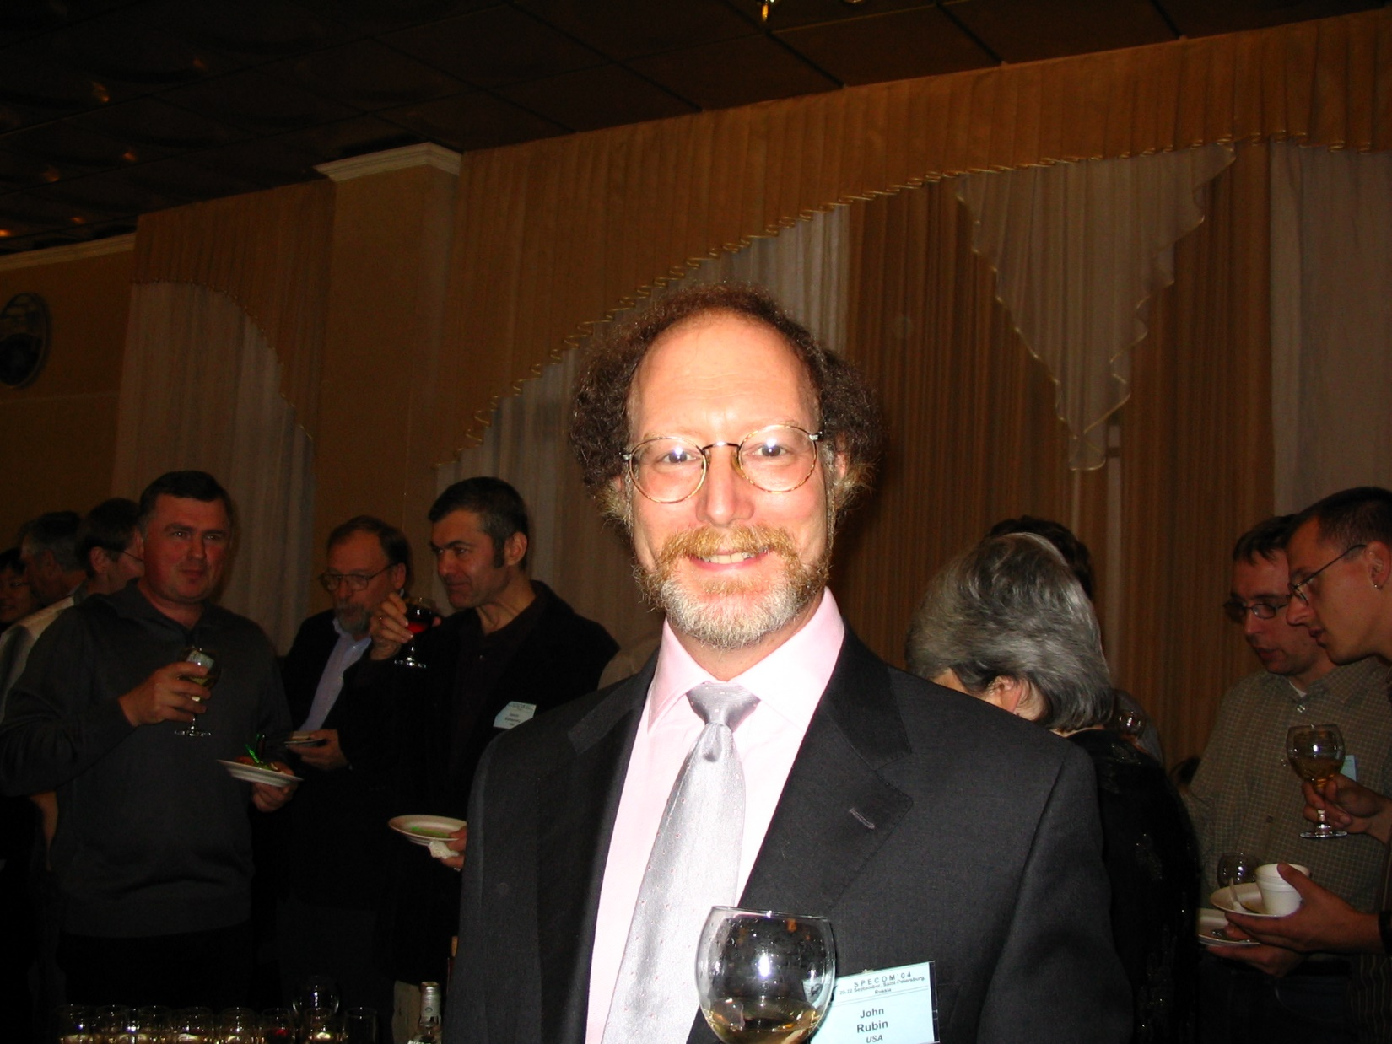

Slide 15
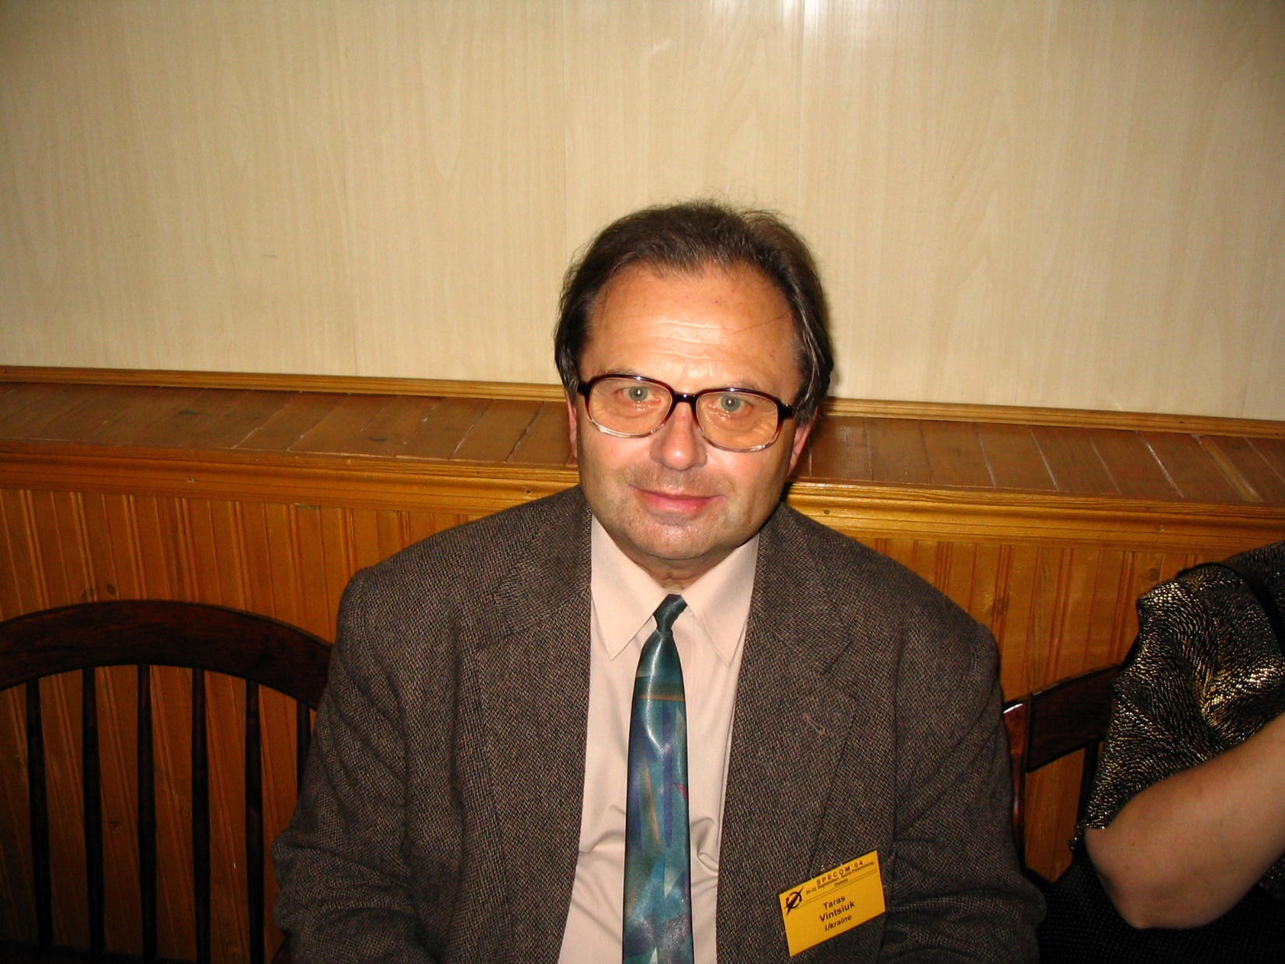

Slide 16
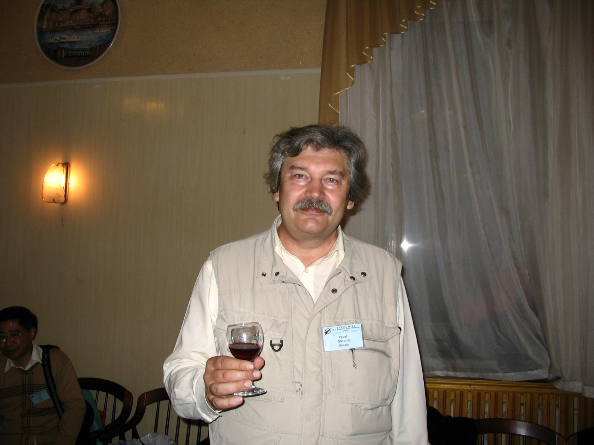

Slide 17
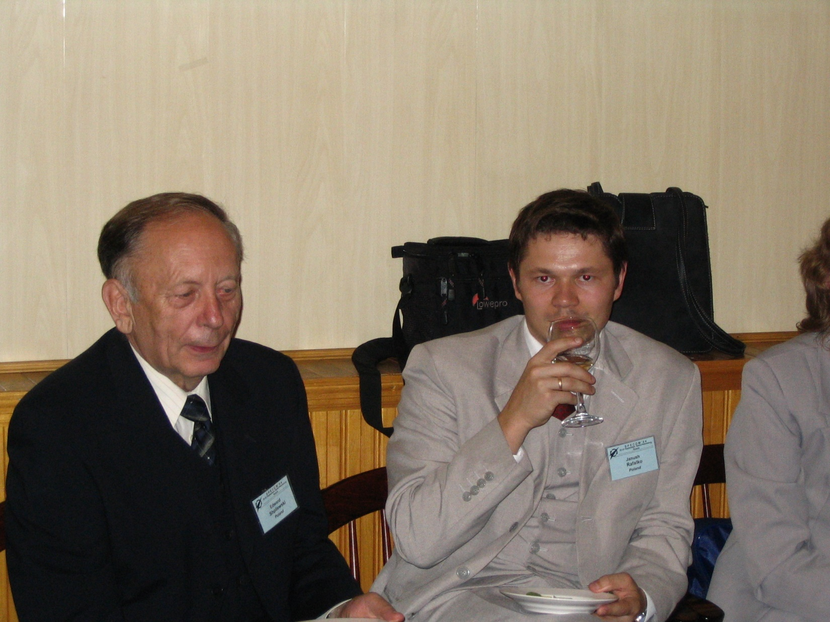

Slide 18
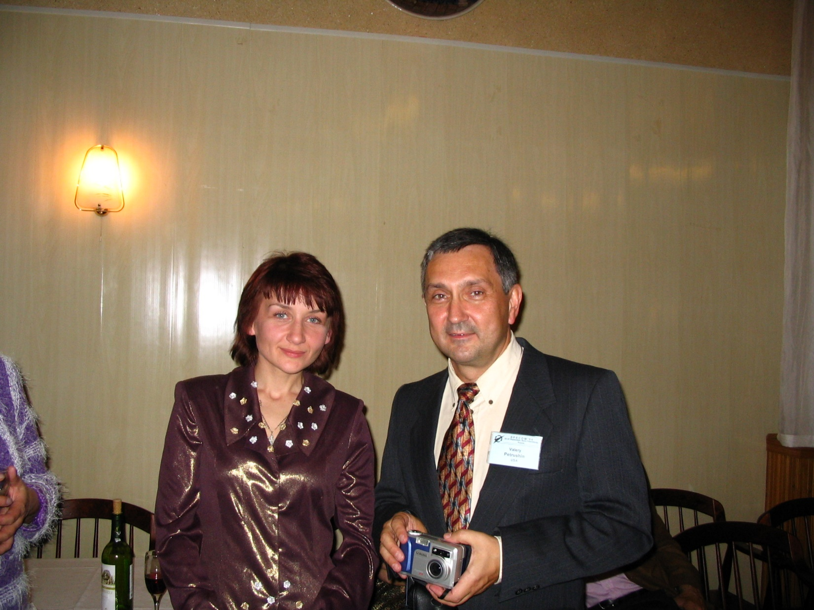

Slide 19
History of SPECOM
Geza Nemeth, SPECOM-2016, Budapest, Hungary
Nikos Fakotakis, SPECOM-2015, Athens, Greece
Vlado Delic, SPECOM-2014, Novi Sad, Serbia
Milos Zelezny, SPECOM-2013, Pilsen, Czech Republic
Potapova Rodmonga, SPECOM-2011, Kazan
Andrey Ronzhin, SPECOM-2009, St. Petersburg
Potapova Rodmonga, SPECOM-2007, Moscow
Andrey Ronzhin, SPECOM-2006, St. Petersburg
George Kokkinakis, SPECOM-2005, Patras, Greece
Andrey Ronzhin, SPECOM-2004, St. Petersburg
Potapova Rodmonga, SPECOM-2003, Moscow
Yury Kosarev, SPECOM-2002, St. Petersburg
Irina Khaleeva, SPECOM-2001, Moscow
Rajmund Piotrowski, SPECOM-2000, St. Petersburg
Irina Khaleeva, SPECOM-1999, Moscow
Yury Kosarev, SPECOM-1998, St. Petersburg
Mircea Pusca, SPECOM-1997, Romania
Rafael Yusupov, SPECOM-1996, St. Petersburg

Slide 20
Сhairs of SPECOM 1996-2016

Slide 21
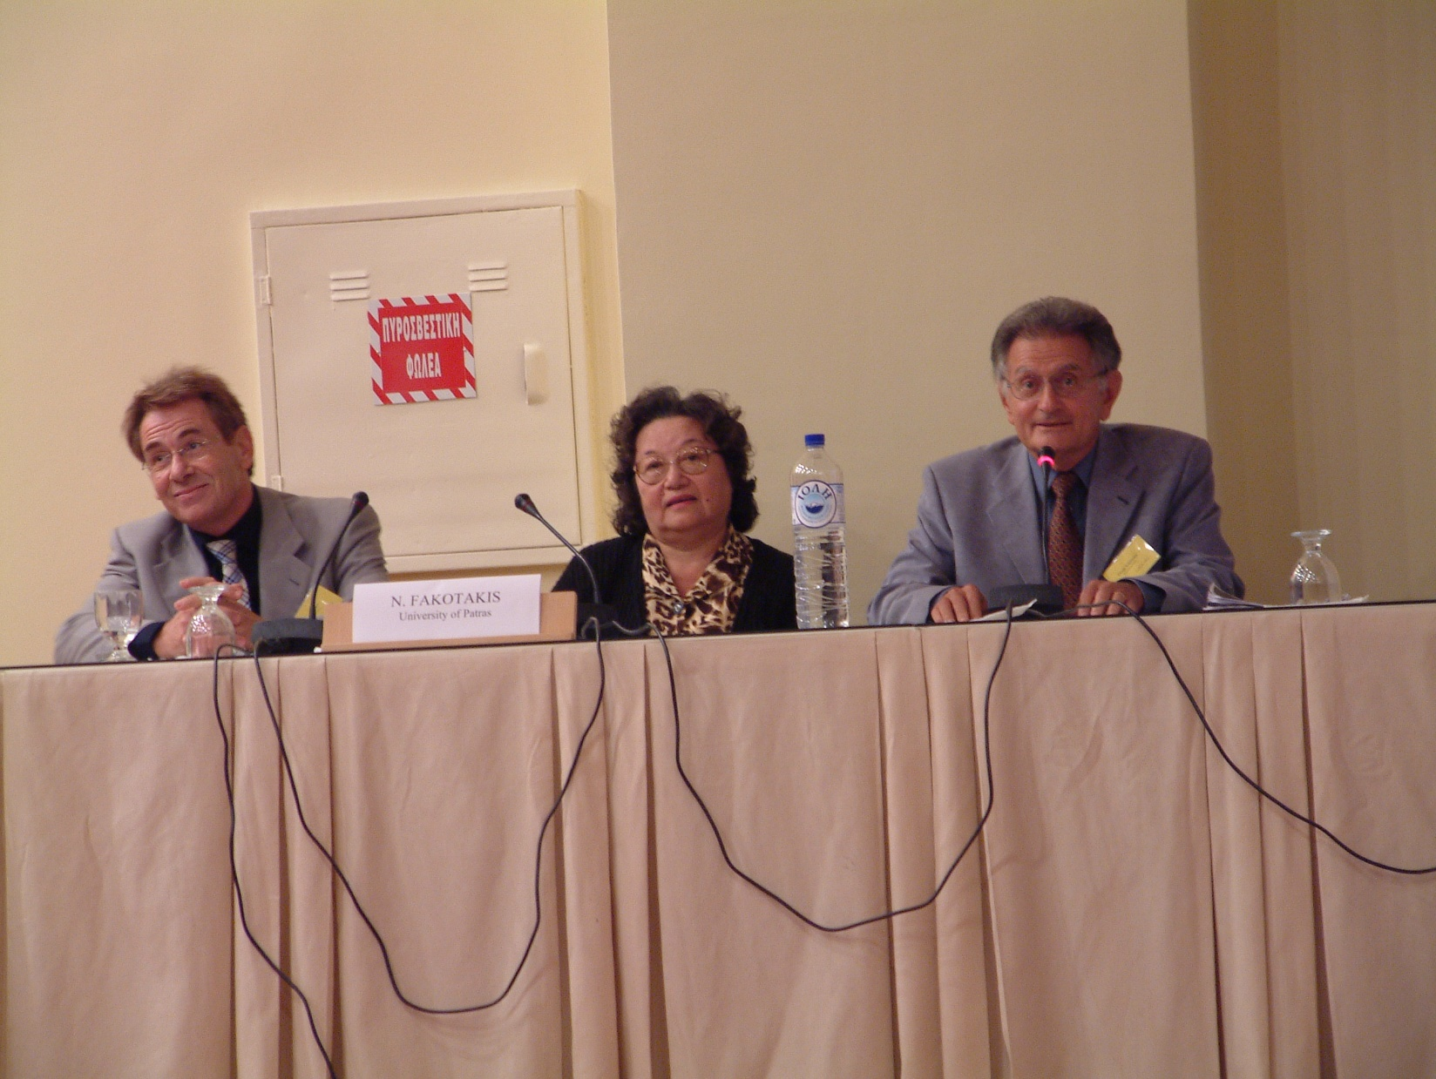

Slide 22
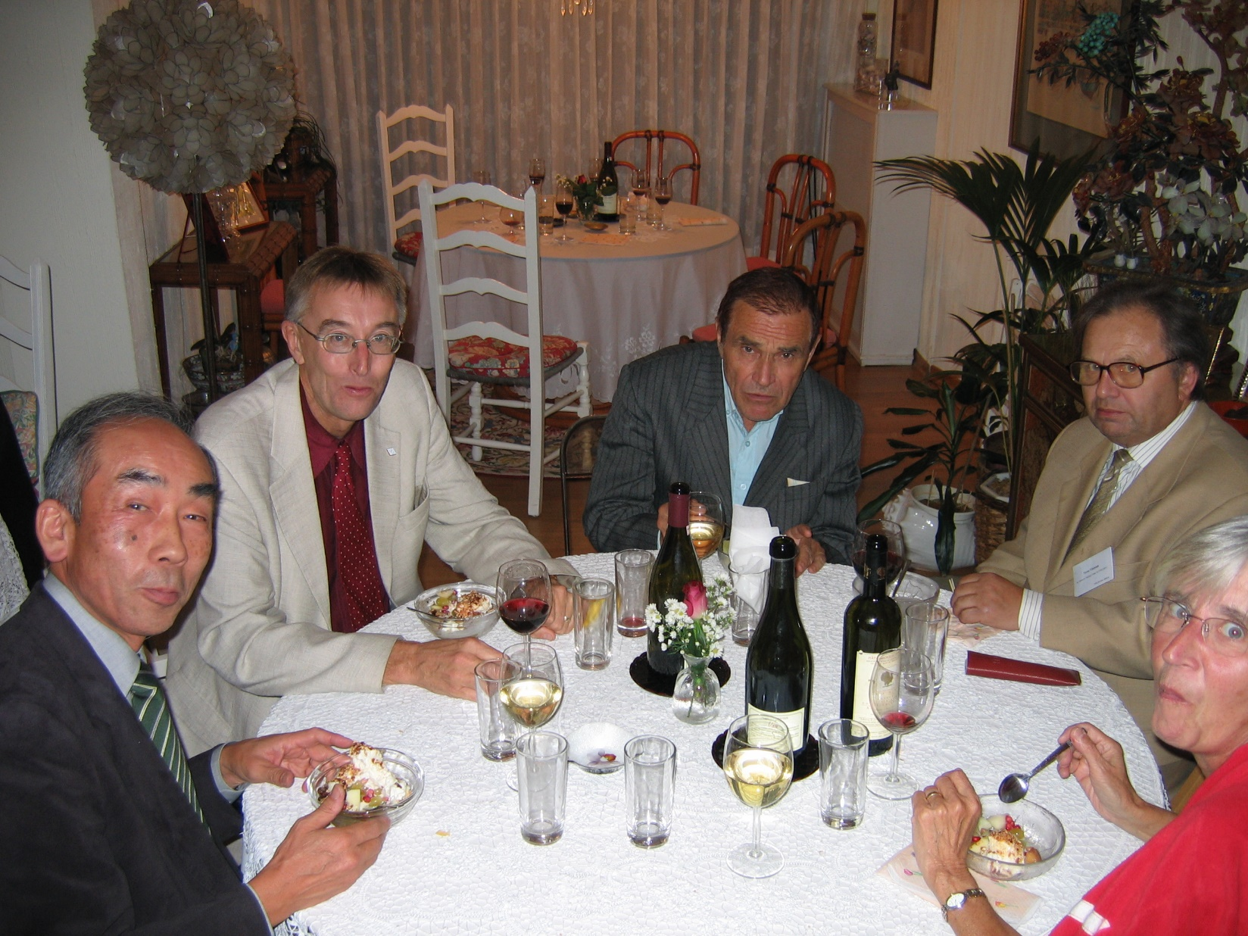

Slide 23
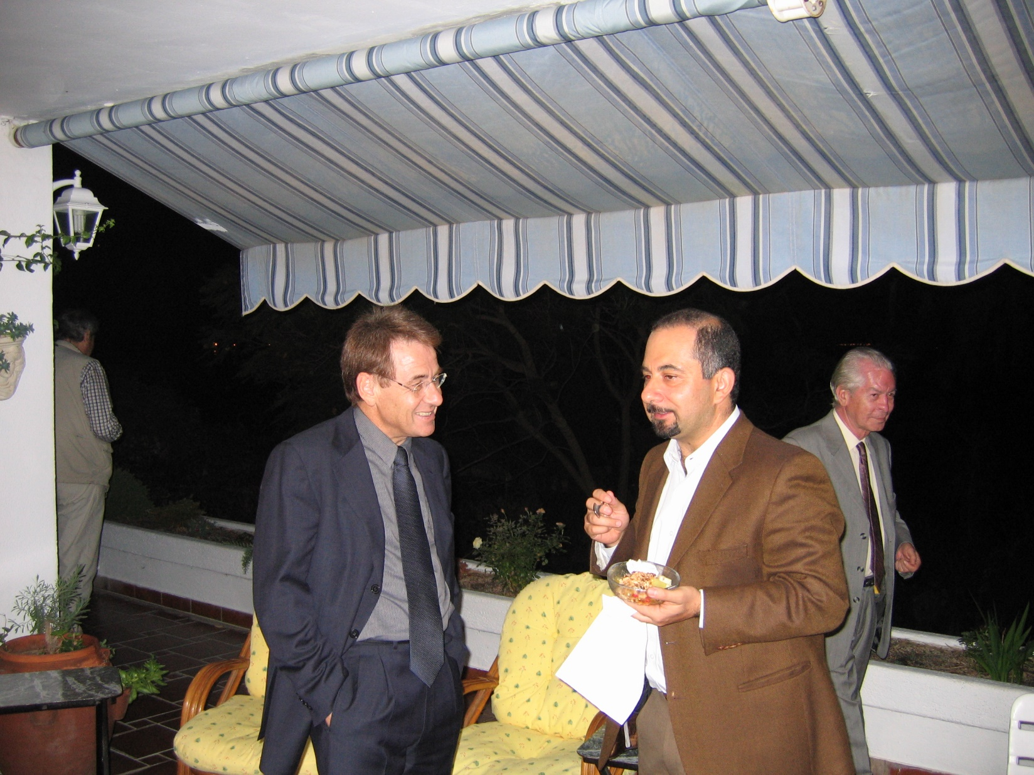

Slide 24
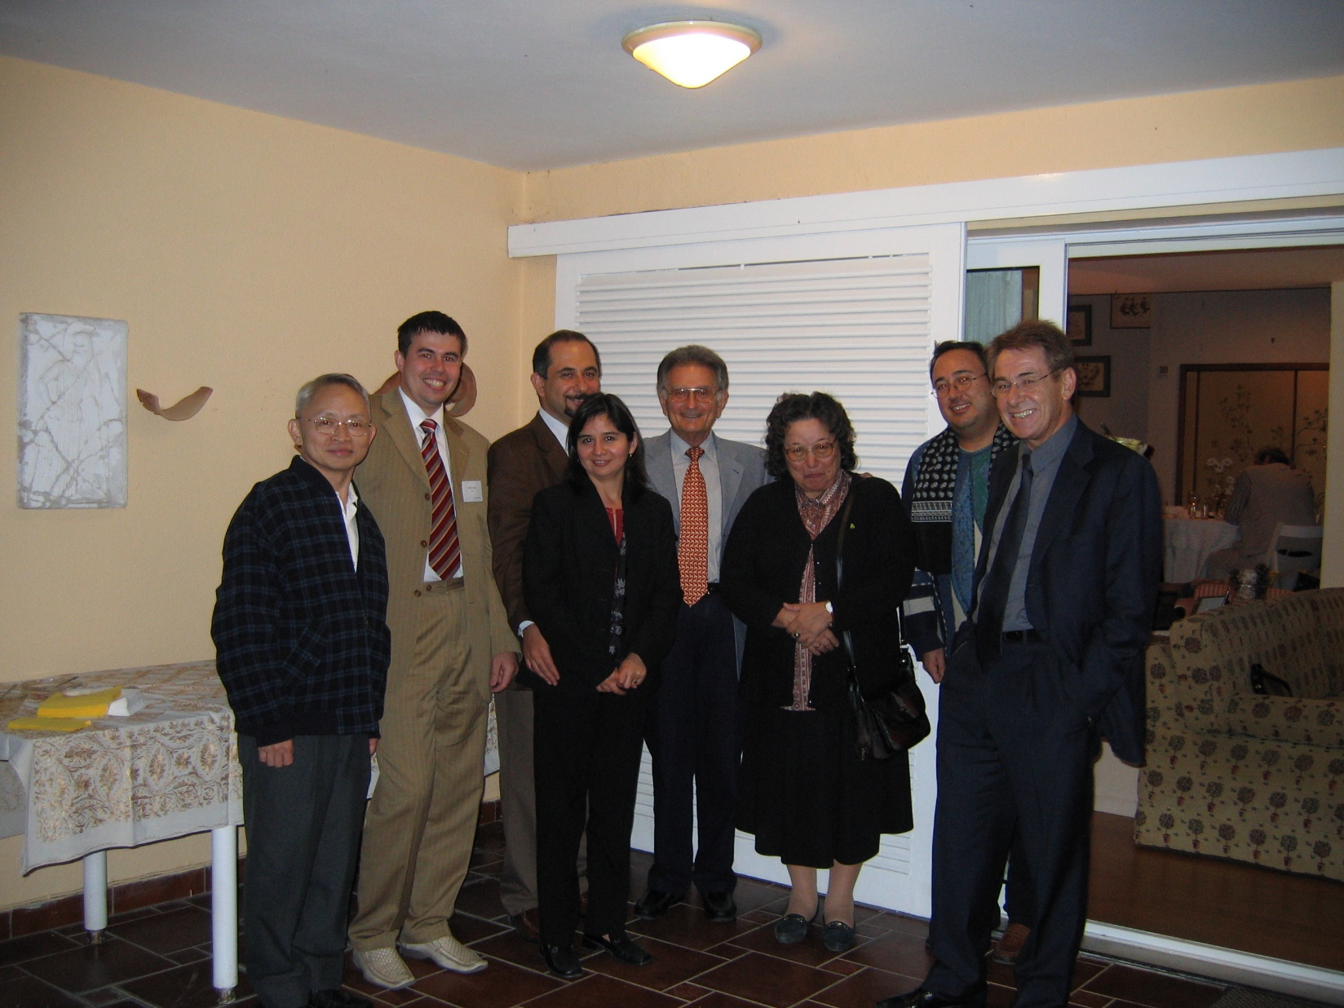

Slide 25
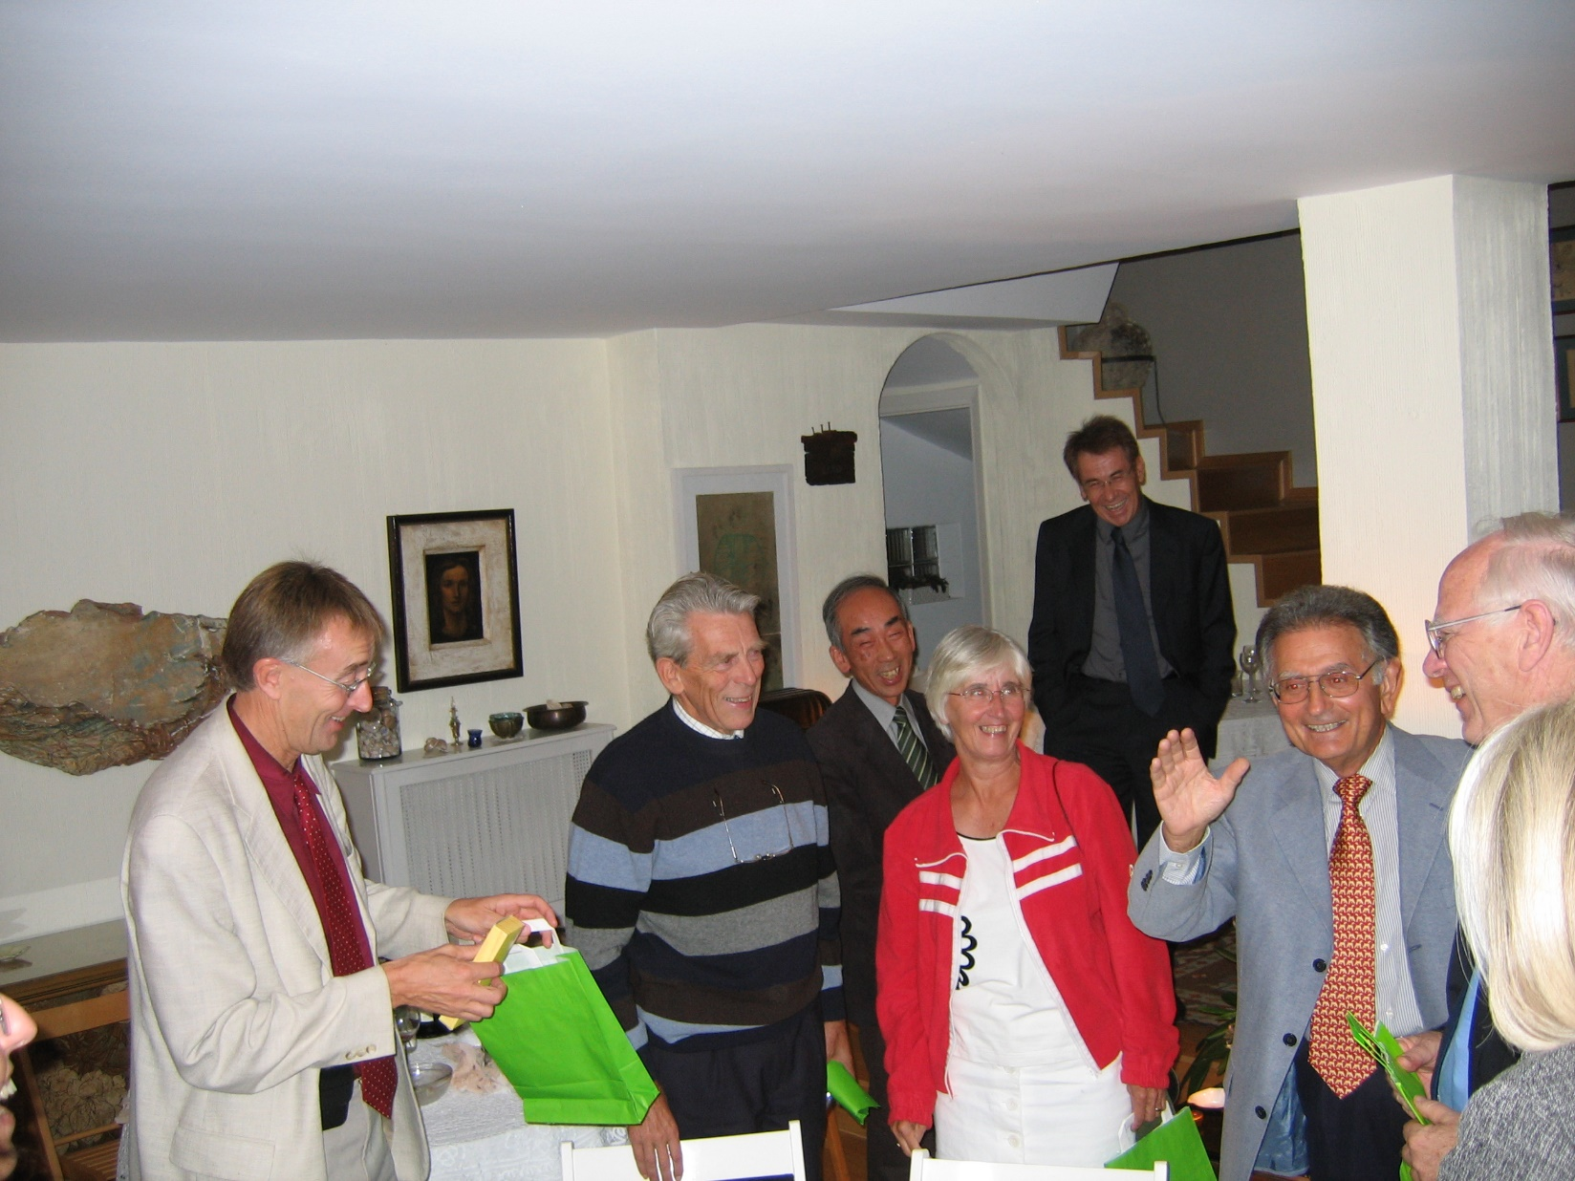

Slide 26
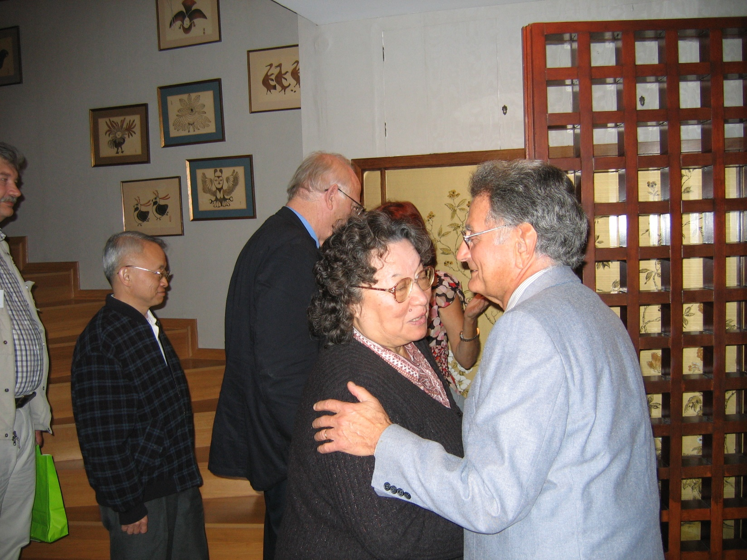

Slide 27
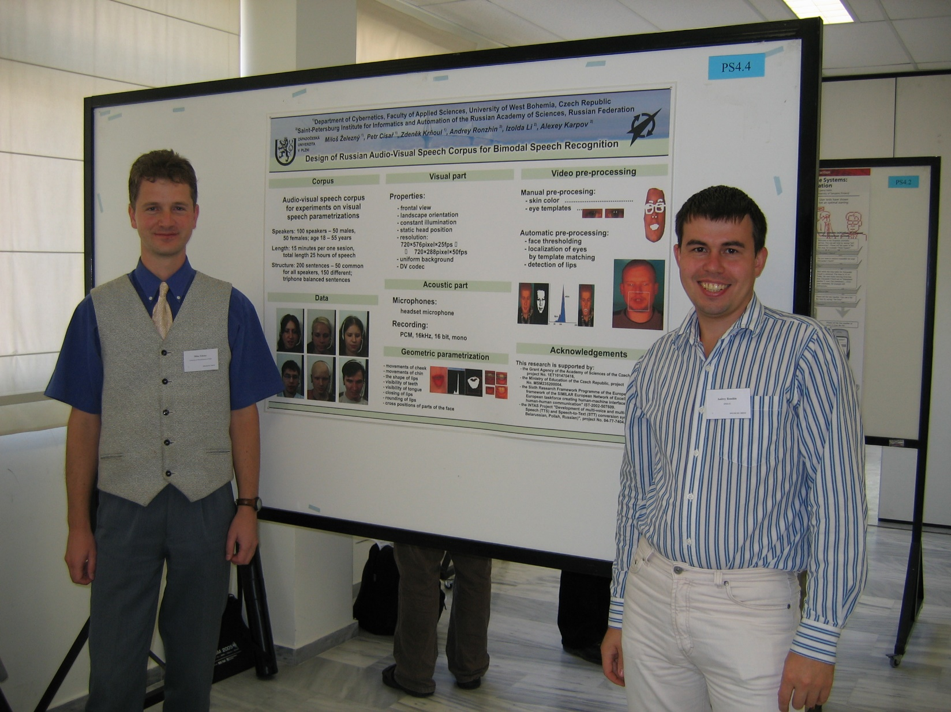

Slide 28
History of SPECOM
Geza Nemeth, SPECOM-2016, Budapest, Hungary
Nikos Fakotakis, SPECOM-2015, Athens, Greece
Vlado Delic, SPECOM-2014, Novi Sad, Serbia
Milos Zelezny, SPECOM-2013, Pilsen, Czech Republic
Potapova Rodmonga, SPECOM-2011, Kazan
Andrey Ronzhin, SPECOM-2009, St. Petersburg
Potapova Rodmonga, SPECOM-2007, Moscow
Andrey Ronzhin, SPECOM-2006, St. Petersburg
George Kokkinakis, SPECOM-2005, Patras, Greece
Andrey Ronzhin, SPECOM-2004, St. Petersburg
Potapova Rodmonga, SPECOM-2003, Moscow
Yury Kosarev, SPECOM-2002, St. Petersburg
Irina Khaleeva, SPECOM-2001, Moscow
Rajmund Piotrowski, SPECOM-2000, St. Petersburg
Irina Khaleeva, SPECOM-1999, Moscow
Yury Kosarev, SPECOM-1998, St. Petersburg
Mircea Pusca, SPECOM-1997, Romania
Rafael Yusupov, SPECOM-1996, St. Petersburg

Slide 29
Сhairs of SPECOM 1996-2016

Slide 30
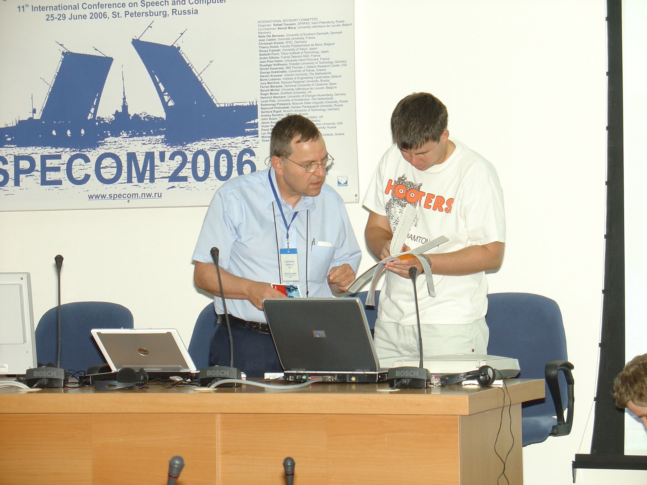

Slide 31
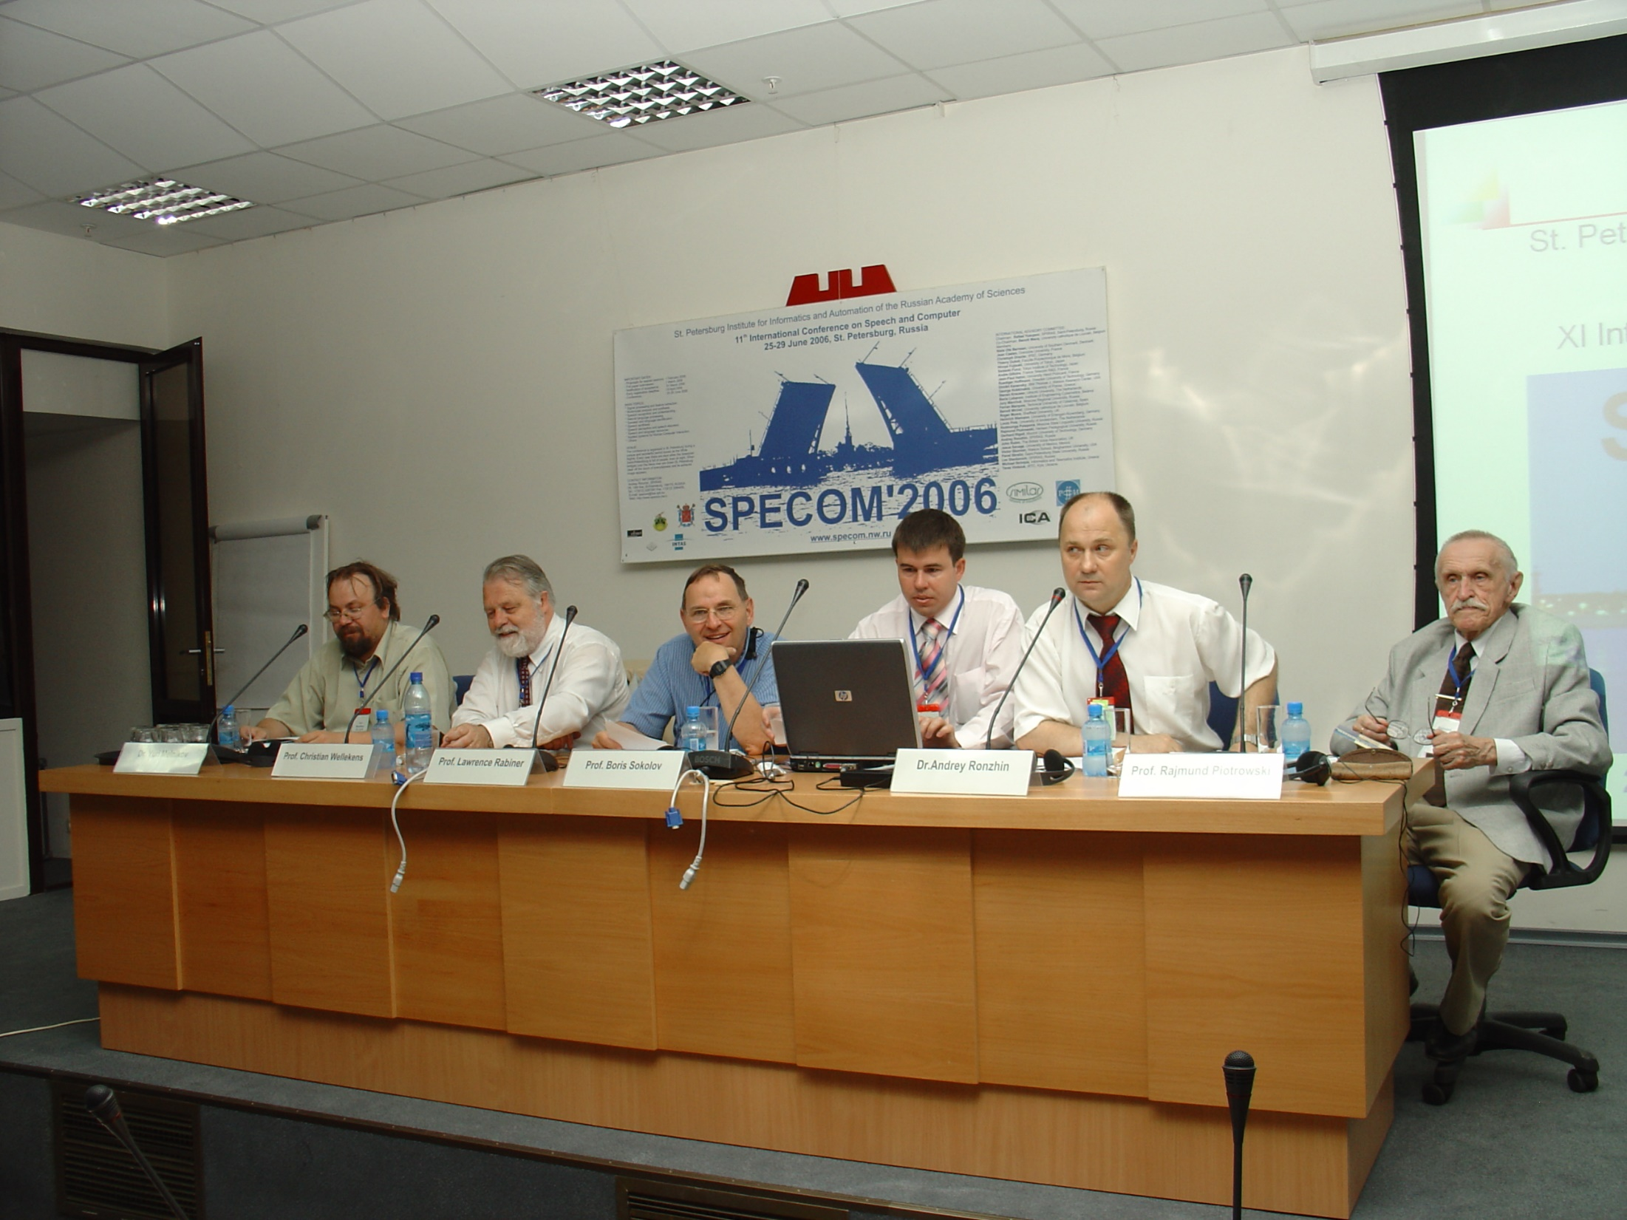

Slide 32
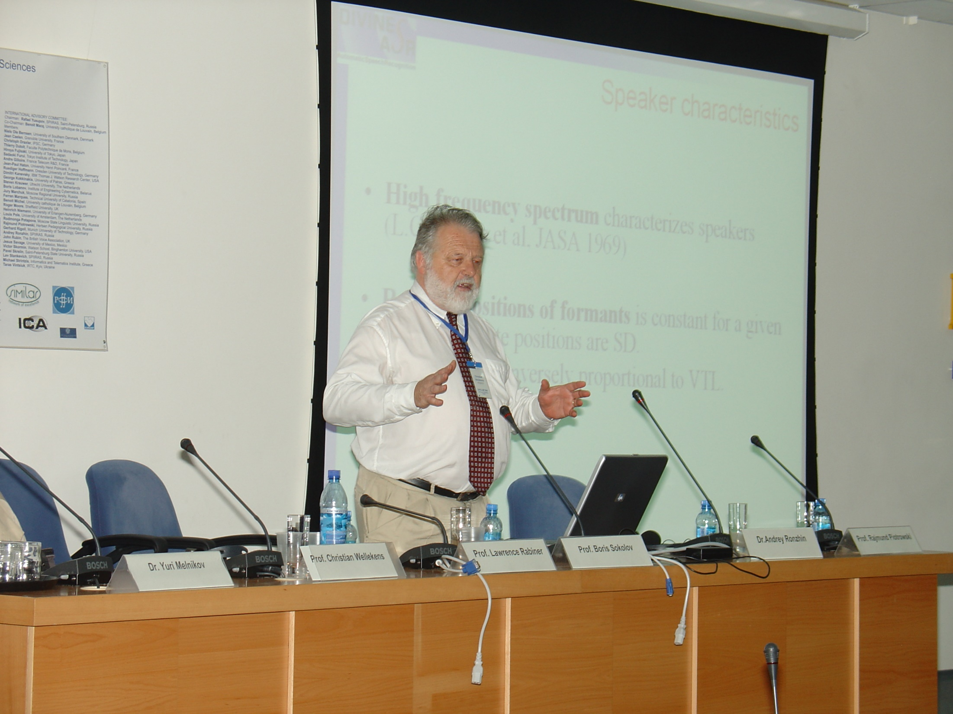

Slide 33
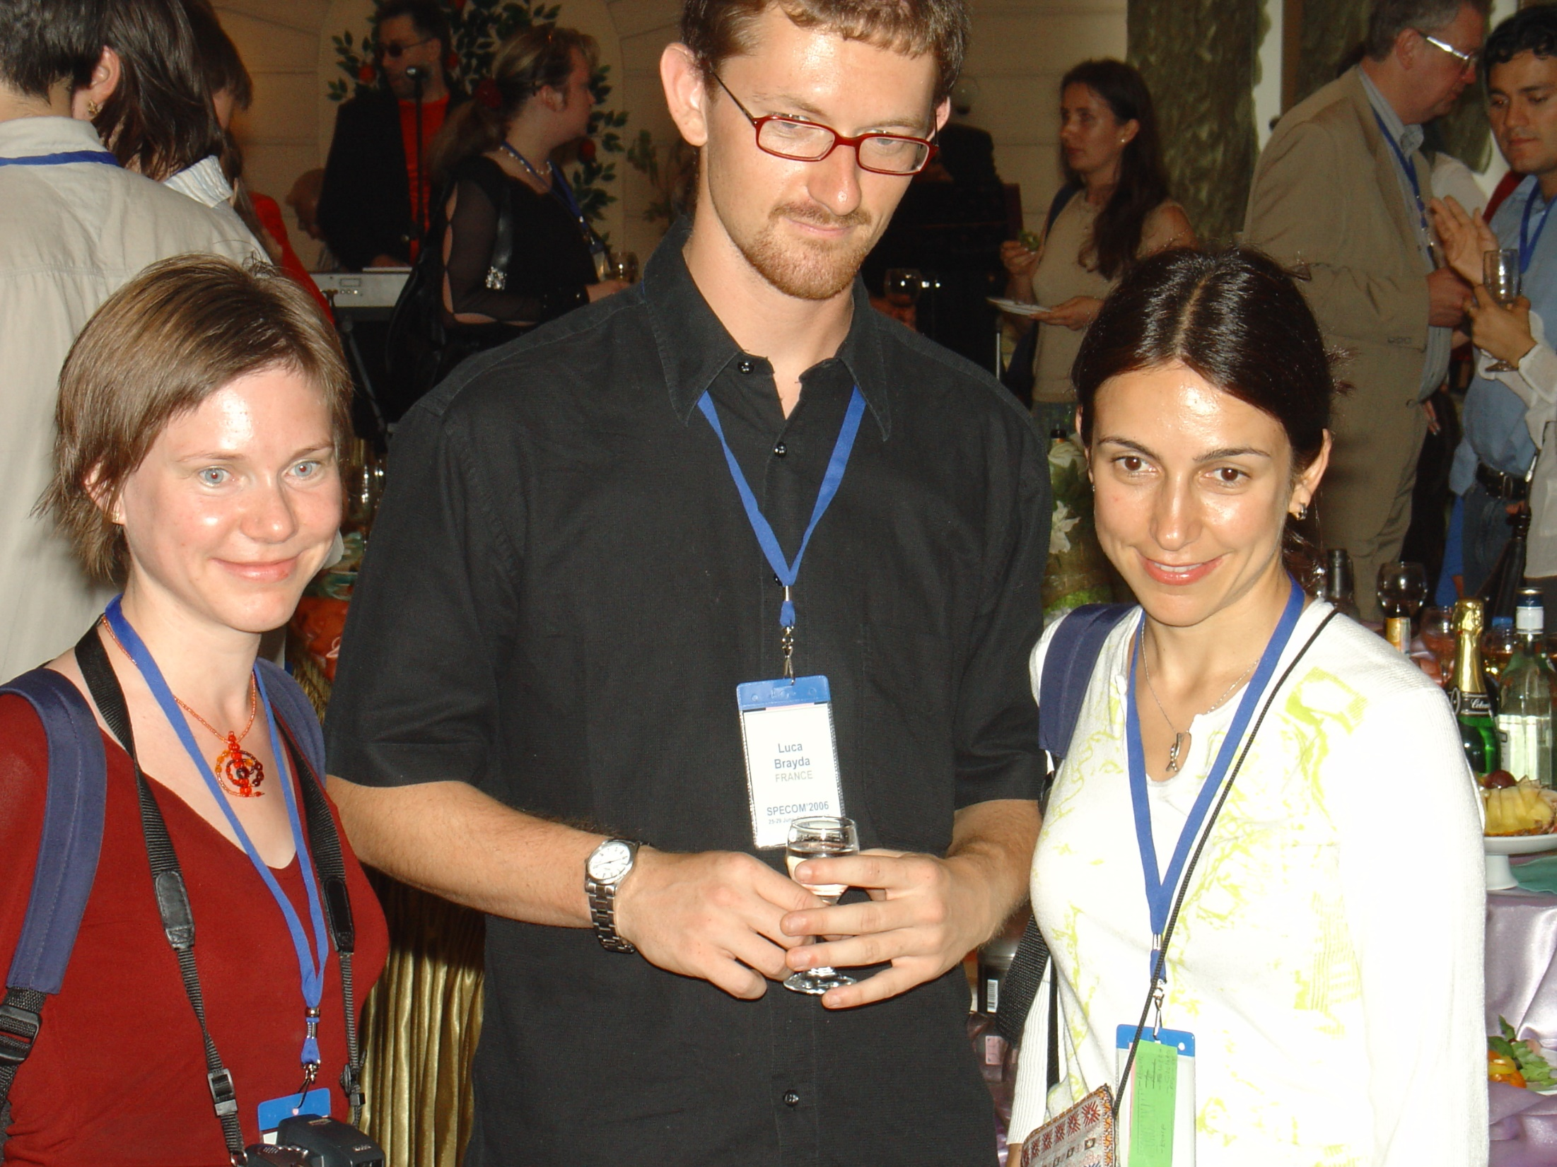

Slide 34
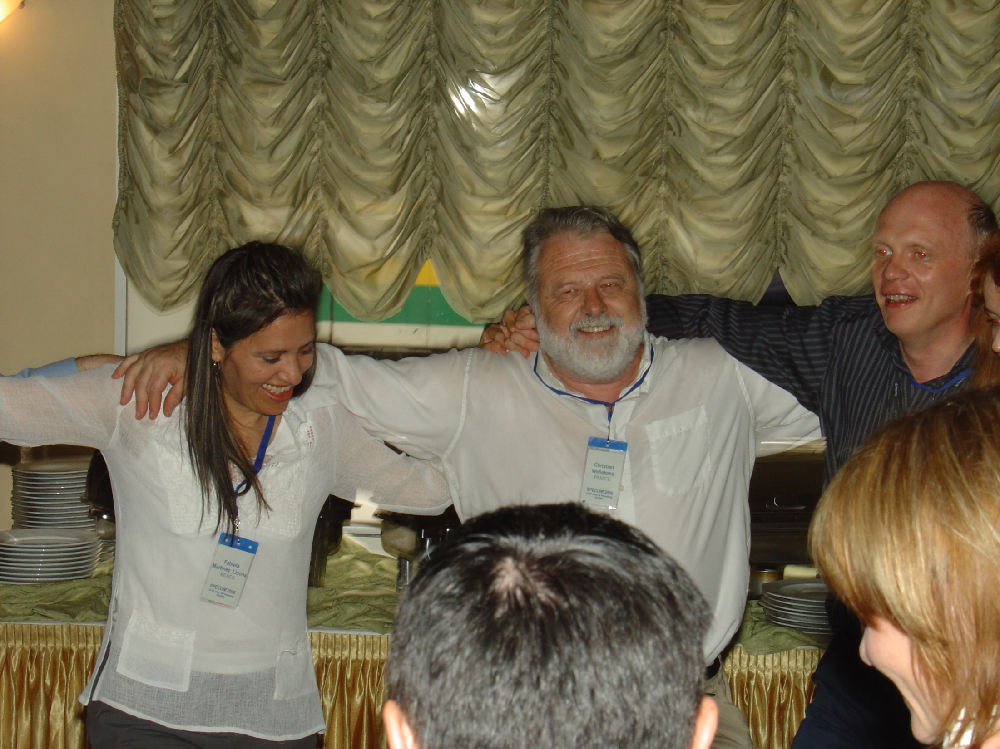

Slide 35
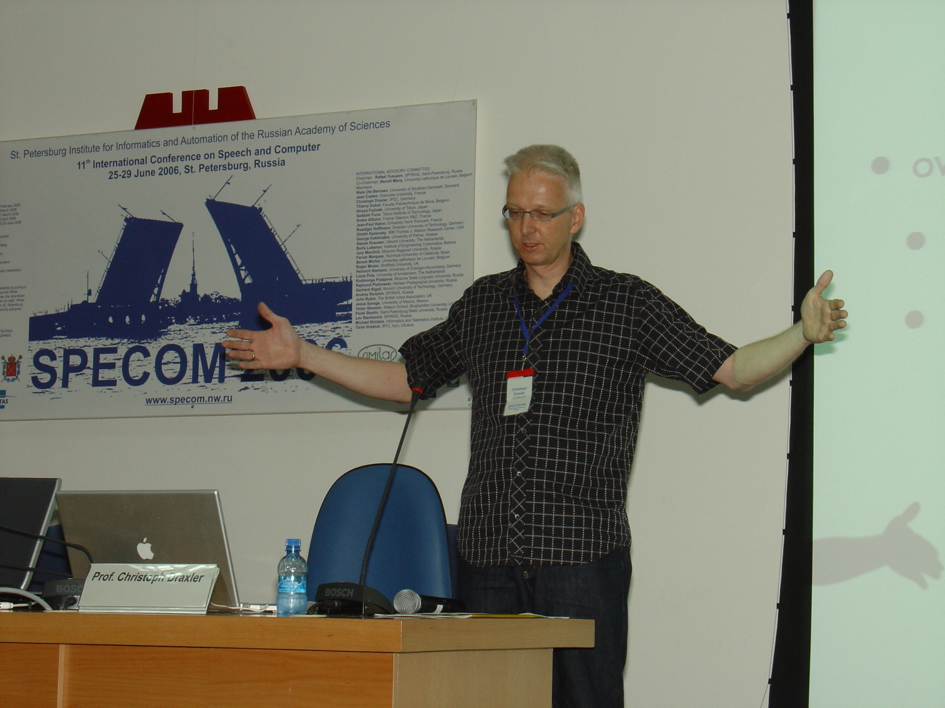

Slide 36
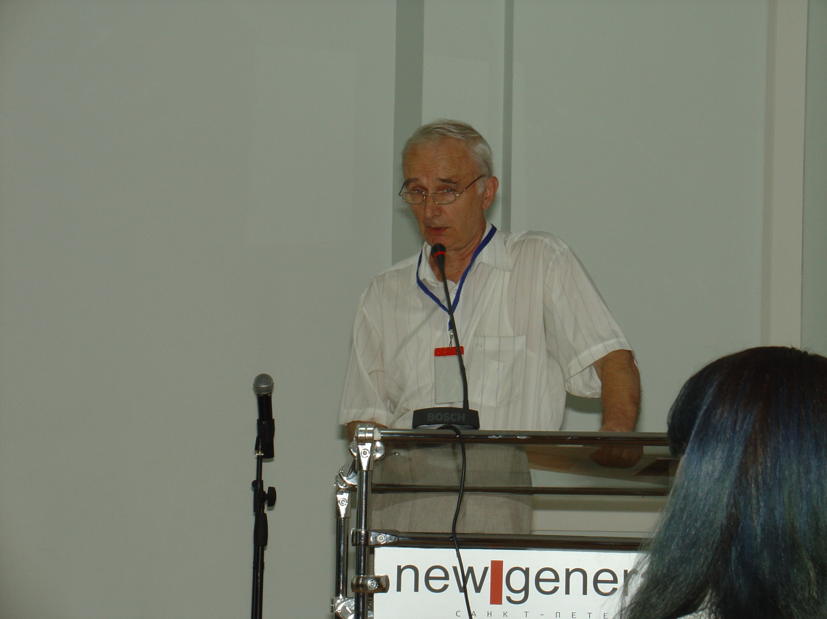

Slide 37
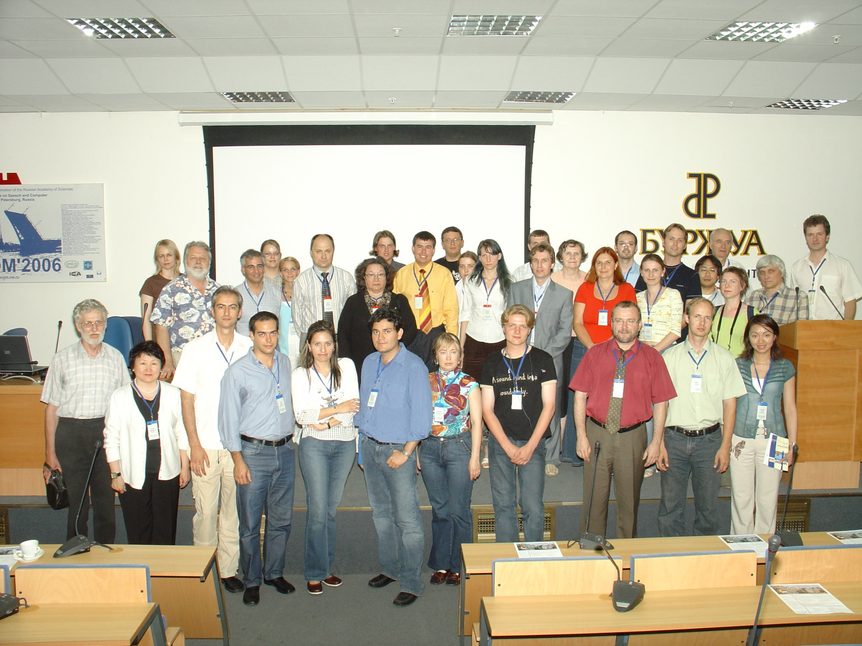

Slide 38
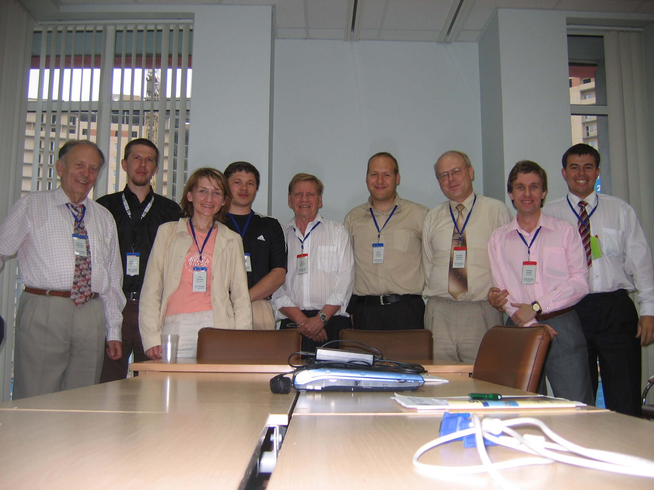

Slide 39
History of SPECOM
Geza Nemeth, SPECOM-2016, Budapest, Hungary
Nikos Fakotakis, SPECOM-2015, Athens, Greece
Vlado Delic, SPECOM-2014, Novi Sad, Serbia
Milos Zelezny, SPECOM-2013, Pilsen, Czech Republic
Potapova Rodmonga, SPECOM-2011, Kazan
Andrey Ronzhin, SPECOM-2009, St. Petersburg
Potapova Rodmonga, SPECOM-2007, Moscow
Andrey Ronzhin, SPECOM-2006, St. Petersburg
George Kokkinakis, SPECOM-2005, Patras, Greece
Andrey Ronzhin, SPECOM-2004, St. Petersburg
Potapova Rodmonga, SPECOM-2003, Moscow
Yury Kosarev, SPECOM-2002, St. Petersburg
Irina Khaleeva, SPECOM-2001, Moscow
Rajmund Piotrowski, SPECOM-2000, St. Petersburg
Irina Khaleeva, SPECOM-1999, Moscow
Yury Kosarev, SPECOM-1998, St. Petersburg
Mircea Pusca, SPECOM-1997, Romania
Rafael Yusupov, SPECOM-1996, St. Petersburg

Slide 40
Сhairs of SPECOM 1996-2016

Slide 41
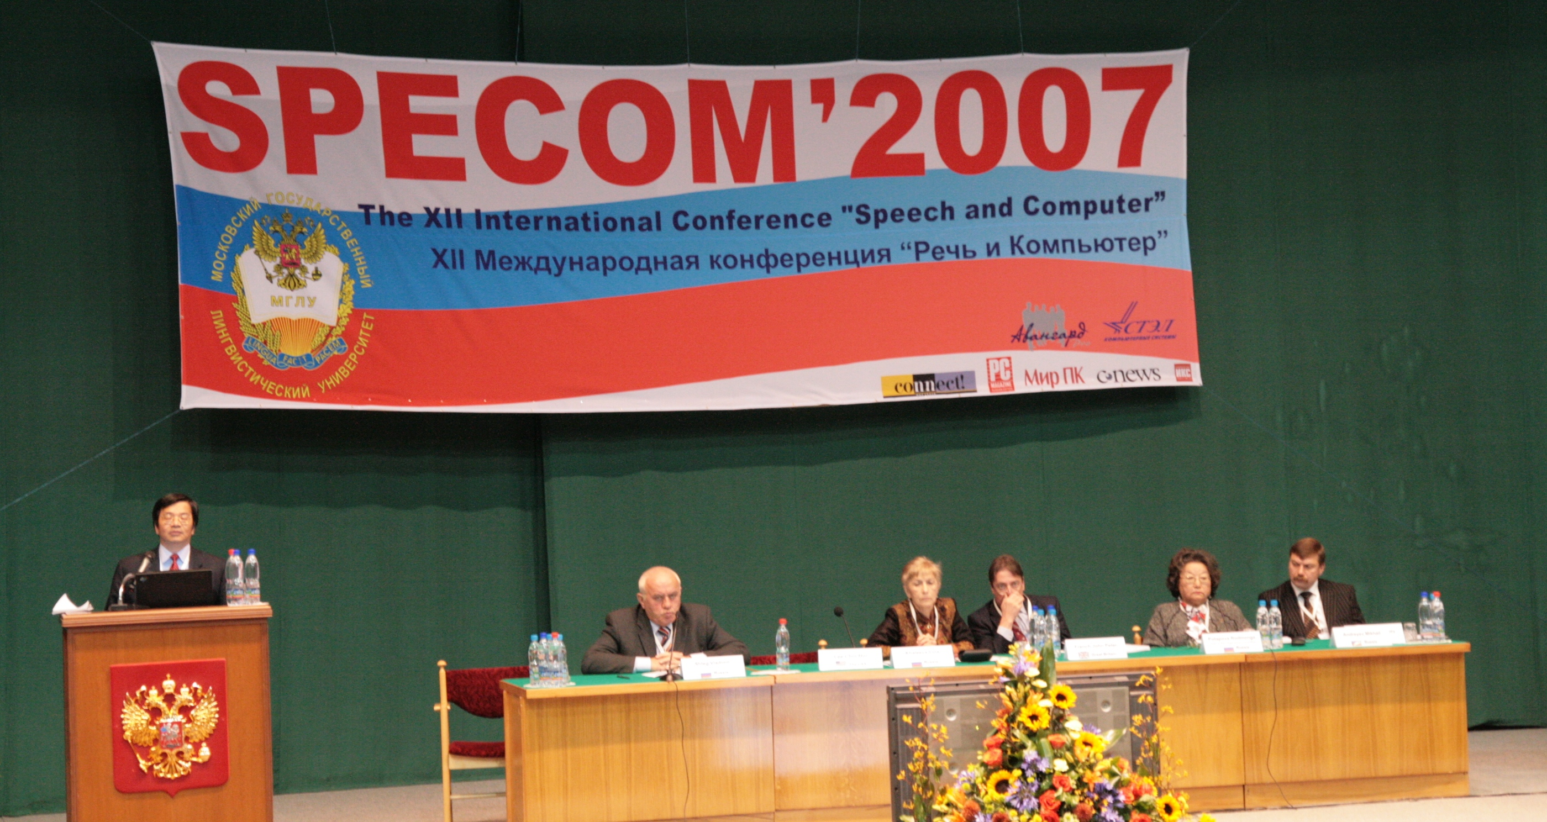

Slide 42
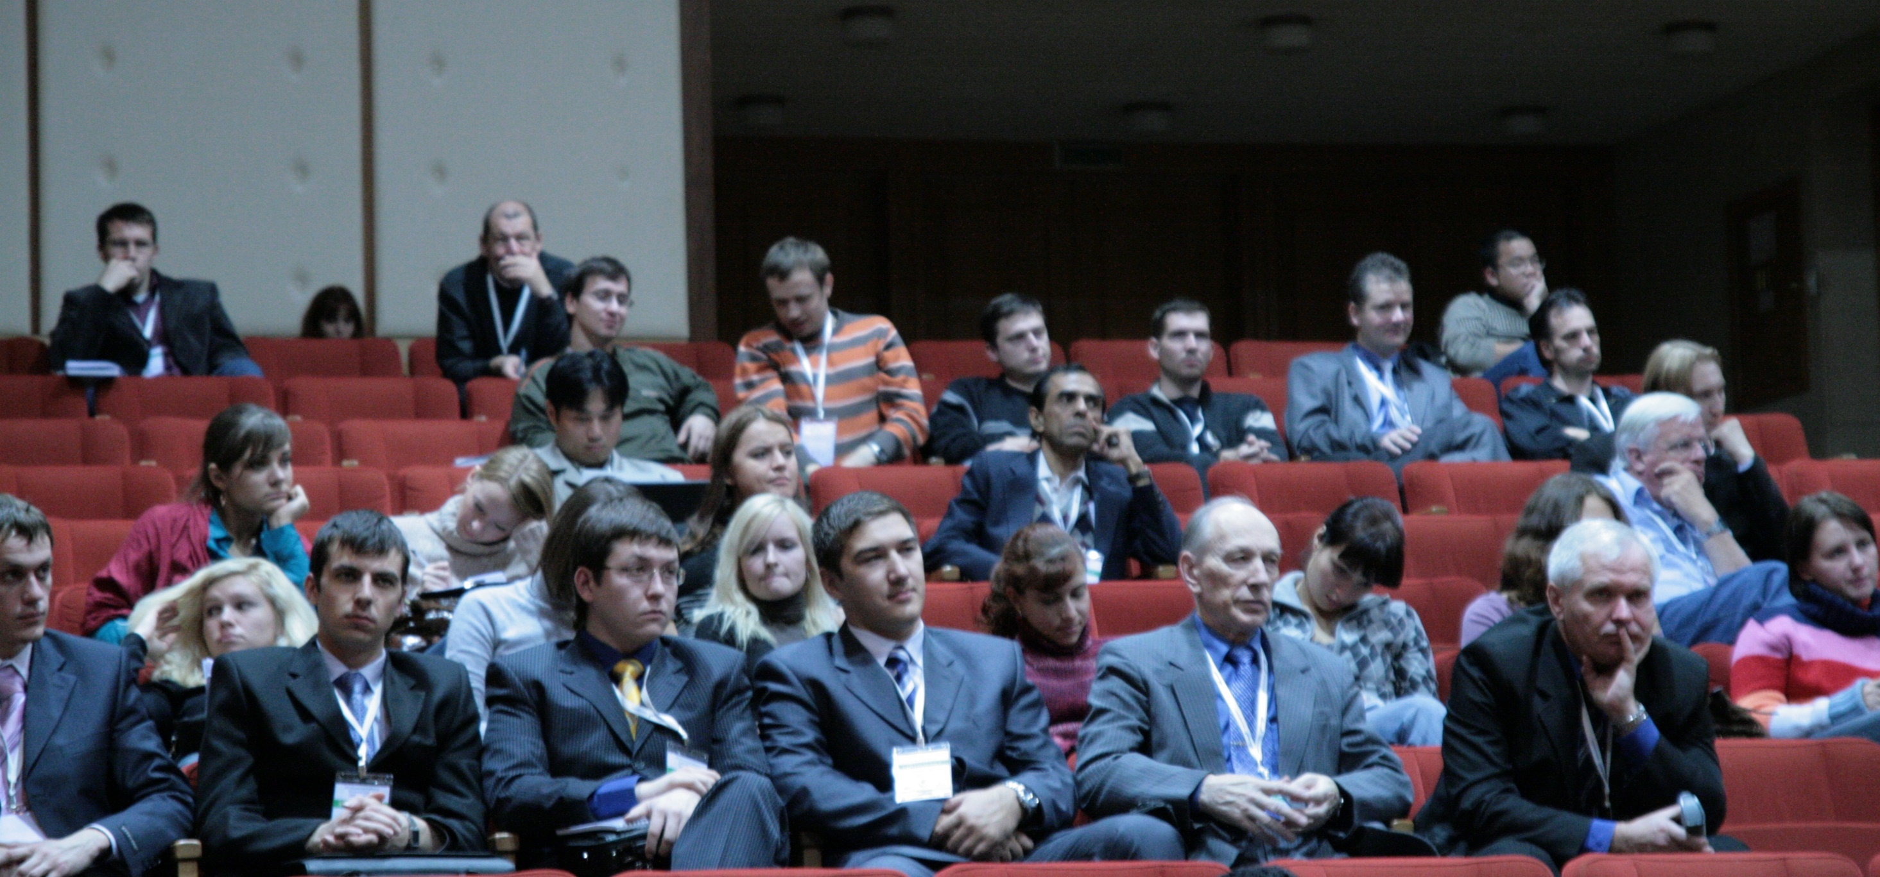

Slide 43
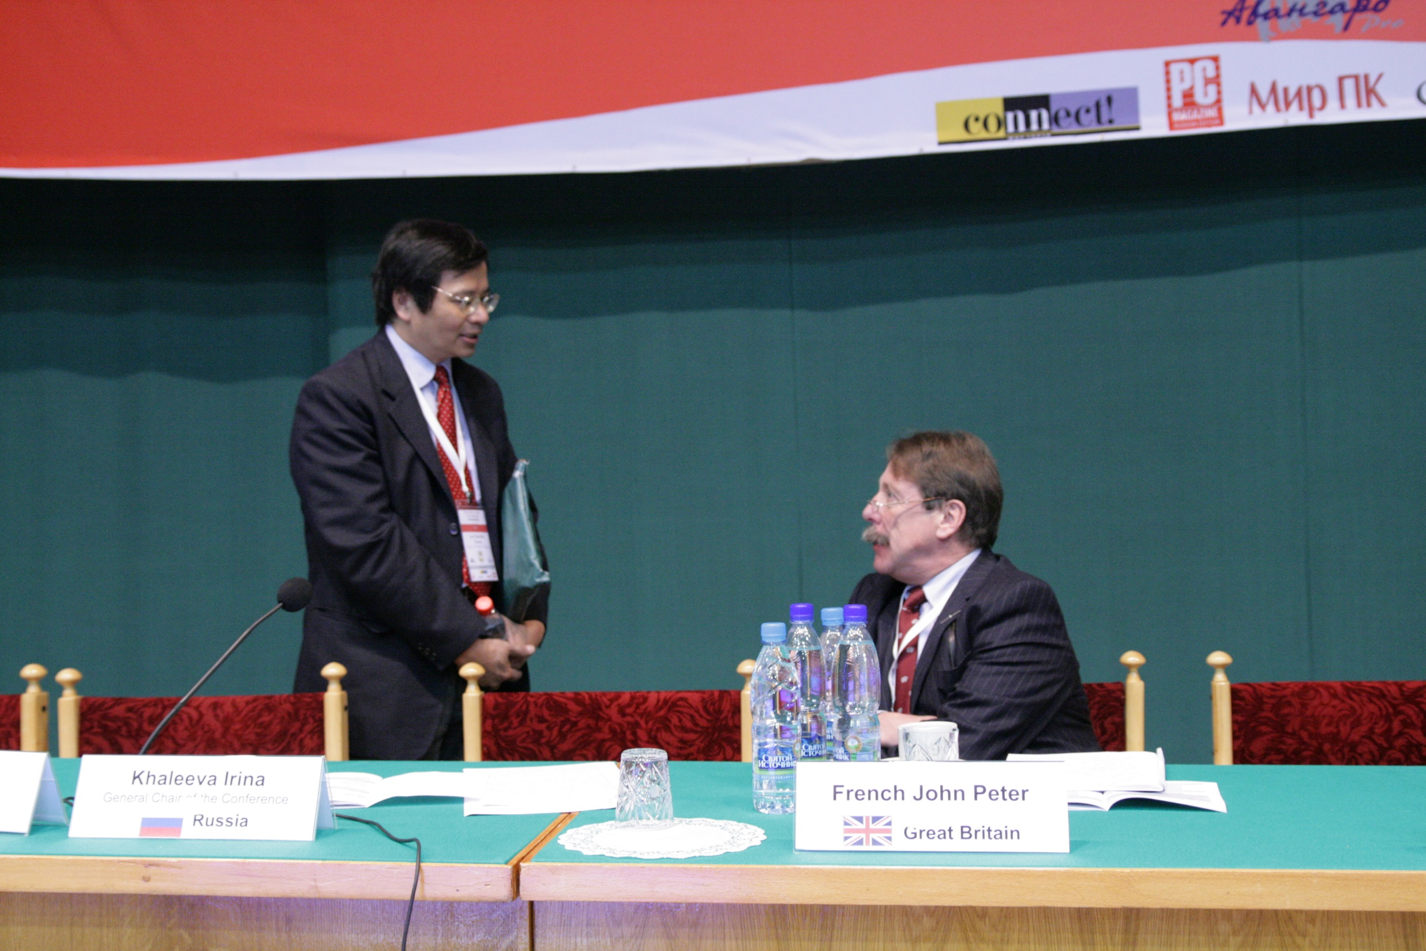

Slide 44
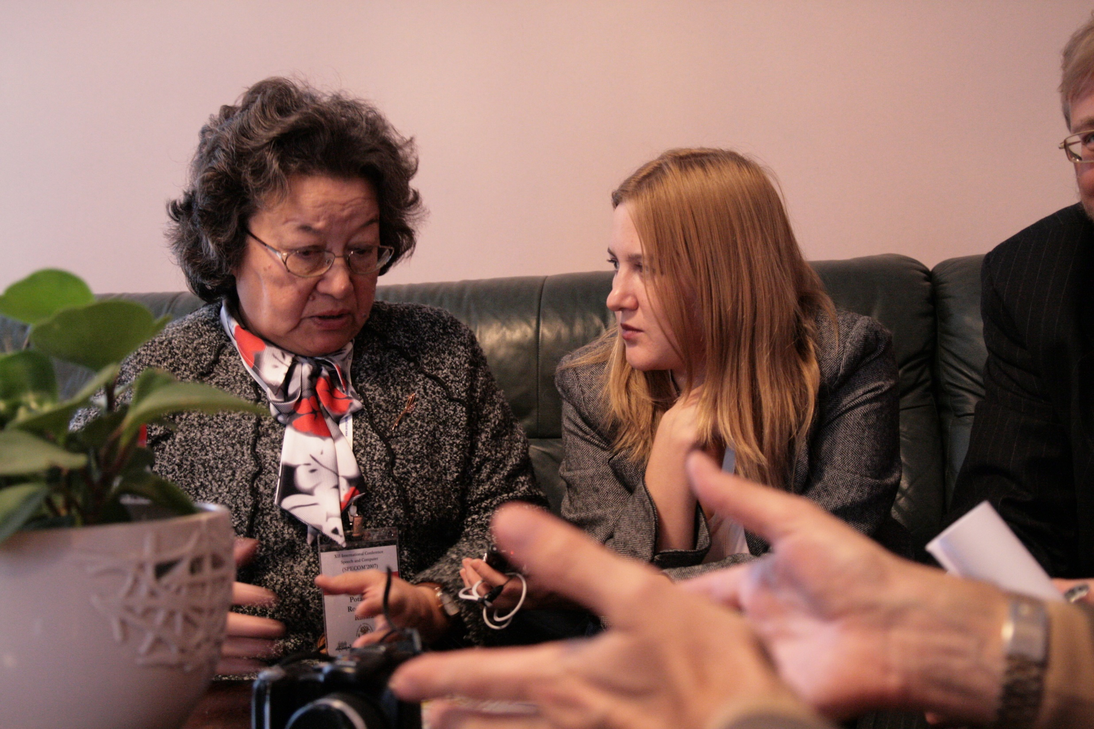

Slide 45
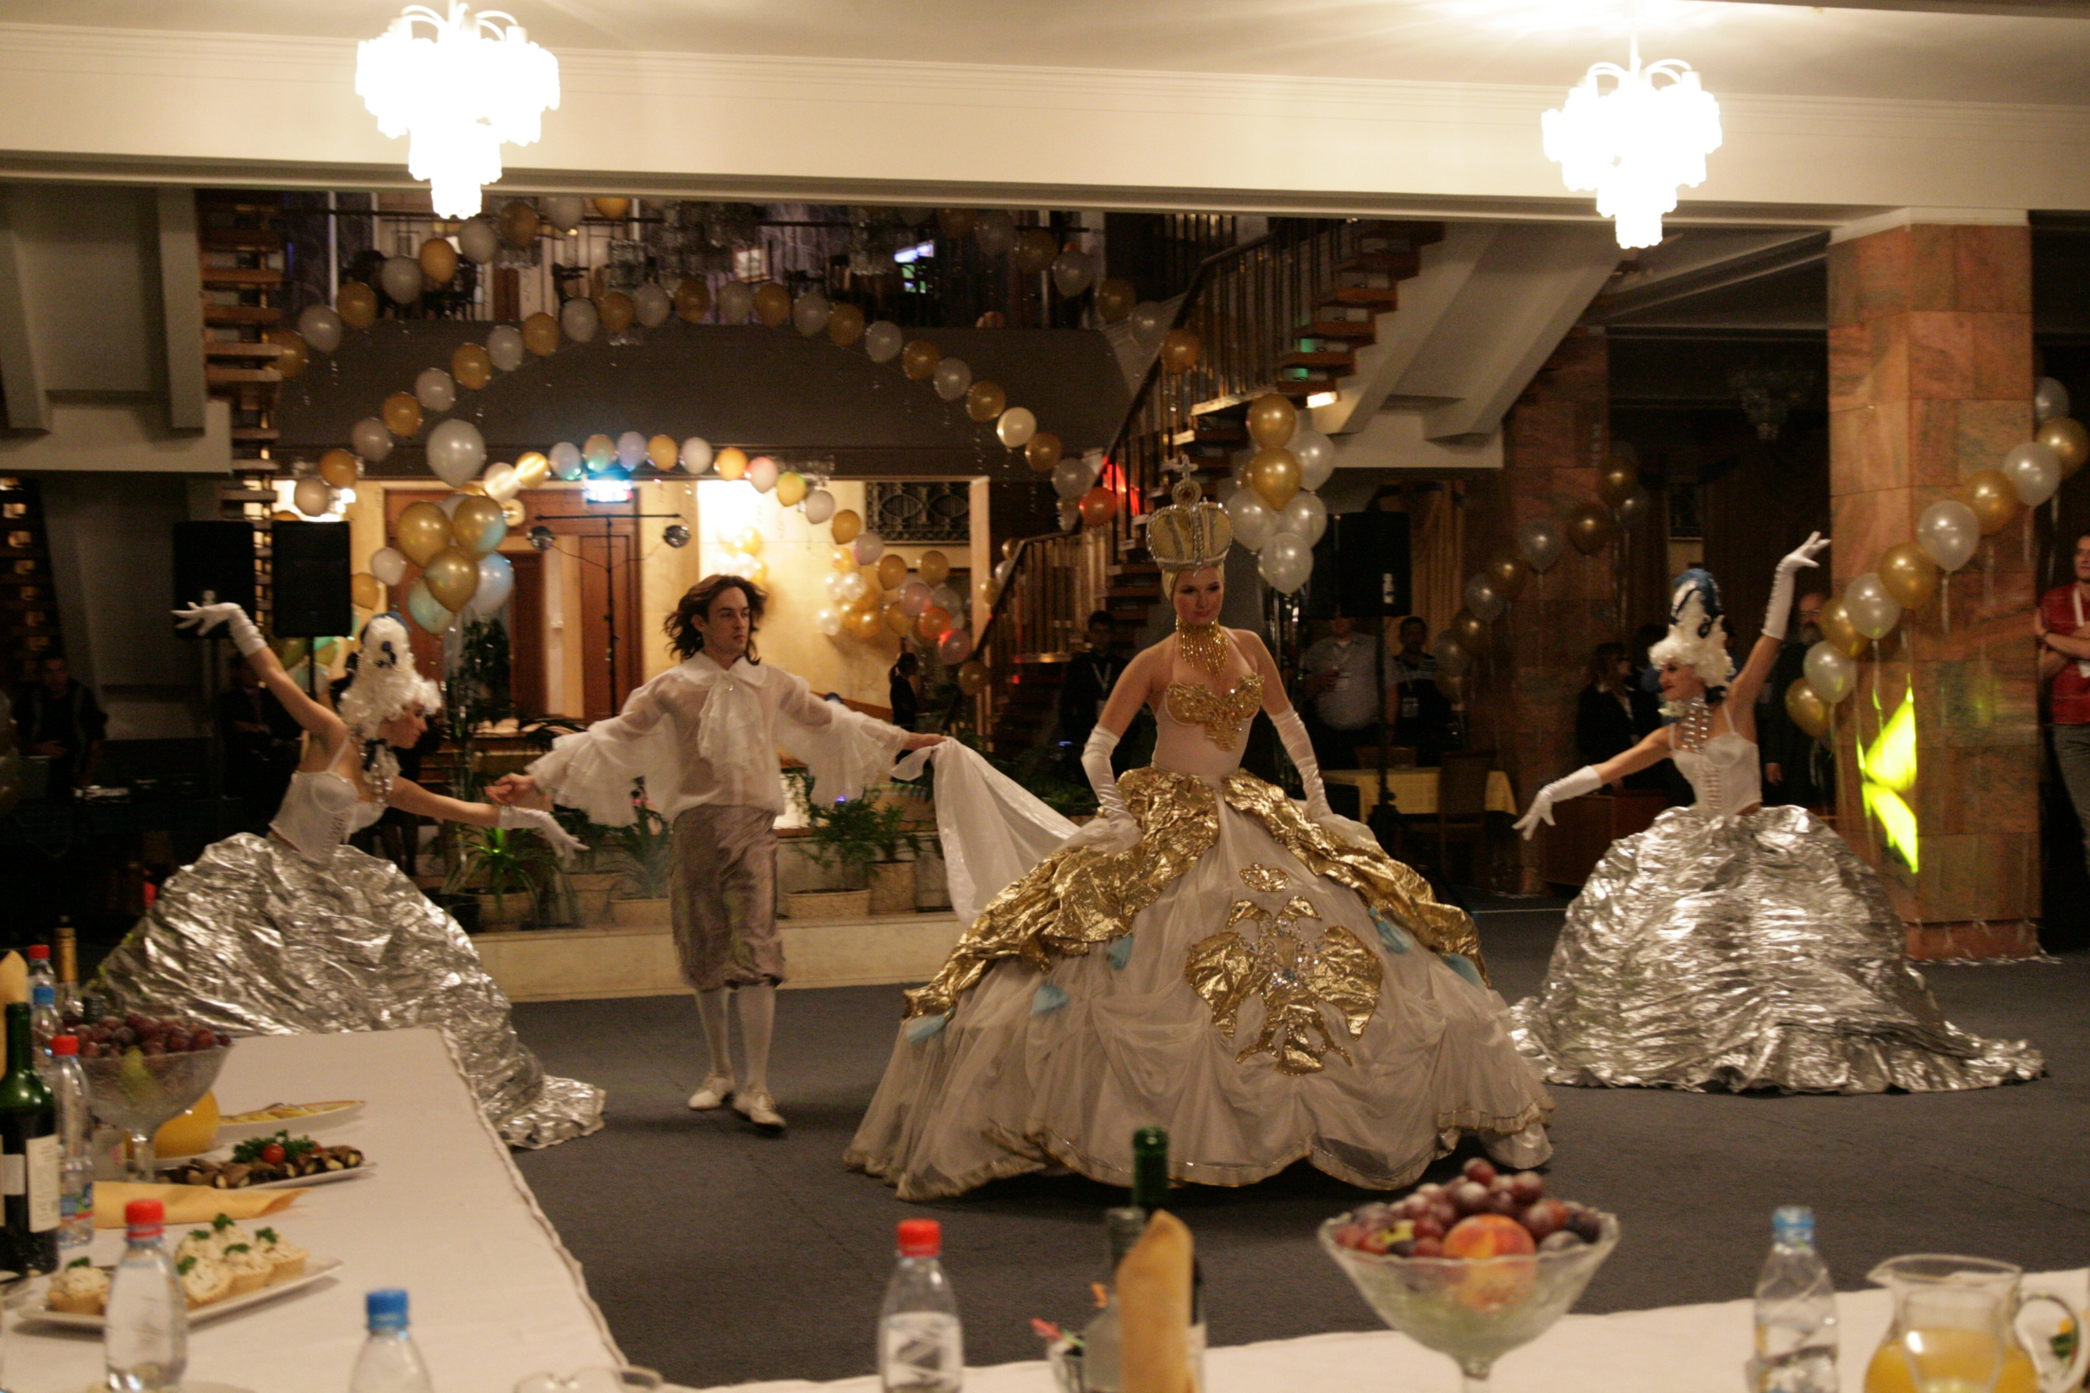

Slide 46
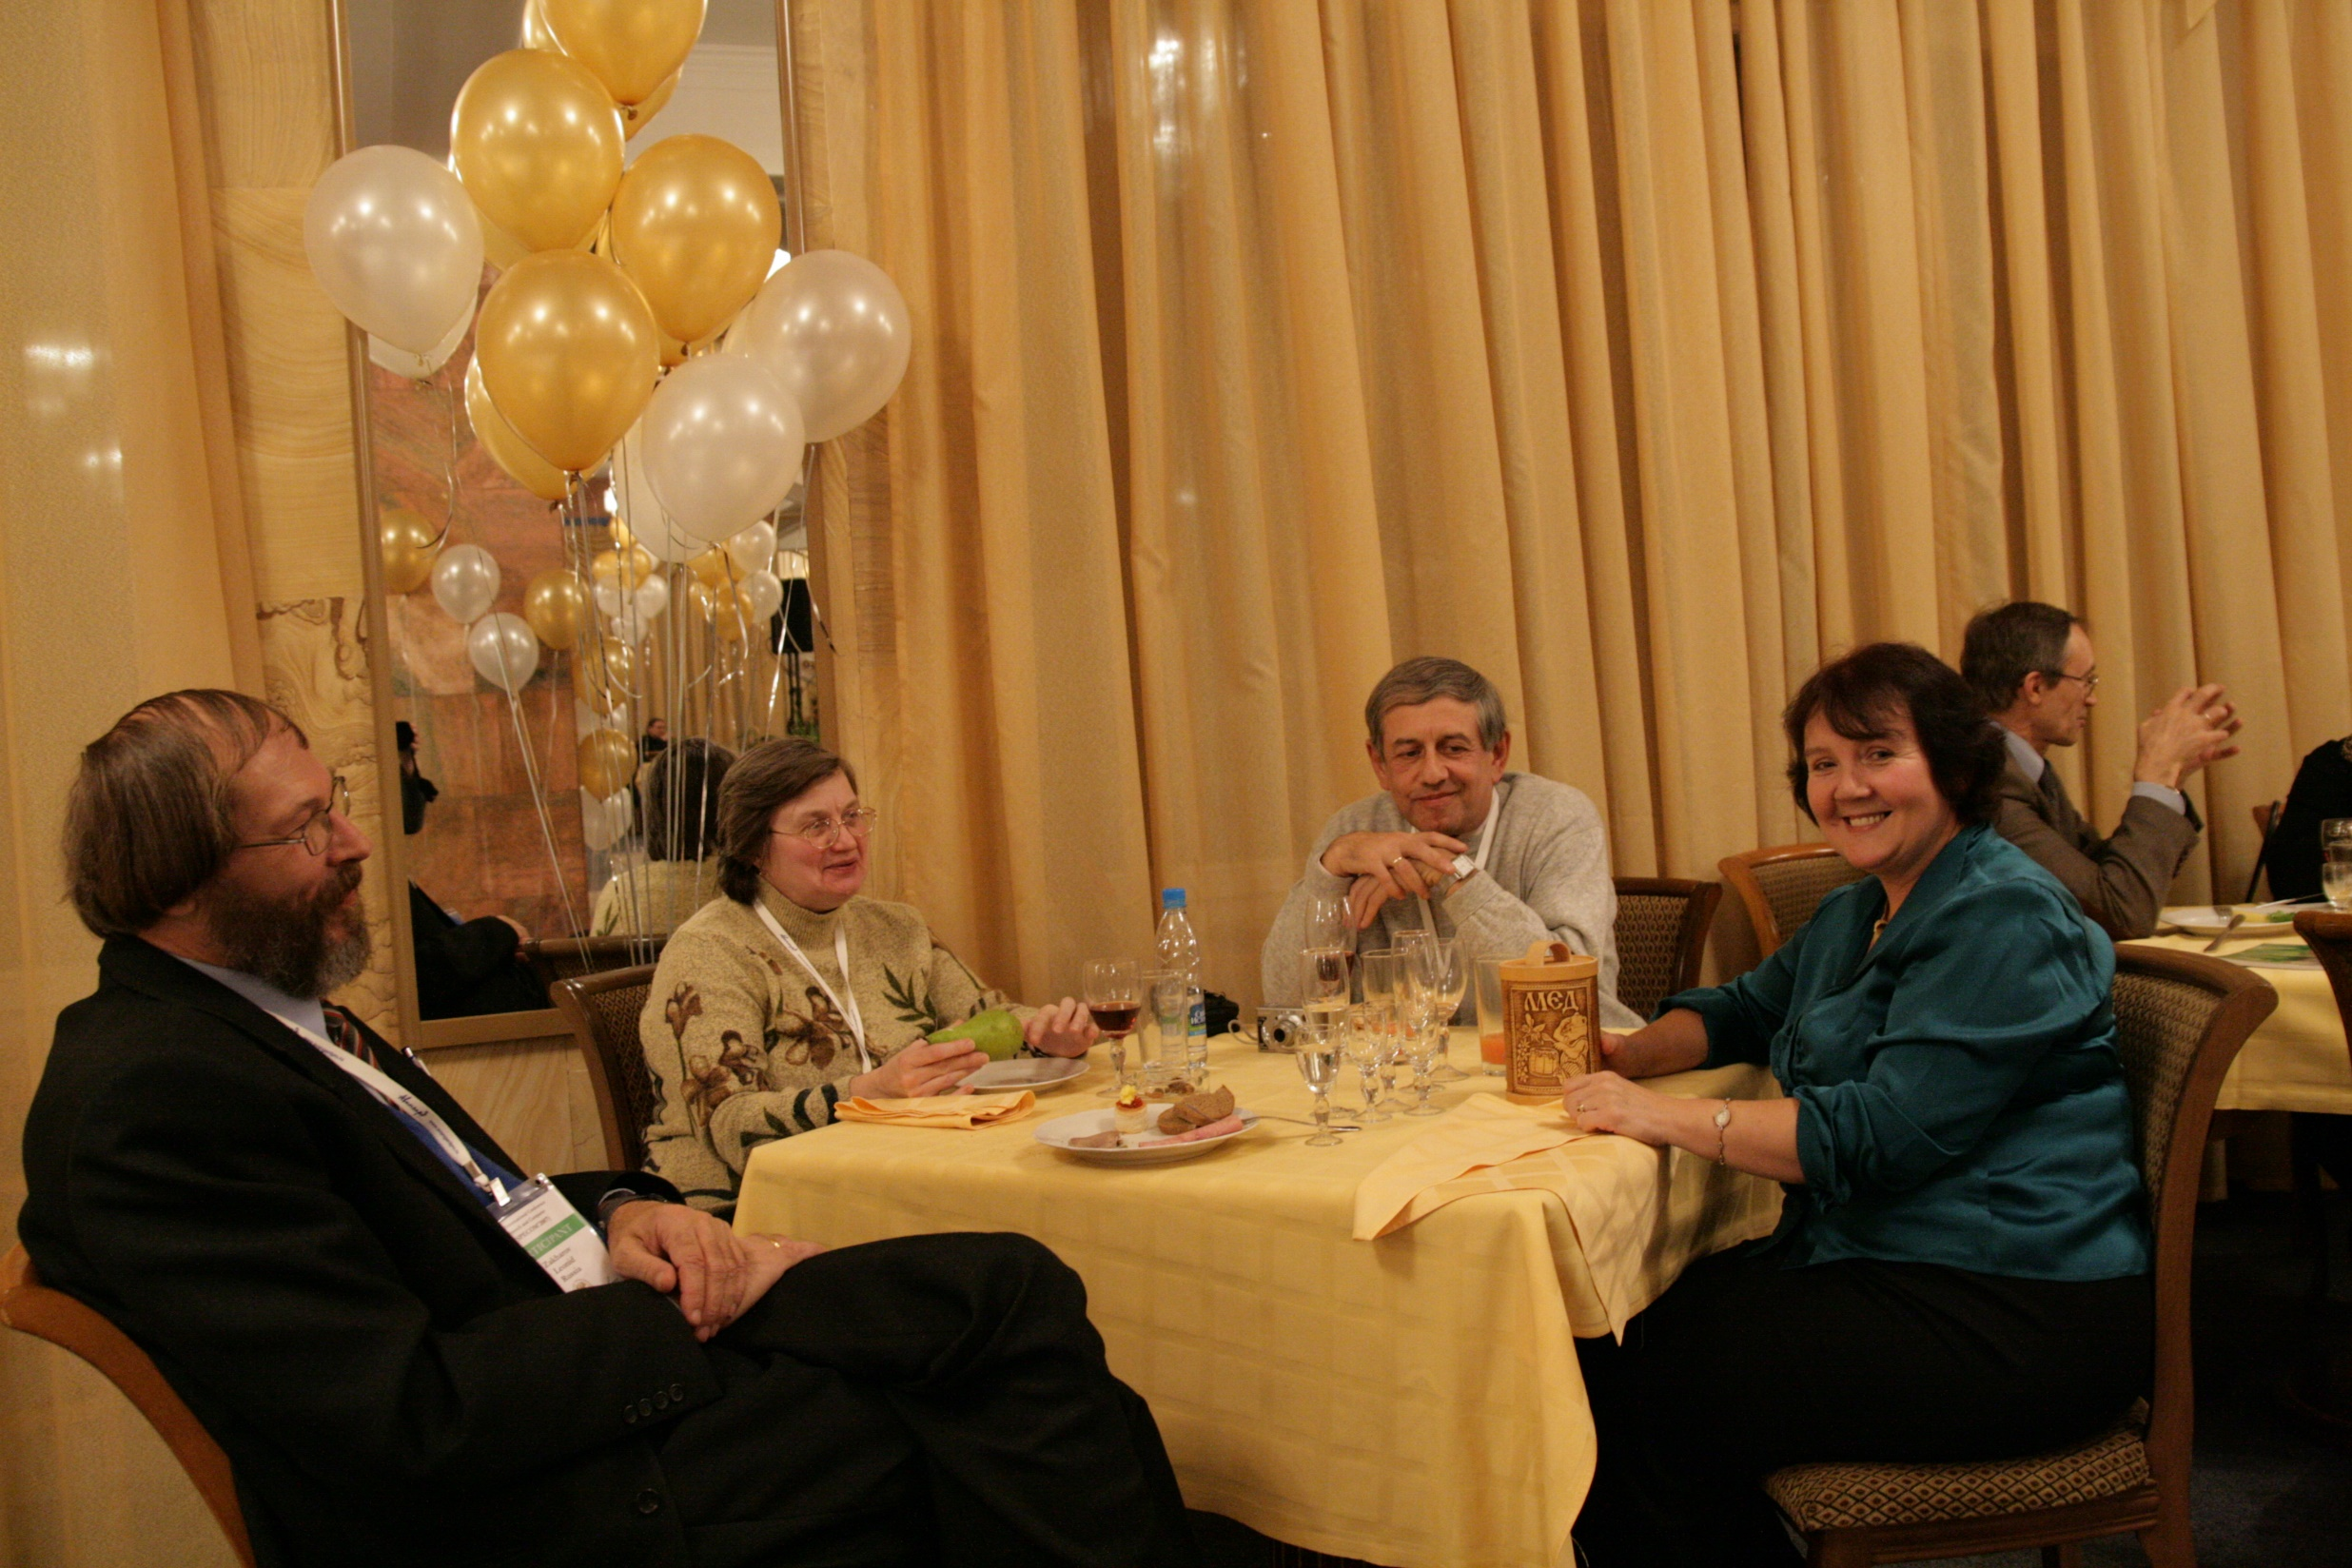

Slide 47
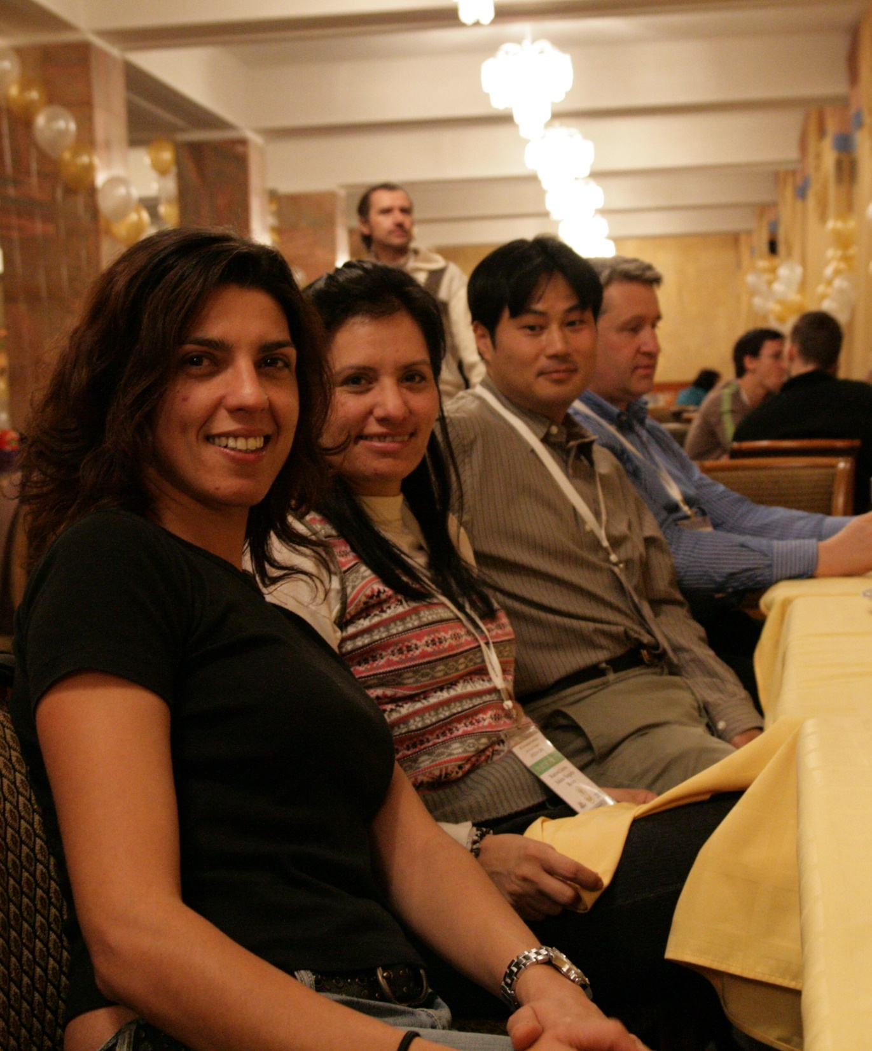

Slide 48
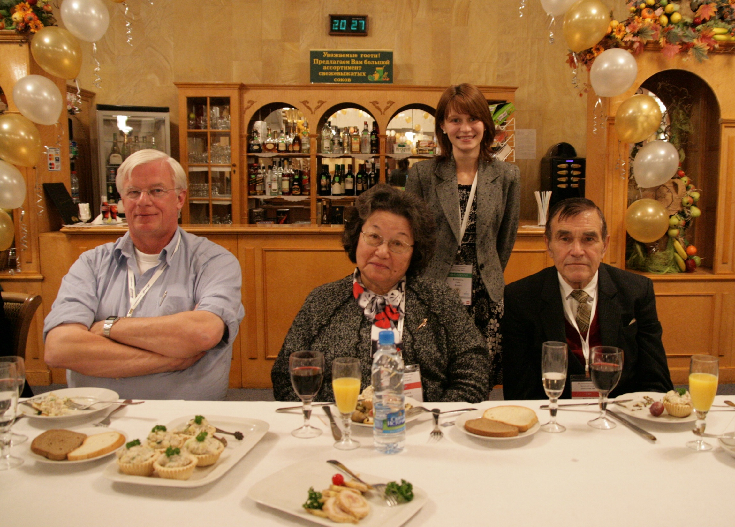

Slide 49


Slide 50


Slide 51
History of SPECOM
Geza Nemeth, SPECOM-2016, Budapest, Hungary
Nikos Fakotakis, SPECOM-2015, Athens, Greece
Vlado Delic, SPECOM-2014, Novi Sad, Serbia
Milos Zelezny, SPECOM-2013, Pilsen, Czech Republic
Potapova Rodmonga, SPECOM-2011, Kazan
Andrey Ronzhin, SPECOM-2009, St. Petersburg
Potapova Rodmonga, SPECOM-2007, Moscow
Andrey Ronzhin, SPECOM-2006, St. Petersburg
George Kokkinakis, SPECOM-2005, Patras, Greece
Andrey Ronzhin, SPECOM-2004, St. Petersburg
Potapova Rodmonga, SPECOM-2003, Moscow
Yury Kosarev, SPECOM-2002, St. Petersburg
Irina Khaleeva, SPECOM-2001, Moscow
Rajmund Piotrowski, SPECOM-2000, St. Petersburg
Irina Khaleeva, SPECOM-1999, Moscow
Yury Kosarev, SPECOM-1998, St. Petersburg
Mircea Pusca, SPECOM-1997, Romania
Rafael Yusupov, SPECOM-1996, St. Petersburg

Slide 52
Сhairs of SPECOM 1996-2016

Slide 53


Slide 54


Slide 55


Slide 56


Slide 57


Slide 58


Slide 59


Slide 60


Slide 61


Slide 62


Slide 63


Slide 64


Slide 65


Slide 66


Slide 67


Slide 68


Slide 69


Slide 70


Slide 71


Slide 72


Slide 73


Slide 74


Slide 75


Slide 76


Slide 77


Slide 78
History of SPECOM
Geza Nemeth, SPECOM-2016, Budapest, Hungary
Nikos Fakotakis, SPECOM-2015, Athens, Greece
Vlado Delic, SPECOM-2014, Novi Sad, Serbia
Milos Zelezny, SPECOM-2013, Pilsen, Czech Republic
Potapova Rodmonga, SPECOM-2011, Kazan
Andrey Ronzhin, SPECOM-2009, St. Petersburg
Potapova Rodmonga, SPECOM-2007, Moscow
Andrey Ronzhin, SPECOM-2006, St. Petersburg
George Kokkinakis, SPECOM-2005, Patras, Greece
Andrey Ronzhin, SPECOM-2004, St. Petersburg
Potapova Rodmonga, SPECOM-2003, Moscow
Yury Kosarev, SPECOM-2002, St. Petersburg
Irina Khaleeva, SPECOM-2001, Moscow
Rajmund Piotrowski, SPECOM-2000, St. Petersburg
Irina Khaleeva, SPECOM-1999, Moscow
Yury Kosarev, SPECOM-1998, St. Petersburg
Mircea Pusca, SPECOM-1997, Romania
Rafael Yusupov, SPECOM-1996, St. Petersburg

Slide 79
Сhairs of SPECOM 1996-2016

Slide 80


Slide 81


Slide 82


Slide 83
History of SPECOM
Geza Nemeth, SPECOM-2016, Budapest, Hungary
Nikos Fakotakis, SPECOM-2015, Athens, Greece
Vlado Delic, SPECOM-2014, Novi Sad, Serbia
Milos Zelezny, SPECOM-2013, Pilsen, Czech Republic
Potapova Rodmonga, SPECOM-2011, Kazan
Andrey Ronzhin, SPECOM-2009, St. Petersburg
Potapova Rodmonga, SPECOM-2007, Moscow
Andrey Ronzhin, SPECOM-2006, St. Petersburg
George Kokkinakis, SPECOM-2005, Patras, Greece
Andrey Ronzhin, SPECOM-2004, St. Petersburg
Potapova Rodmonga, SPECOM-2003, Moscow
Yury Kosarev, SPECOM-2002, St. Petersburg
Irina Khaleeva, SPECOM-2001, Moscow
Rajmund Piotrowski, SPECOM-2000, St. Petersburg
Irina Khaleeva, SPECOM-1999, Moscow
Yury Kosarev, SPECOM-1998, St. Petersburg
Mircea Pusca, SPECOM-1997, Romania
Rafael Yusupov, SPECOM-1996, St. Petersburg

Slide 84
Сhairs of SPECOM 1996-2016

Slide 85


Slide 86


Slide 87


Slide 88


Slide 89


Slide 90


Slide 91


Slide 92


Slide 93


Slide 94


Slide 95
History of SPECOM
Geza Nemeth, SPECOM-2016, Budapest, Hungary
Nikos Fakotakis, SPECOM-2015, Athens, Greece
Vlado Delic, SPECOM-2014, Novi Sad, Serbia
Milos Zelezny, SPECOM-2013, Pilsen, Czech Republic
Potapova Rodmonga, SPECOM-2011, Kazan
Andrey Ronzhin, SPECOM-2009, St. Petersburg
Potapova Rodmonga, SPECOM-2007, Moscow
Andrey Ronzhin, SPECOM-2006, St. Petersburg
George Kokkinakis, SPECOM-2005, Patras, Greece
Andrey Ronzhin, SPECOM-2004, St. Petersburg
Potapova Rodmonga, SPECOM-2003, Moscow
Yury Kosarev, SPECOM-2002, St. Petersburg
Irina Khaleeva, SPECOM-2001, Moscow
Rajmund Piotrowski, SPECOM-2000, St. Petersburg
Irina Khaleeva, SPECOM-1999, Moscow
Yury Kosarev, SPECOM-1998, St. Petersburg
Mircea Pusca, SPECOM-1997, Romania
Rafael Yusupov, SPECOM-1996, St. Petersburg

Slide 96
Сhairs of SPECOM 1996-2016

Slide 97


Slide 98


Slide 99


Slide 100


Slide 101


Slide 102


Slide 103


Slide 104


Slide 105


Slide 106


Slide 107


Slide 108
History of SPECOM
Geza Nemeth, SPECOM-2016, Budapest, Hungary
Nikos Fakotakis, SPECOM-2015, Athens, Greece
Vlado Delic, SPECOM-2014, Novi Sad, Serbia
Milos Zelezny, SPECOM-2013, Pilsen, Czech Republic
Potapova Rodmonga, SPECOM-2011, Kazan
Andrey Ronzhin, SPECOM-2009, St. Petersburg
Potapova Rodmonga, SPECOM-2007, Moscow
Andrey Ronzhin, SPECOM-2006, St. Petersburg
George Kokkinakis, SPECOM-2005, Patras, Greece
Andrey Ronzhin, SPECOM-2004, St. Petersburg
Potapova Rodmonga, SPECOM-2003, Moscow
Yury Kosarev, SPECOM-2002, St. Petersburg
Irina Khaleeva, SPECOM-2001, Moscow
Rajmund Piotrowski, SPECOM-2000, St. Petersburg
Irina Khaleeva, SPECOM-1999, Moscow
Yury Kosarev, SPECOM-1998, St. Petersburg
Mircea Pusca, SPECOM-1997, Romania
Rafael Yusupov, SPECOM-1996, St. Petersburg

Slide 109
Сhairs of SPECOM 1996-2016

Slide 110


Slide 111


Slide 112


Slide 113


Slide 114


Slide 115


Slide 116


Slide 117


Slide 118


Slide 119


Slide 120


