Slide 1
IoT – de minek?
Kalvach Arnold, 2023 június 6

Slide 2
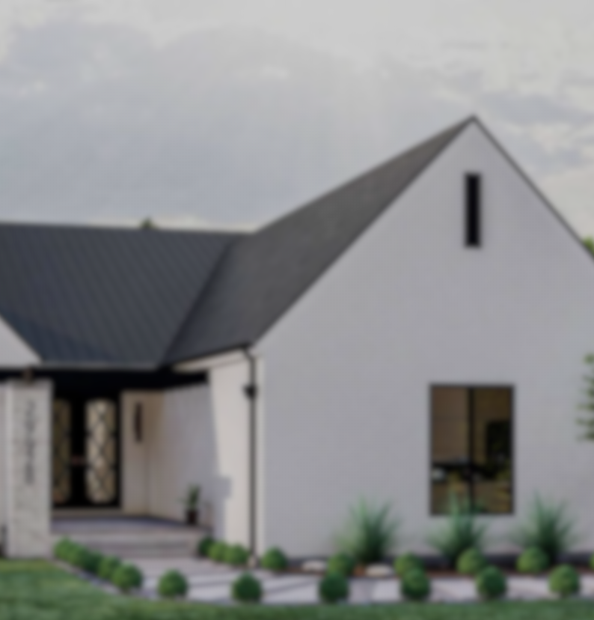
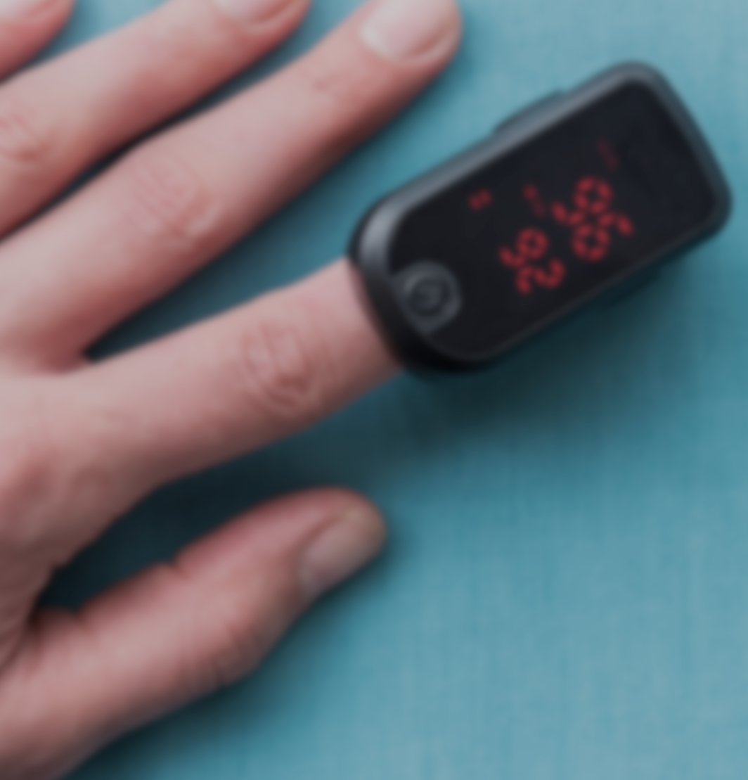


















Applications – Home & Life
Home
Life
HVAC Control
Home Security
Smart Lighting
Patient Monitoring
Personal Health
Elder Care
Smart Switch, Sensors, Shades
Works With any Ecosystem
Smart Irrigation
Wellness
Wearables
Smart Appliances
Smart Access
Smart Hub
Smart Cameras
Entertainment
Fitness
Accessories
Notes:
Mondjatok pár use caset

Slide 3


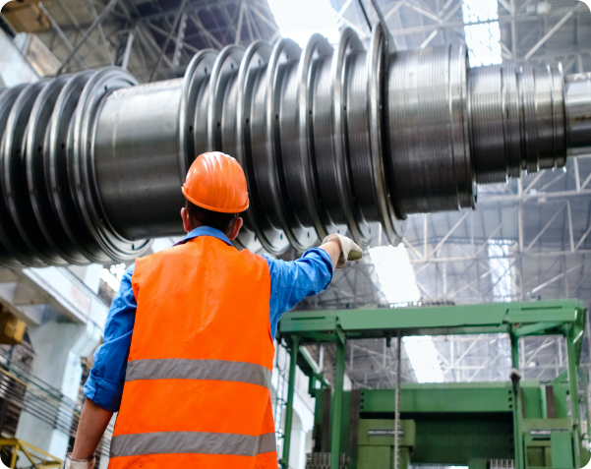


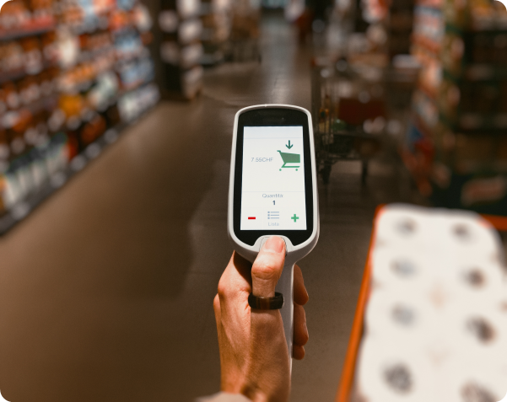















Applications – Industrial & Commercial
Smart Cities
Industrial IoT
Commercial IoT
Energy Conversion
Smart
Metering
Industrial Wearables
Automotive Accessories
Medical Asset & Patient Monitoring
Smart
Buildings
Street
Lighting
Electric Vehicle SE
Access
Safety
Asset Tracking
Commercial Lighting
Electronic Shelf Labels
Agriculture
Municipal Infrastructure
Predictive Maintenance
Tools & Diagnostics
Loss
Prevention
Enterprise
APs
Notes:
Mondjatok pár use caset

Slide 4





















Protocols and Ecosystems
+ MORE
+ MORE
Notes:
Wifin bluetoothon kívül milyen protokollokat ismertek?

Slide 5

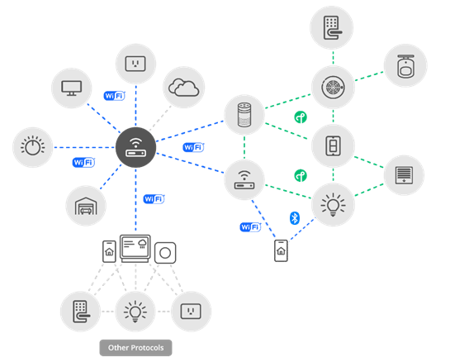
What’s the Matter?
TCP
UDP
IPv6
Wi-Fi
Thread
Bluetooth Low Energy
Commissioning Only
Ethernet
Additional future network layers
Notes:
Milyen nagyságrendbe esik a matter memóriaigénye? Háttértár igénye? Frekvencia?

Slide 6
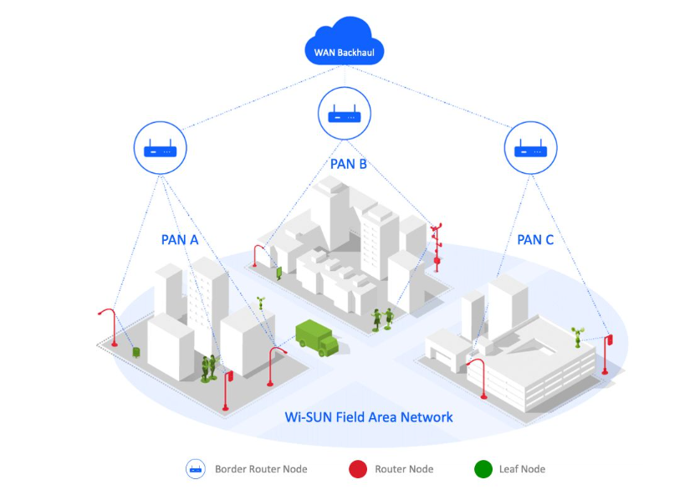
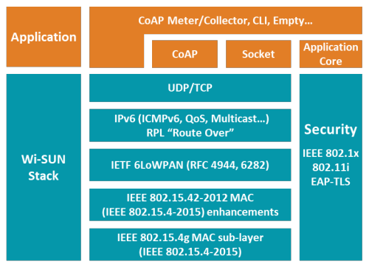
Wi-SUN

Slide 7
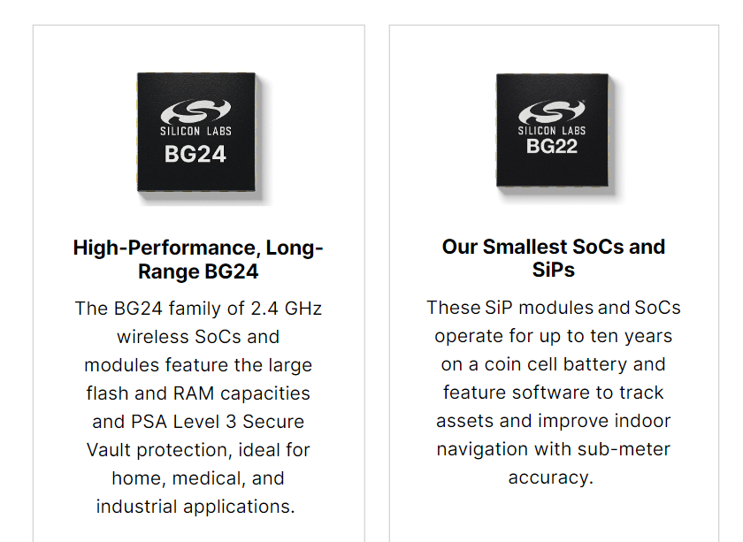
Performance
High Performance 32-bit 78.0 MHz ARM Cortex®-M33 with DSP instruction and floating-point unit
Up to 1536 kB flash program memory
Up to 256 kB RAM data memory
2.4 GHz radio operation
High Performance 32-bit 76.8 MHz ARM Cortex®-M33 with DSP instruction and floating-point unit
Up to 512 kB flash program memory
Up to 32 kB RAM data memory
2.4 GHz radio operation

Slide 8
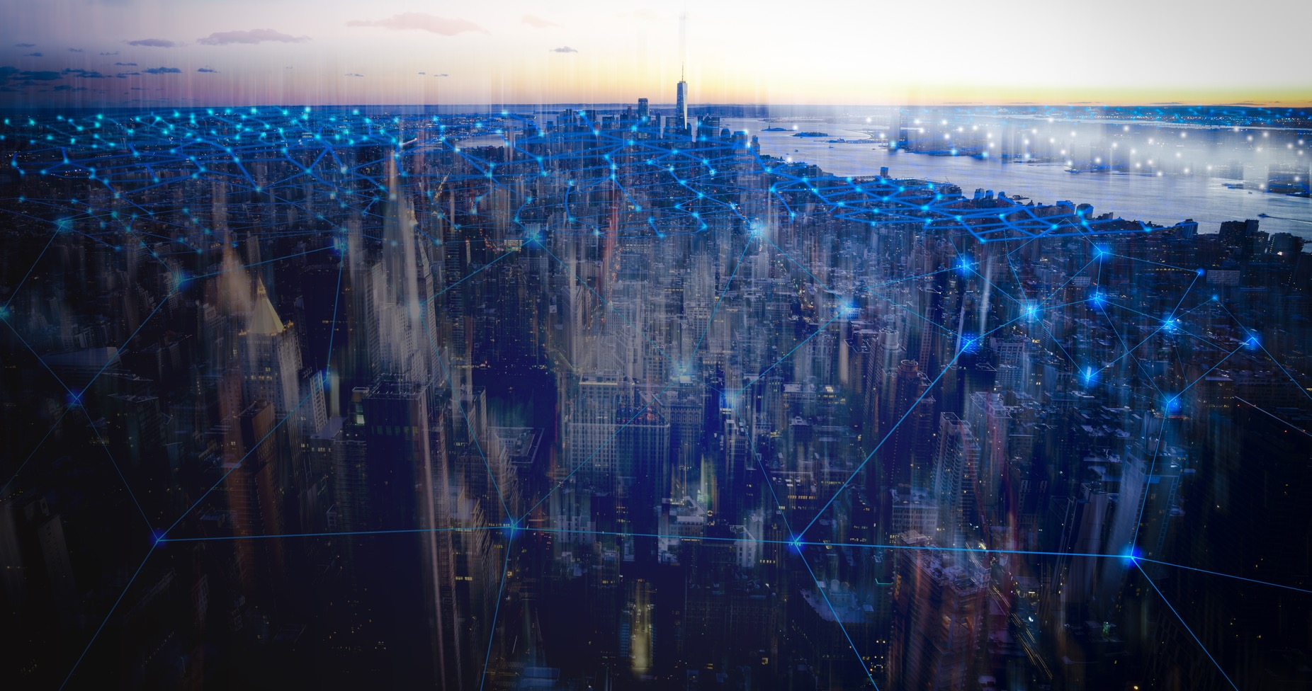

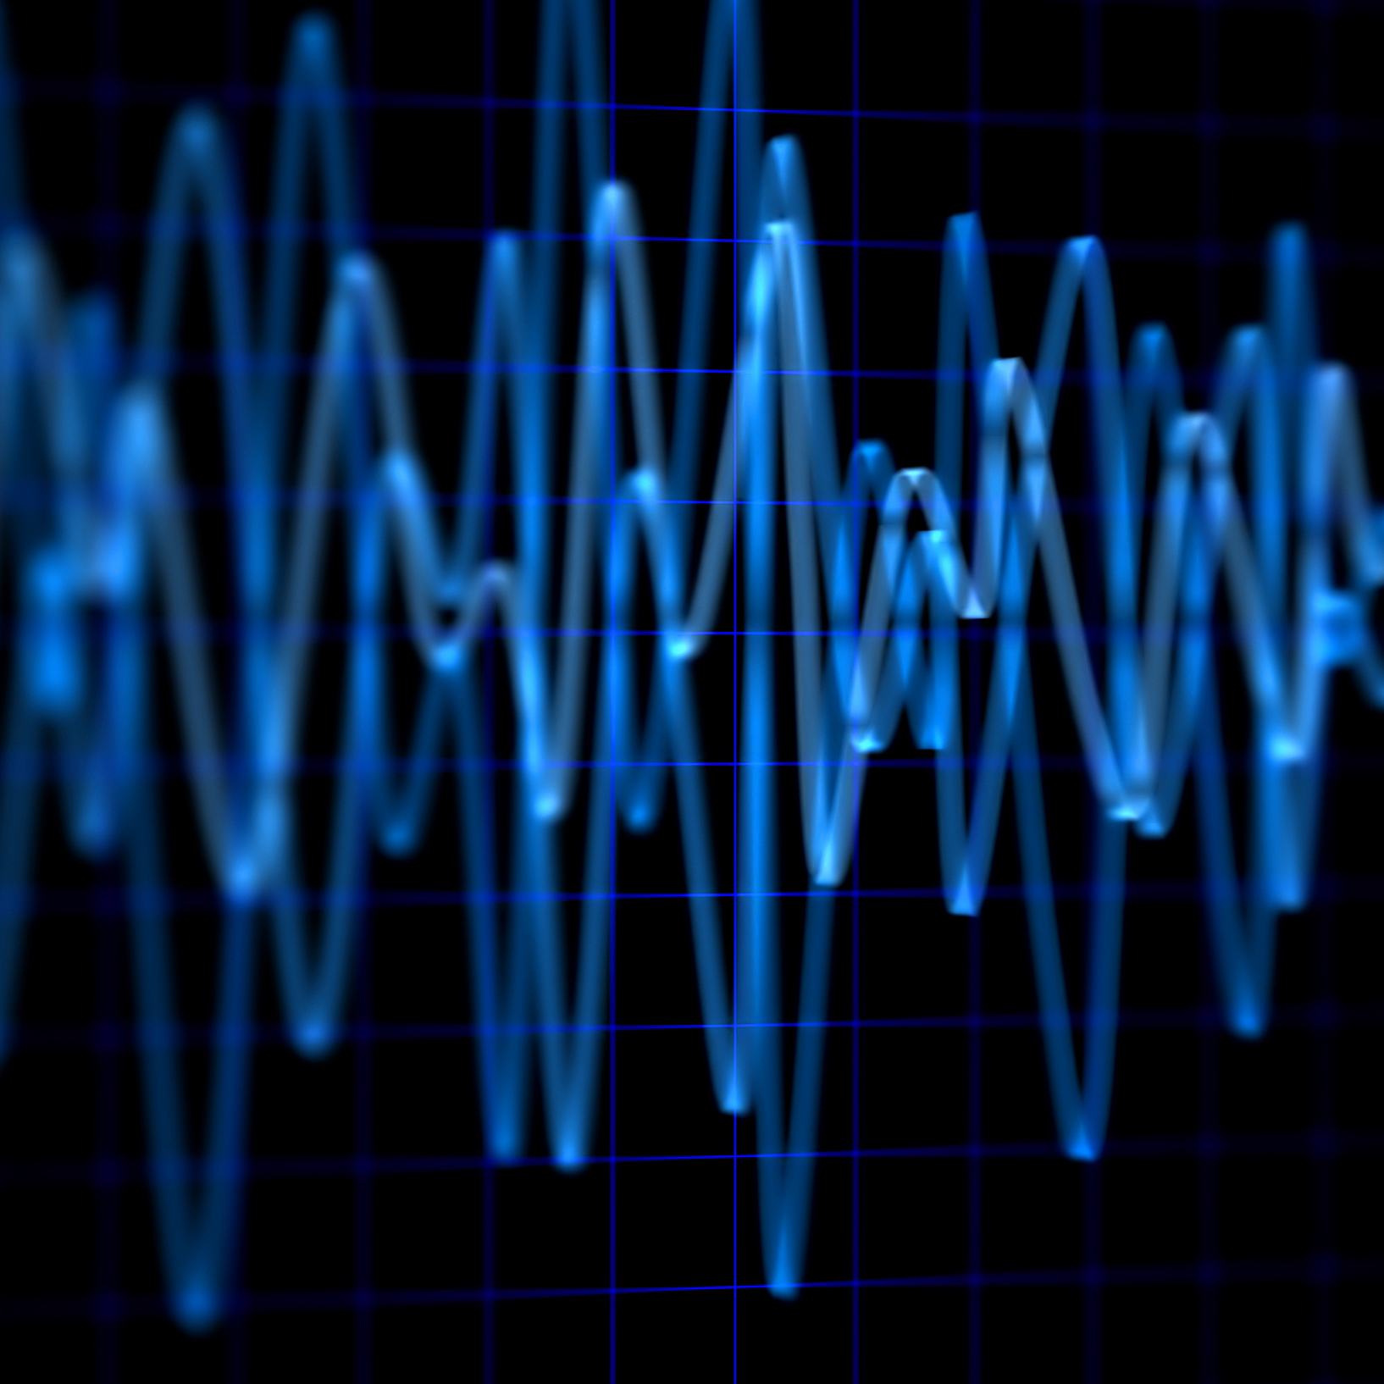
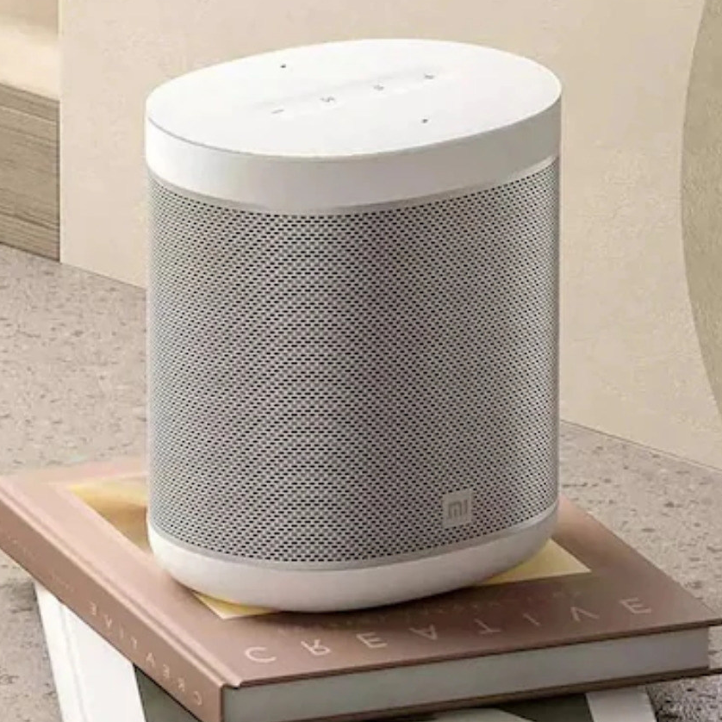





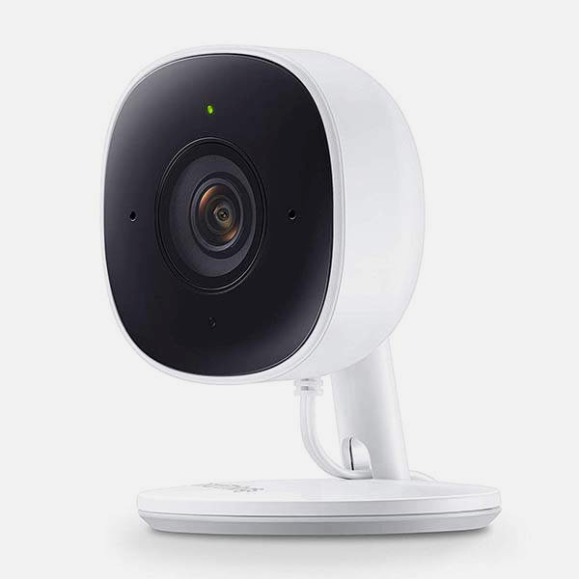
Applications – Machine Learning
Sensor | ML methods based on Time-series Data Data anomaly detection Data pattern matching
Communicate
Audio | ML methods based on Audio Audio pattern matching (ex. glass break) ML methods based on Voice Wake word/command word detection
Event Detection
Act
Vision | ML methods based on Vision Fingerprint reading Always-on vision (comparing snapshot images) Image/object classification and detection

Slide 9
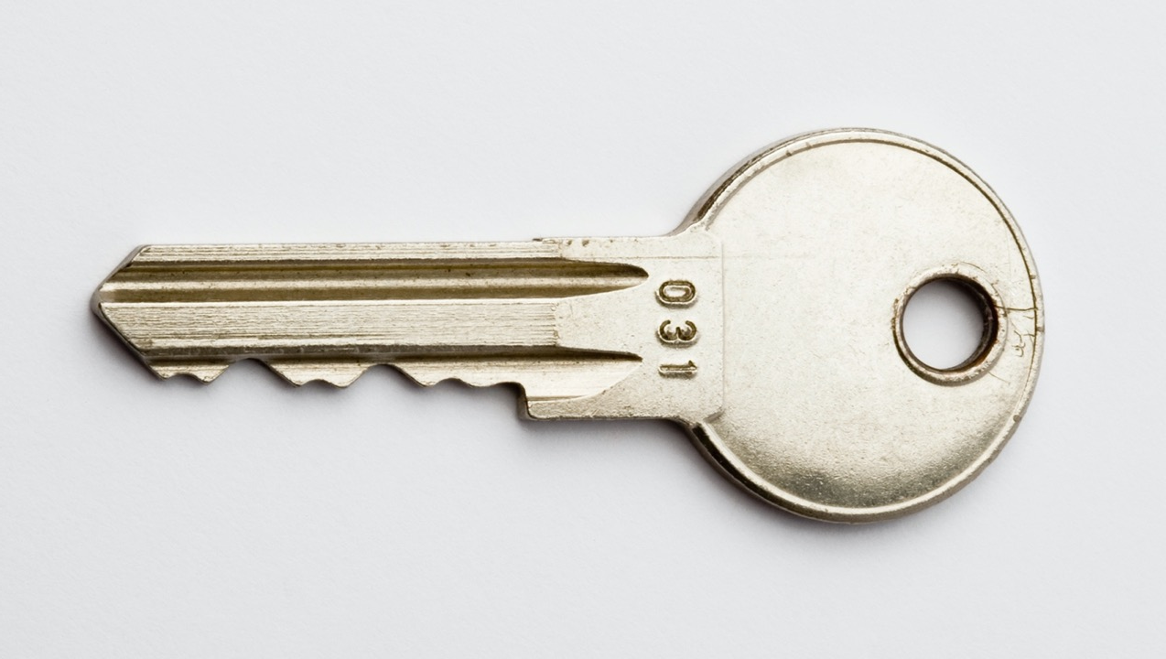
IoT Security
Secure Debug
Secure Boot
Anti-tamper
True Random Number Generator
Secure Attestation
Confidentiality
Ensures the data is only readable by the proposed destination
Authenticity
Ensures the supposed sender is the real sender
Cryptography
Integrity
Ensures the information contained in the original message is kept intact
Non-repudiation
Ensures that signatures of data cannot be denied
Secure Engine
DPA Countermeasures
Crypto Engine
Secure Key Management

Slide 10
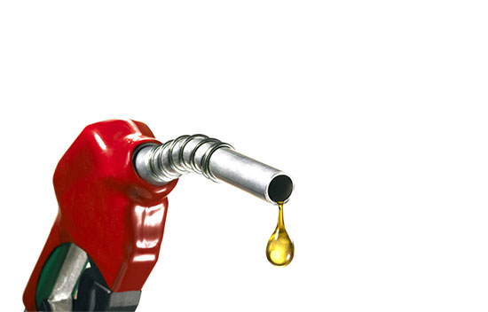
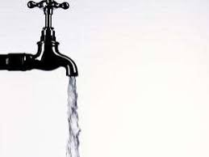
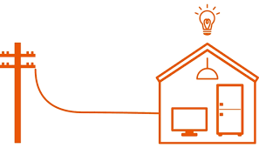

IoT net savings by 2030
Eletricity
fuel
water
emission
Reduce consumption by 1.5 PWh
Energy for 100 million homes for 1 year
Reduce hydrocarbon fuel consumption by
3.5 PWh / year
Conserve 200 billion m³ of sweet water
Benefit 1 Gigaton CO₂ emission

Slide 11
Thank you!

