Slide 1
IoT Security
Levente Buttyán
CrySyS Lab, BME
www.crysys.hu

Slide 2
Internet of Things (IoT)
Embedded computers connected to the Internet …
Smart City
Intelligent Transport
Smart Home
Connected Car
Wearables
Digital Healthcare
Industry 4.0
Smart Retail
Precision Agriculture
Supply Chain Automation

Slide 3
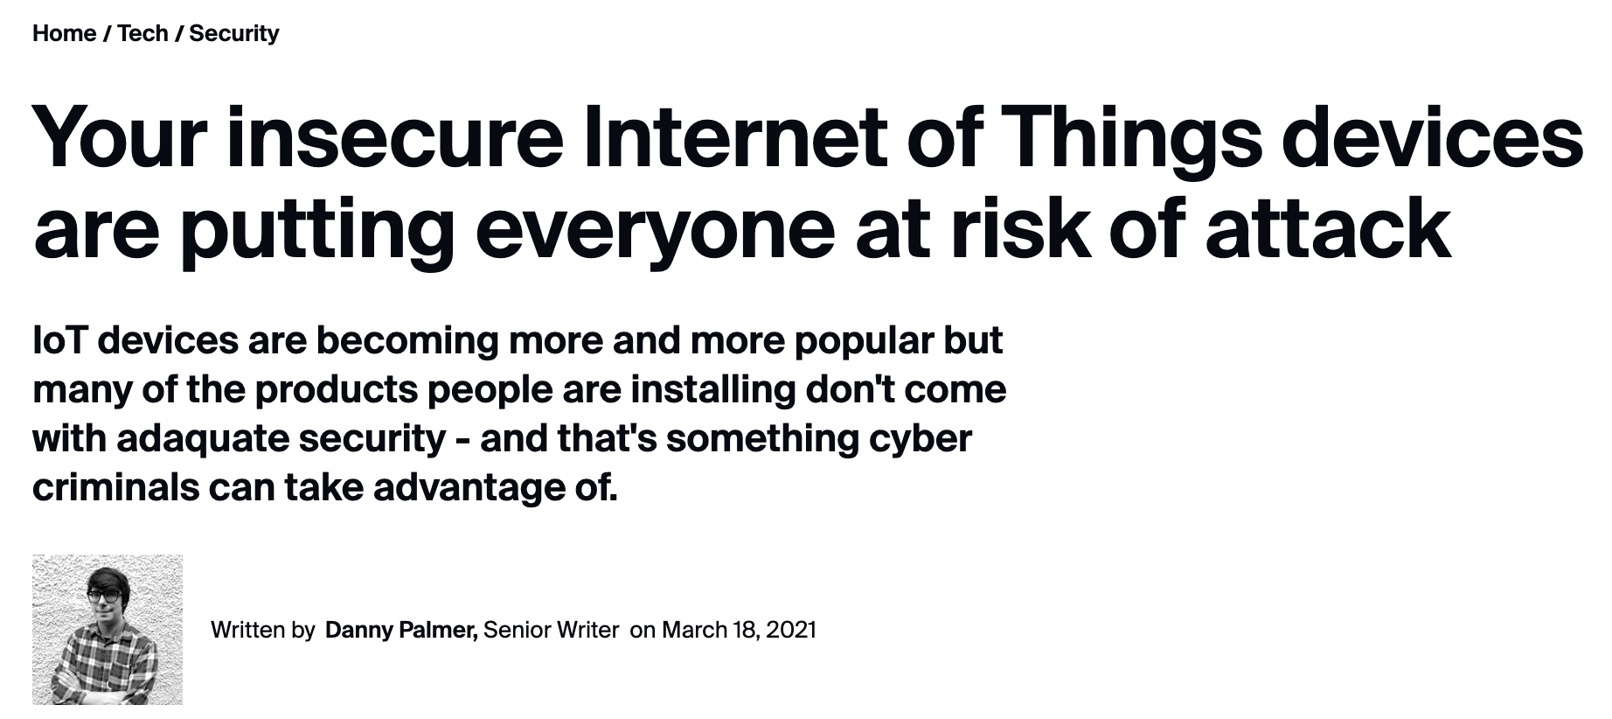
IoT (in)security

Slide 4
Indeed...

Slide 5
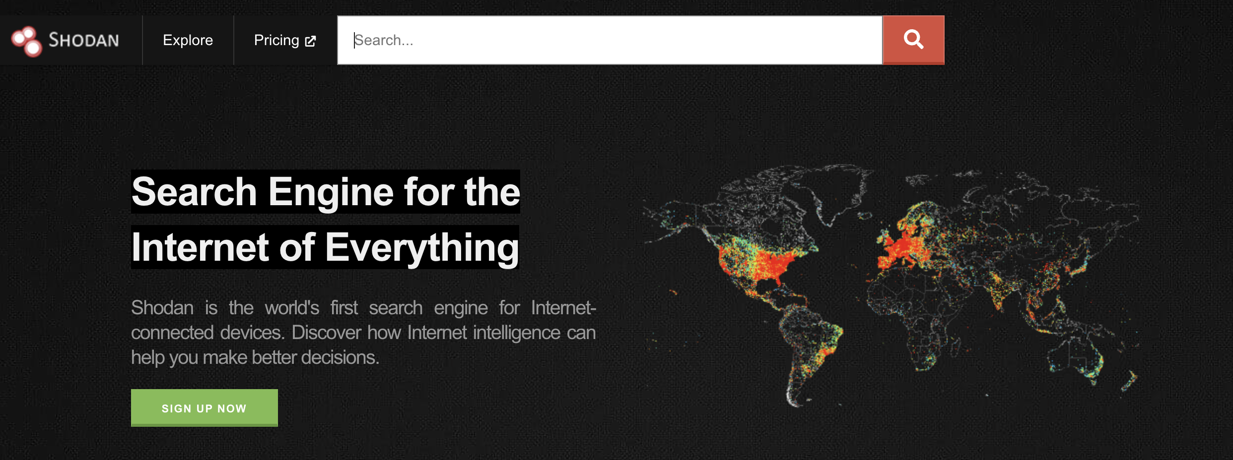
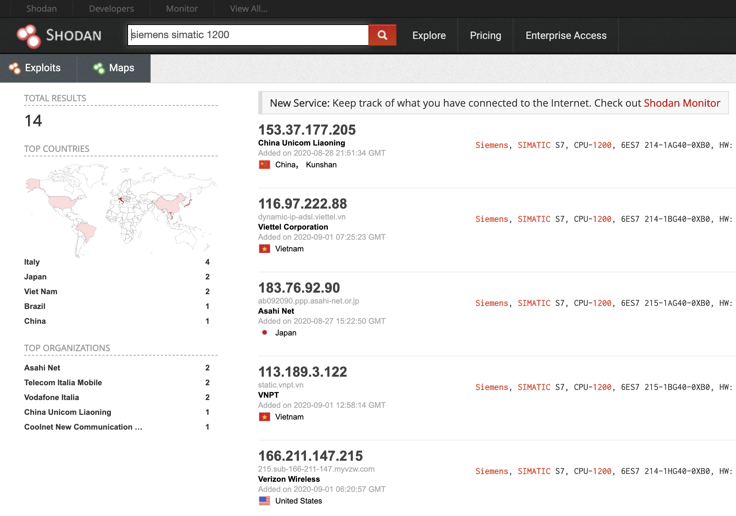
Compromising IoT devices
Main attack surfaces
Some embedded IoT devices are connected directly to the Internet
Many embedded IoT devices have wireless interfaces (e.g., WiFi, Bluetooth, ZigBee, ...)
Some IoT devices may be unattended and physically accessible
shodan.io
Common weaknesses
Insecure ports are open unnecessarily
Password based authentication with weak passwords
Exploitable vulnerabilities in the software running on the device
Software updates are not available (at all or in a timely manner)
No protection against physical attacks

Slide 6
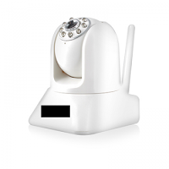
Example: Insecure ports and weak passwords

Slide 7
Example: Unpatched vulnerabilities

Slide 8
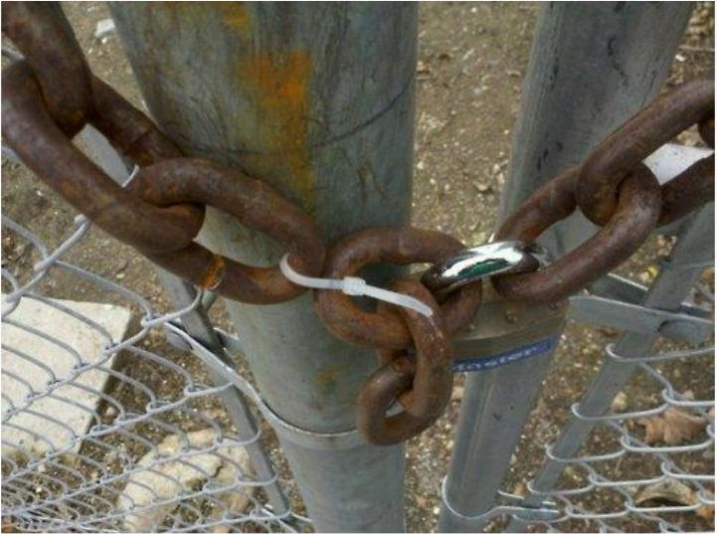
IoT devices seem to be the weakest link

Slide 9
IoT from a hacker’s perspective
Internet of Things
now easily searchable and
accessible remotely
cheap (in every sense)
computers easy to compromise

Slide 11
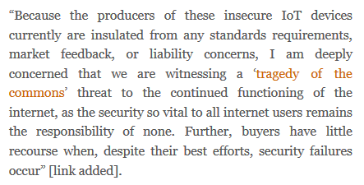

Slide 12
Explanation by security economics
vendors build
cheap devices
maximize profit
minimize time to market
more features, no security
consumers buy
cheap devices
optimize price/value ratio
don’t understand the risk
can’t identify quality
misplaced incentives
makes no sense to build secure, but more expensive devices
lemon market:
information asymmetry
consumers will pay average price
quality vendors leave the market

Slide 13
European Cyber Resilience Act
Published on September 15, 2022 (very fresh!)
Aims at setting common cybersecurity standards for connected devices and services in order to protect consumers and the market from cyber incidents (such as Mirai)
Introduces rules to protect digital products (including IoT devices) that are not covered by any previous regulation (e.g., NIS) → it will be the first IoT security legislation in the world!
Sets minimum security requirements for connected devices, both during product development and throughout the product life cycle
Make manufacturers responsible for ensuring that their products are digitally secure
Enables consumers to have better information regarding the security of their devices

Slide 14
European Cyber Resilience Act (cont’d)
Two product categories: critical and non-critical
compliance of critical products (e.g., VPNs, routers, firewalls, operating systems) will be assessed by third-parties
non-critical products (90% of the market) will only require a self-declaration of conformity
Proposed requirements include:
providing an “appropriate” level of cybersecurity (risk-based approach)
prohibition to sell products with any known vulnerability
regular tests to identify vulnerabilities
security by default configuration
limitation of attack surfaces
minimization of incident impact
Member States must put in place market surveillance bodies
Penalties for non-complying with the requirements can amount to €15 million or 2.5% of the annual turnover

Slide 15
IoT malware

Slide 16
Why infecting IoT devices?
It’s technically possible
IoT devices are (re)programmable --» they can run (malicious) code
It makes sense economically
Number of IoT devices is huge and still growing
IoT devices are almost always on and connected
IoT devices are valuable targets
IoT devices are not so esoteric (as you might think)
Many deployed IoT devices were not designed with security in mind
Many deployed IoT devices are not operated with security in mind
Vulnerable devices are easy to find (e.g., with shodan.io)
Device compromise is hard to detect
Notes:
Getting value for low cost:
number of IoT devices is huge and still growing
IoT devices are almost always on and connected (routers, web cameras)
IoT devices are valuable targets (interesting data, non-negligible computing power, stepping stone towards some internal network infrastructure)
IoT devices are not so esoteric (they often run some embedded Linux)
IoT devices are not (yet) designed with security in mind (open ports, easy-to-guess passwords, old and vulnerable software, no patching, …)
IoT devices are not operated with security in mind (ports left open, default passwords not changed, firmware never updated, logs never examined, …)
vulnerable devices are easy to find (shodan.io, censys.io)
device compromise is hard to detect (no visible signs, no anti-virus scanners)

Slide 17
Example: Mirai botnet
On 21st October 2016
Dyn experienced a DDoS attack on their managed DNS servers
The attack was launched by ~100 000 Internet enabled IoT devices, all infected by the Mirai malware
According to some experts, the attack magnitude reached 1.2 Tbps
On 27th November 2016
A large number of Deutsche Telekom customers using Speedport home routers reported connectivity problems
The root cause of the problem was found to be a new variant of Mirai which was trying to expand the botnet

Slide 18
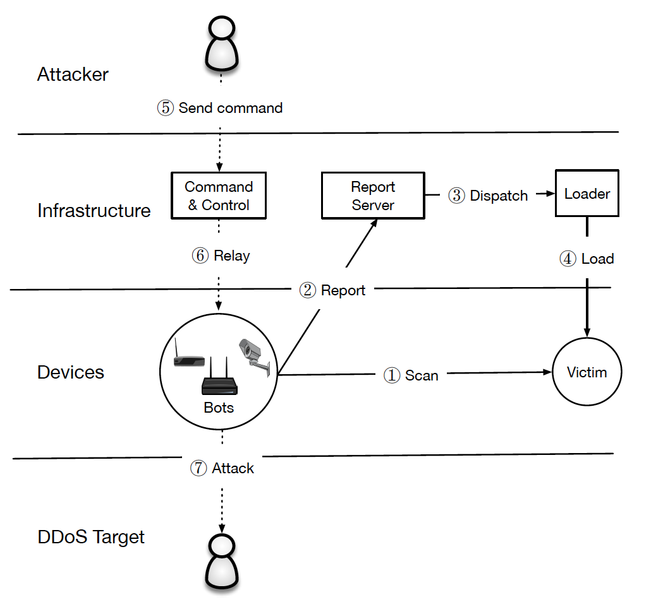
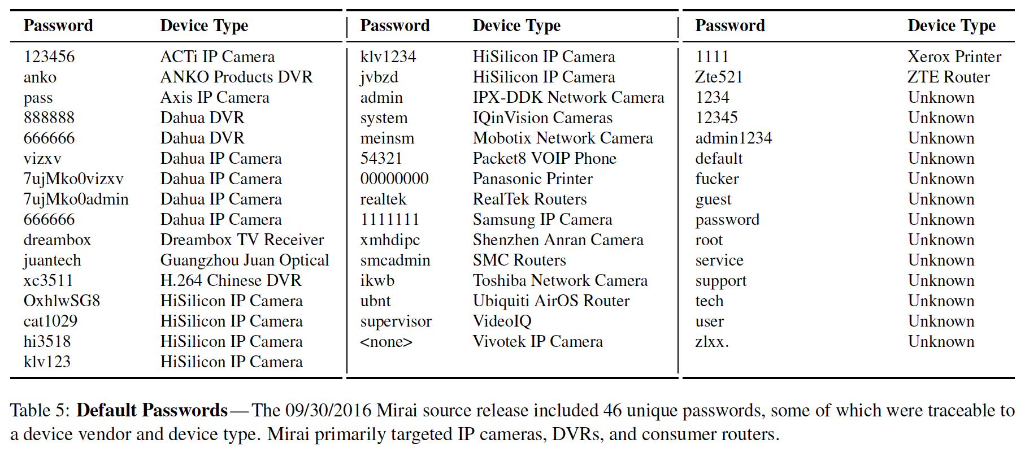
Example: Mirai botnet (cont’d)
Targeted devices were DVRs, IP cameras, routers, and printers
Number of IoT devices infected:
65 000 in the first 20 hours of the outbreak
200-300 000 in steady state (and a peak of 600 000)
Source code published → rapid emergence of new features
improved infection capabilities
DGA in place of a hardcoded C&C domains
obfusctaing binaries to slow down reverse engineering efforts
Operation:

Slide 19
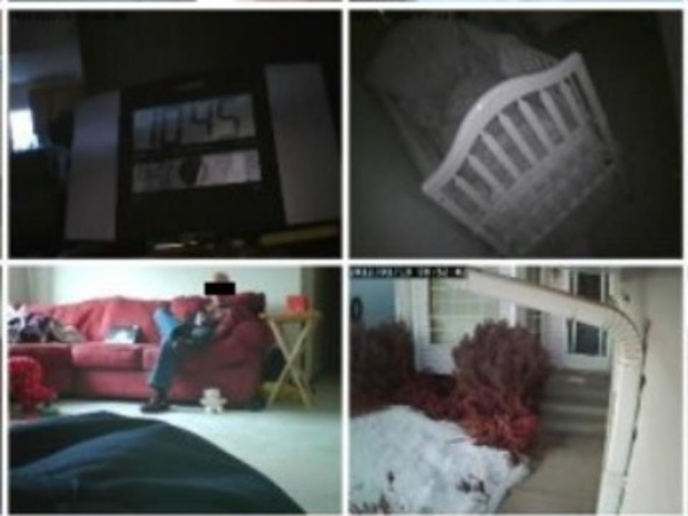
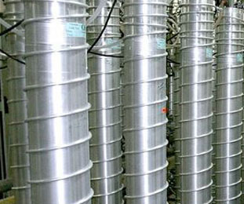
Potential consequences
If IoT devices are compromised in large quantity by malware, they can be organized into IoT botnets (attack infrastructure)
Compromised IoT devices can steal confidential data and cause privacy breaches
Compromised IoT devices in cyber-physical systems may cause physical damage or fatal accidents

Slide 20
SETIT project
(2018-1.2.1-NKP-2018-00004)
Goal:
Develop new methods (algorithms, protocols, tools, …) that enhance the security of IoT systems
Research areas:
Software security for embedded devices
bug prediction by static code analysis
Platform security for embedded devices
secure boot and remote firmware update
malware detection and attestation of malware free state
Algebraic foundations and cryptographic building blocks
Consortium:

Slide 21
The challenge of IoT malware detection
Anti-virus (AV) products currently available for desktop PCs
do not support IoT devices
have too demanding system requirements
IoT devices have resource constraints
computing power, storage space, connectivity / network bandwidth
Existing proposals have limitations
Network-based solutions
detection is performed on a gateway device in front of the IoT device
can be circumvented with encrypted traffic or USB pendrives
Cloud-based solutions
samples are sent to the cloud for analysis and detection
delayed decision
needs constant network availability

Slide 22
We proposed…
SIMBIoTA = SIMilarity Based IoT Anti-virus*
SIMBIoTA-ML = SIMBIoTA with Machine Learning**
Efficient – affordable for resource constrained IoT devices
Small storage requirements
Lightweight detection process
Effective – they actually work!
Very high (90-98%) true positive detection rate, even for previously unseen samples!
Very low (0-1%) false positive rate
* Cs. Tamás, D. Papp, L. Buttyán, SIMBIoTA: Similarity-Based Malware Detection on IoT Devices, 6th International Conference on Internet of Things, Big Data and Security (IoTBDS), 2021.
** D. Papp, G. Ács, R. Nagy, L. Buttyán, SIMBIoTA-ML: Light-weight, Machine Learning-based Malware
Detection for Embedded IoT Devices, 7th International Conference on Internet of Things, Big Data
and Security (IoTBDS), 2022. (Best Paper Award)

Slide 23
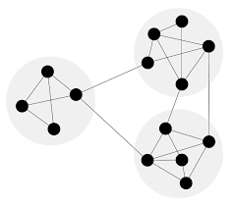
Operation of SIMBIoTA
Backend
Malware feeds
Honeypot farms
Malware
intelligence network
Malware
database
Public malware
repositories
Malware
similarity
graph +
dominating
set
IoT device
Malware detector
process
TLSH values of
the nodes in the
dominating set
Binary file

Slide 24
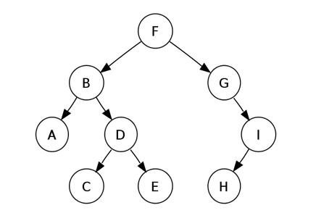
Operation of SIMBIoTA-ML
Backend
Malware feeds
Malware
database
Benign
database
Honeypot farms
Malware
intelligence network
Public malware
repositories
TLSH
values
TLSH
values
IoT device
Machine
learning
Malware detector
process
Trained
ML model
Binary file

Slide 25
More ingredients for securing IoT devices
System hardening
No open ports, no weak passwords
Switch on available OS configuration settings for increased security
Disable JTAG access
Strong authentication (cryptography based, multi-factor)
Cryptographic protection for data in transit and data at rest
Malware protection (and attestation of malware-free state)
Detection of malicious files
Continuous integrity monitoring of the device
Verified boot process
Trusted Execution Environment (TEE)
Secure (remote) software update

Slide 26
Acknowledgements
The presented work was carried out within the SETIT Project, which has been implemented with the support provided from the National Research, Development and Innovation Fund of Hungary, financed under the 2018-1.2.1-NKP funding scheme (project no. 2018-1.2.1-NKP-2018-00004).
The presented work was also supported by the Ministry of Innovation and Technology NRDI Office within the framework of the Artificial Intelligence National Laboratory Program (RRF-2.3.1-21-2022-00004).

