Slide 1
IoT Present and Future 4iG Group’s IoT capabilities from Business and Technology point of view
dr. Pete Gábor

Slide 2
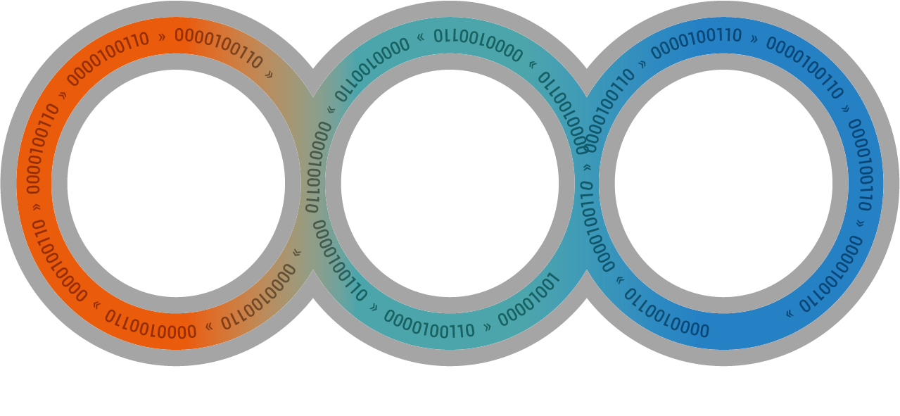
4iG Vision, Strategy & Holding Structure
VISION AND STRATEGY
Extensive partner networks in Hungary and abroad
Acquisition strategy greatly contributes to the profitable operations of the group
Continuous involvement of additional resources and the penetration of new markets
Holding structure
Addition to IT, 4iG is building strong market positions in the telco and space industry
DATA is the link between the three areas
Investments are aimed at increasing business efficiency.
Tele-
communications
infrastructure
Space industry,
Space TELE-
COMMUNICATIONS
IT System
integrator

Slide 3
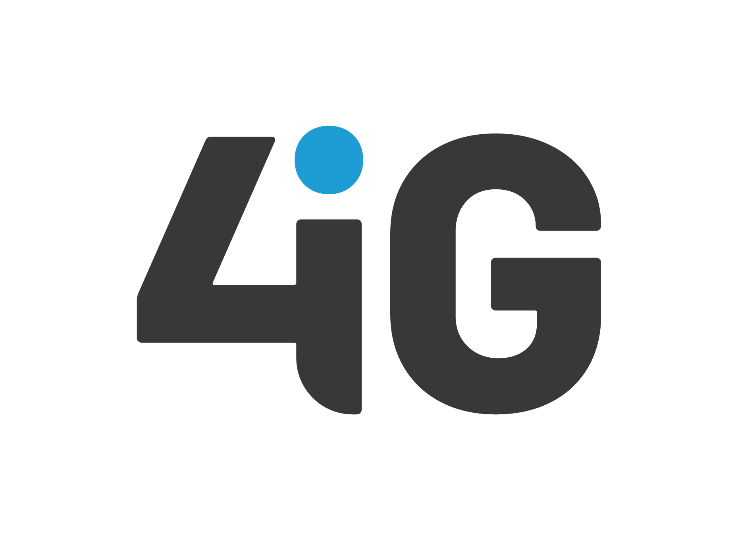
4iG Group’s IoT capabilities
Complementer capabilities to plan, build, deliver and run complex IoT solutions and services
Antenna Hungária
LoRaWAN network capabilities
E2E developer ecosystem
Public & Private cloud connectors
Solutions for Smart City, Agriculture and Utility
4iG
Complex IT / SI capabilities
From HW to SW development
AEPs and Cloud availibility
Low-code / no-.code
AI/MI data collection and processing
4iG
IoT
Vodafone
3GPP network capabilities
MPN for dedicated use
50+ E2E IoT solutions
Partner eco-system
Business consultancy
Invitech
Network, Cloud & Security
Data center solutions
IaaS, PaaS
DDoS, WAF nd End-point protection
Collect & Process the Data
Store & Analyze the Data
Notes:
WAF – Web Application Firewall

Slide 4
Approach to the IoT eco-system from Data point of view
Our capabilities lies in connecting Business needs and Technology solutions under one umbrella
Business
Technology
2
How to collect the Data?
What Data to collect?
1
How to access the Data?
3
4
How to transfer the Data?
6
How to store and structure the Data?
What to do with the Data?
.
5
4

Slide 5
What Data to collect and how?
Understanding the business goal is key for proper architectural design in IoT data collection
Understanding data collection requirements are fundamental for proper project planning for the maximized Business outcome
Data collection is a combination of sensor Technology
solutions and business intelligence that requires precise
planning and execution
RS-232
Ethernet
Wifi
LoRa
3GPP
Why did it happen?
What is happening?
Usage data
Communication interface
Machine & Sensors data
Events & Alarms
Video data
Geolocation
Microprocessor
RTC
Power Supply
Environmental info
Energy consumption
What is likely to happen?
Display
What should I do about it?
External data
Signal conditioning
Sensor
Sensor
Sensor

Slide 6
How to access and transfer the Data?
3GPP & LoRaWAN networks do not have unlimited resources – fit for use is essential
Business needs
>10Mb/sec
Cost felixble
Power available
Low latency
Ultra Reliable
Technology to use
Real time access to mass amount of data
High bandwith and two-way communication
Mission critical function with extreme availability
Manufacturing, Industrial Automation & Control, Smartgrid Automation
Critical & Industrial MTC
LTE CAT3 & above
5G SA & NSA
MPN
<10Mb/sec
Cost focused
Fixed & moving
Power available &
battery powered
(w/ charging)
”Legacy” data collection & transfer
Upgrade from existing 2G / 3G solutions
Voice & SMS as a secondary bearer
Security, Track & Trace, Logistics, Consumer IoT
Standard MTC
LTE CAT-1
LTE CAT-M
(3G)
One-way or
non-symetric communication
Battery powered
(w/o charging)
<1Mb/sec
Cost sensitive
Multicast
Long range
Low power
Fixed & mass
deployment
Massive MTC
Massive fixed deployment of devices
Access and latency is secondary
8+ years device lifecycle
Smart City, Smart Metering, Street Lighting, Agriculture
LTE CAT-M
NB-IoT
LoRaWAN
(2G)

Slide 7
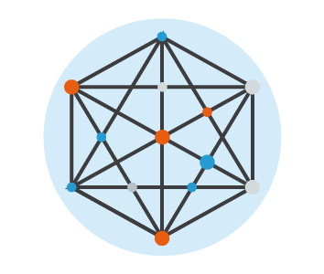
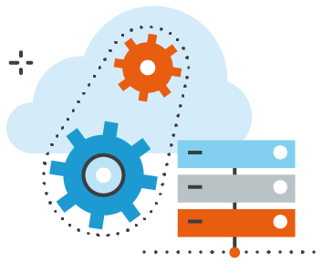
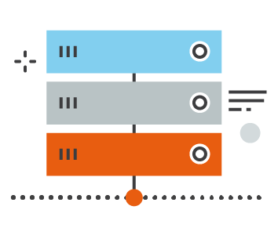
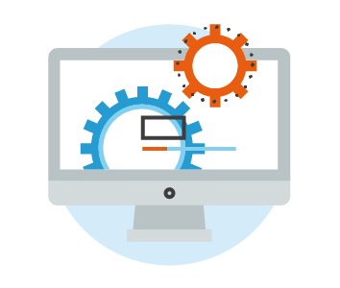
What to do with the Data and how to store and structure it?
Combination of BI and Data Analytics with right-sized managed IT / SI resources to fit for future
Improve the decision making processes
Access & share information
Network operations
Storage, Server & Virtualization
Datacenter
Real time analysis
Know your business
Cloud operations
Middleware and DB
Operating System
Reduce risks & bottlenecks
Identify waste
Application and
sw developement
Security &
Blockchain
Ai & Machine
Learning
7

Slide 8
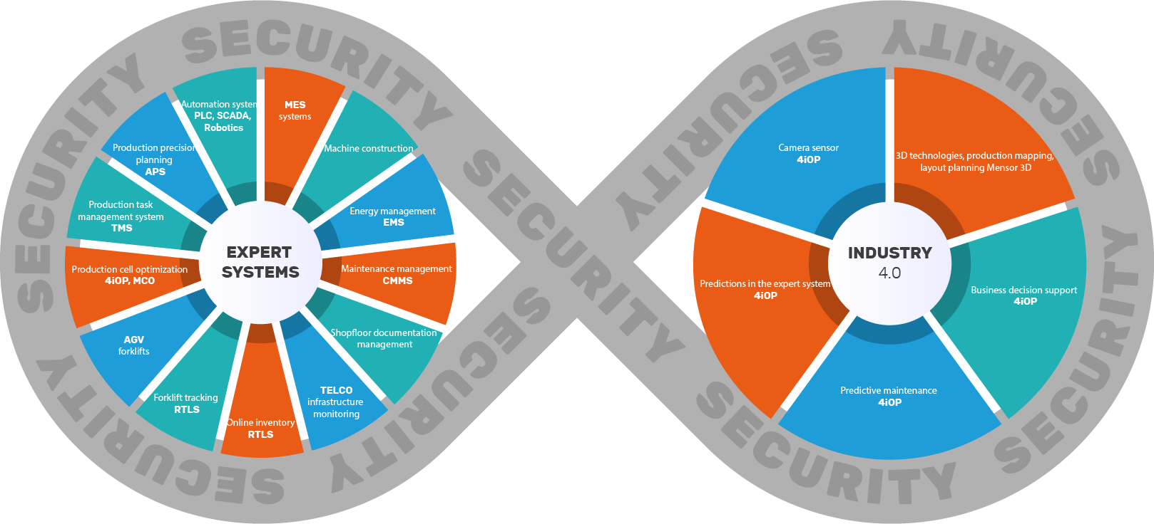
4iG Industry 4.0 Solutions – 4iOP
Business consultancy with end-to-end modular solution for all industrial needs with focus on security
Digital Twin Solutions
for industrial operations
Building 3D/2D Digitization – Inside and Outside
Internal reorganization
VR connection/ ergonomic test
Internal Navigation
Digital Twin
Plant Simulation – testing and managing all material flow
TMS -Task Management System
MCO - Manufacturing Cell Optimalisation
BDA - Business Decision Assistant
VAS - Visual Analisys System Camera Sensor
Intralogistics Solutions
I4.0 – Applications And Services
CMMS – Computerized Maintenance Management System
APS – Advanced Planning and Scheduling
MES – Manufacturing Execution System
EMS – Energie Mangement Systems
Facility Management Systems
RTLS – Real Time Location Services (Positioning)
AGV – Automated Guided Vehicles
Plant Simulation
WMS – Warehouse Mangement Systems

Slide 9
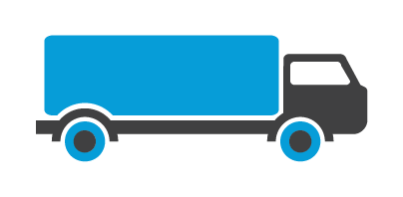
4iG IoT capability landscape
Connectivity agnostic full stack IoT solutions for B2B and B2G vertical needs
Buildings
Public Sector
Industry
Education
Agriculture
Transport & Logistics
Retail
Home
Health
Utilities
360° SERVICES
7/24 SSC & SOC
Managed outsourced services
DC (hosting, co-location, facility management)
Consultancy, Audit, QA service
HIGH AVAILABILITY IT SYSTEMS
Design, implementation /delivery, support of business critical IT & network infrastructure and SW-applications
SW app. development & integration
HW (infra+network) delivery& integration
BUSINESS ADMINISTRATION EFFICIENCY
Digitalization
Process automation / collaboration and workflow solutions
Document management
PUBLIC SECTOR
Tailored-made, customized IT solutions with various SW+HW components
E2E Fund management service
IoT Solutions
Manufacturing: Production and supply chain traceability system
Finance: Regulatory, productivity and security solutions
Utility/Energy: Smart Metering, Energy Data Management
3D: Building digitalization, faility, asset man.
Agriculture: IoT solutions, Process automation, digitalization, Drone systems
Health Care: Digital diagnostics, digitalization
CUTTING-EDGE TECHNOLOGIES
AI, Machine Learning, IoT
Microservices, Blockchain
Notes:
Verticals competence MAP

Slide 10
4iG’s IoT mission is to connect Business needs and Technology solutions under one umbrella to maximize the power of Data.
10

Slide 11
THANK YOU FOR YOUR ATTENTION!

