Slide 1


The Ecosystem of the Digital Future
FOR A STRONG DIGITAL EUROPE
László Gulyás
Node Director

Slide 2
EIT Digital for a strong digital Europe
EIT (HQ in Budapest)
'become the leading European initiative that empowers innovators and entrepreneurs to develop world-class solutions to societal challenges and creates growth and skilled jobs.'
EIT Digital
Address strategic interests of a strong digital Europe
Delivery on
  Innovative digital products and services
  Start and grow digital ventures
  Skilled digital entrepreneurs
Impact and thought leadership

Slide 3



EIT Digital for a strong digital Europe
EIT (HQ in Budapest)
'become the leading European initiative that empowers innovators and entrepreneurs to develop world-class solutions to societal challenges and creates growth and skilled jobs.'
EIT Digital
Address strategic interests of a strong digital Europe
Delivery on
  Innovative digital products and services
  Start and grow digital ventures
  Skilled digital entrepreneurs
Impact and thought leadership

Slide 4
Just what is Innovation?
Business Need
Technology Provider
Innovation Factory
Accelerator
EIT Digital
Entrepreneurial Education
education
creating a new breed of entrepreneurs
EIT Digital Co-Investment
Knowledge triangle
business
research
supporting innovators all the way to the market
enabling excellent individuals and multidisciplinary teams to develop breakthrough ideas
Startup or
New Product Launched – within 1 year

Slide 5
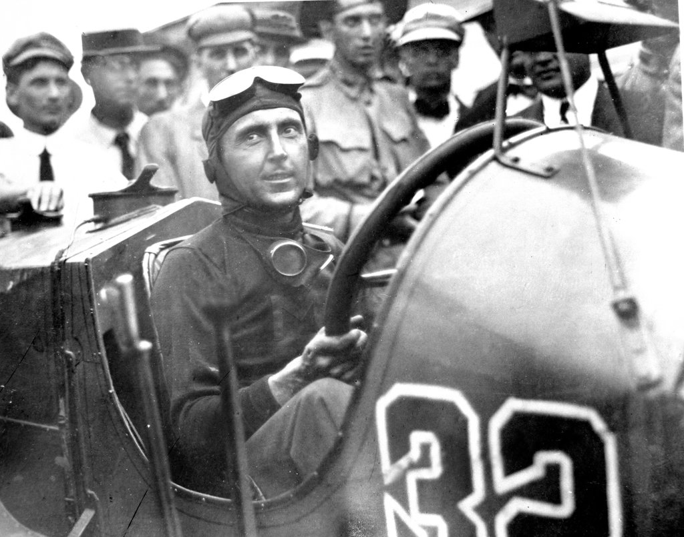
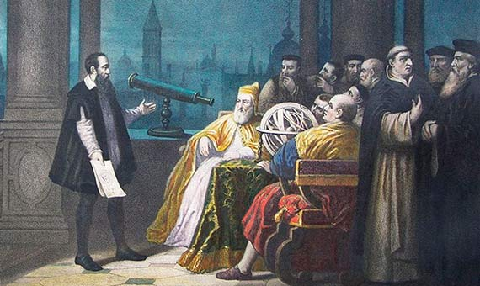
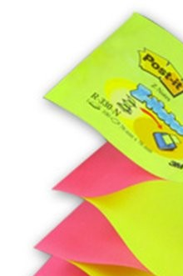
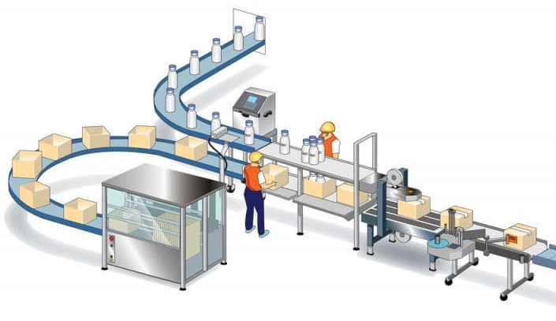

Just what is Innovation?
Business Need
Technology Provider
EIT Digital Co-Investment
Startup or
New Product Launched – within 1 year

Slide 6
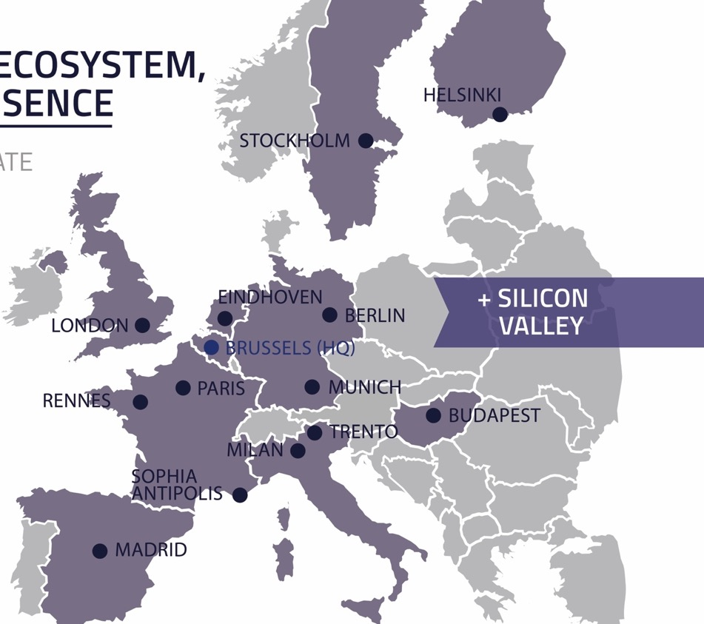
EIT Digital Ecosystem
EDINBURGH
AMSTERDAM
Co-Location Centre
Satellite
Hub
Office
BRAGA

Slide 7
EIT Digital Ecosystem
2010: 5 Nodes
2012: Trento becomes a Full Node
2014: London becomes a Full Node
2014: Silicon Valley Hub established
2017: Budapest and Madrid become Full Nodes

Slide 8









EIT Digital Achievements 2010-2018/2020
EIT Support
€ 420m/585m
VALUE CREATED
IMPACT
120/160
Startups created
€ 600m/€ 800m
Valuation
Partners
380/530
Products launched
€ 400m/€ 560m
Value
Scaleups
300/370
Scaleups supported
€ 2B/€ 2.5B
Valuation
1500/2200
Graduates
€ 150m/€ 220m
Yearly salaries
Students
€ 1,4B/2.1B
Partner Investments

Slide 9
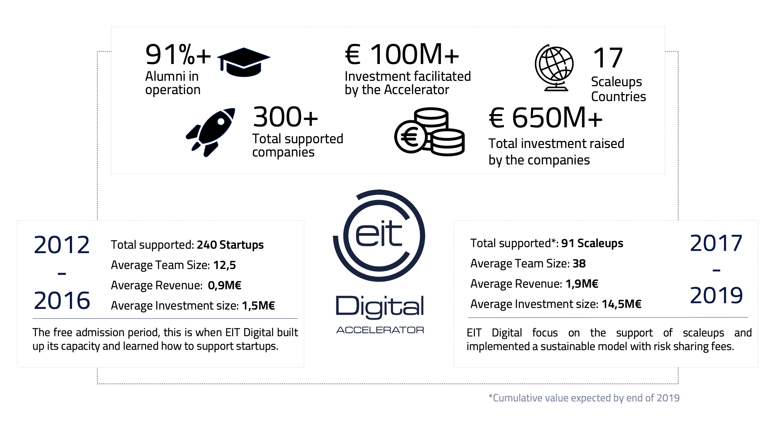

Slide 10

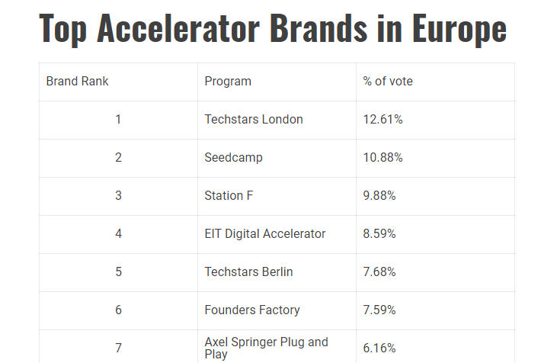

Slide 11
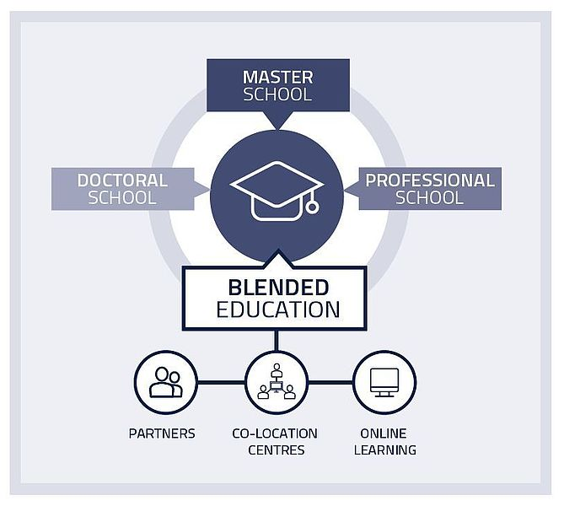
No Innovation Without Education

Slide 12
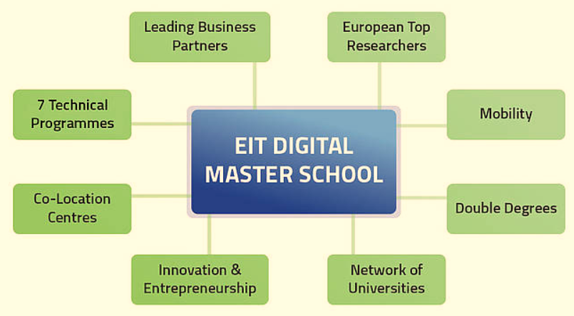
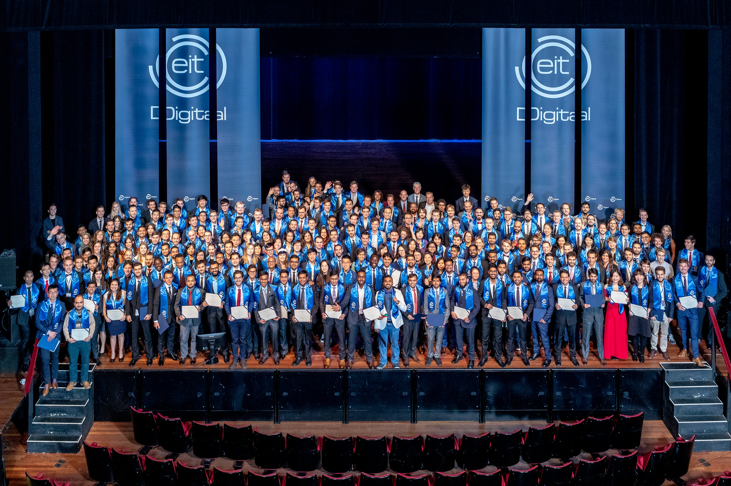
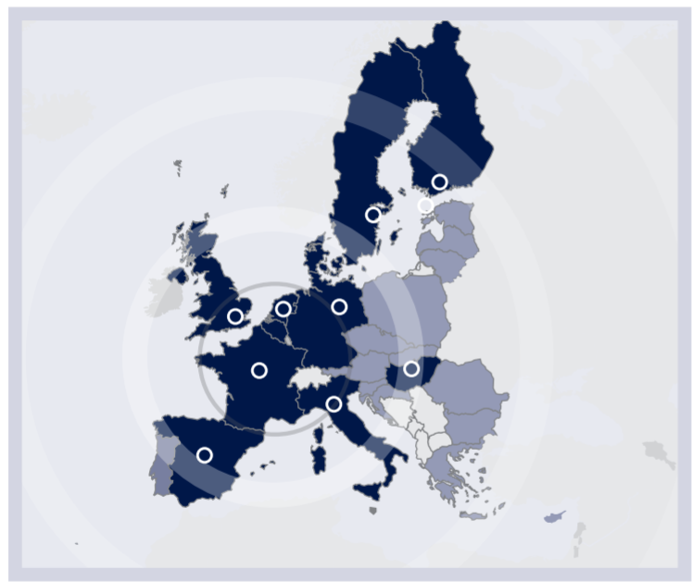
The Digital Entrepreneurs and Innovators of Tomorrow

Slide 14

Innovation & Entrepreneurship
Ecosystem
Entrepreneurial Education

Slide 15




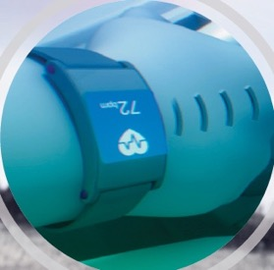
Focus Areas
Digital Industry
Digital Tech
Digital Finance
Digitised factory, blended retail, personalised products, integrated data-driven process
Including Digital Agriculture
Digital transformation of banking and insurance: new customer banking, digital investment banks/asset management, data/AI based solutions, blockchain
The infrastructure itself, convergence of computing and networking, integrated cybersecurity and privacy, built-in intelligence, big databases and AI
Digital Cities
Digital Wellbeing
Autonomous transportation, open data and city analytics, real/virtual city exploration, safety of the citizens
Preventing and coping with physical and cognitive impairments

Slide 16
Innovation / Business – Innovation Factory
Business Need
Technology Provider
EIT Digital Co-Investment
Startup or
New Product Launched
1 year

Slide 17
Innovation / Business – Innovation Factory
100-200 proposal pitches
~50 selected
35%-75% co-investment
Revenue or equity share mechanisms
VC-like selection & looking for impact (by external experts)

Slide 18
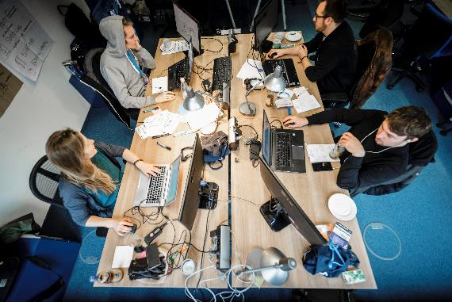
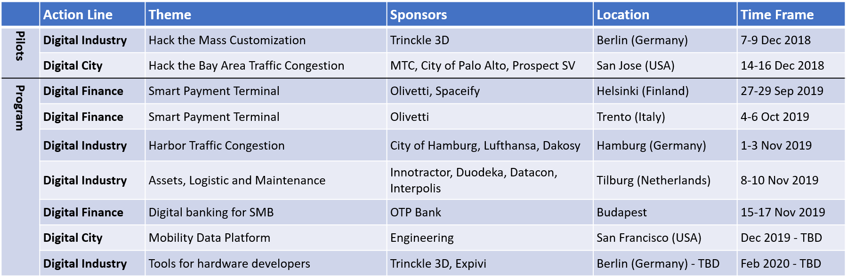
DeepHack leverages the EIT Digital eco-system
Advance or explore alternatives for your innovation and business challenges
Eco-system building around your platform or solution
Access to talent, experts
and entrepreneurs

Slide 19


Slide 20


Slide 21
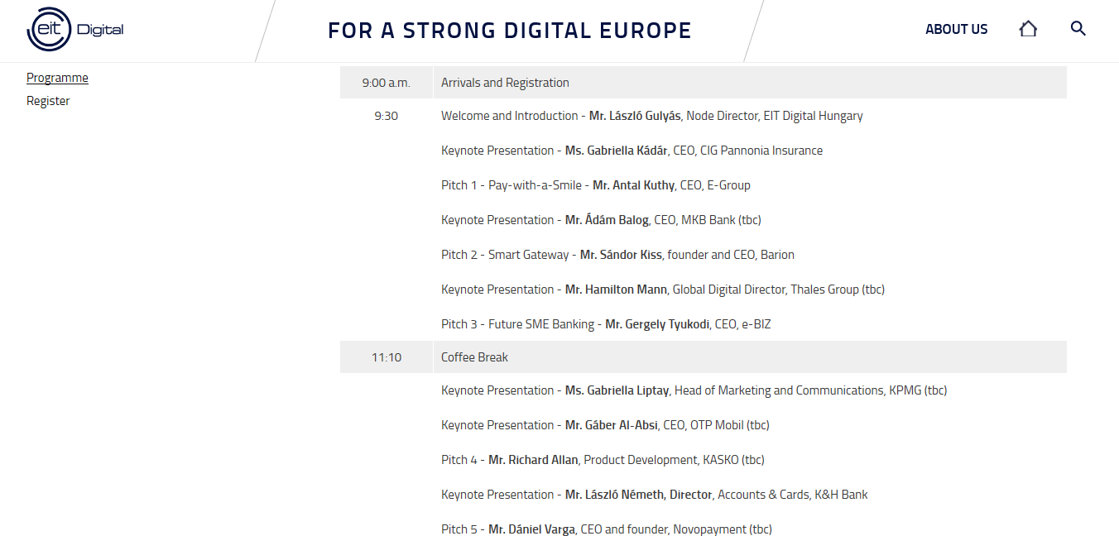

Slide 22
Thank you

Slide 23
László Gulyás
Node Director Hungary
laszlo.gulyas@eitdigital.eu

